Slide 1
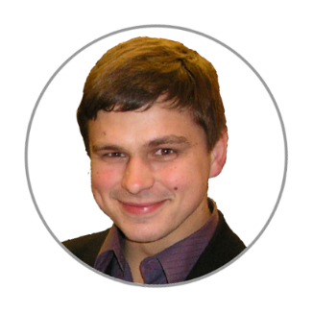
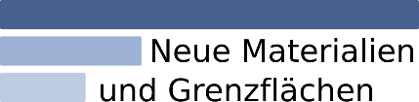

the questions you asked about
CRC1625
Research Data Management System
Victor Dudarev

Slide 2
Agenda
    Registration!
    Typical workflow:
      Idea or experiment plan (+characterisation types)
      Request for synthesis
      Samples / characterisations
      Report in “Idea or Experiment Plan”
    Graph: interlinking objects
    Handovers

Slide 3
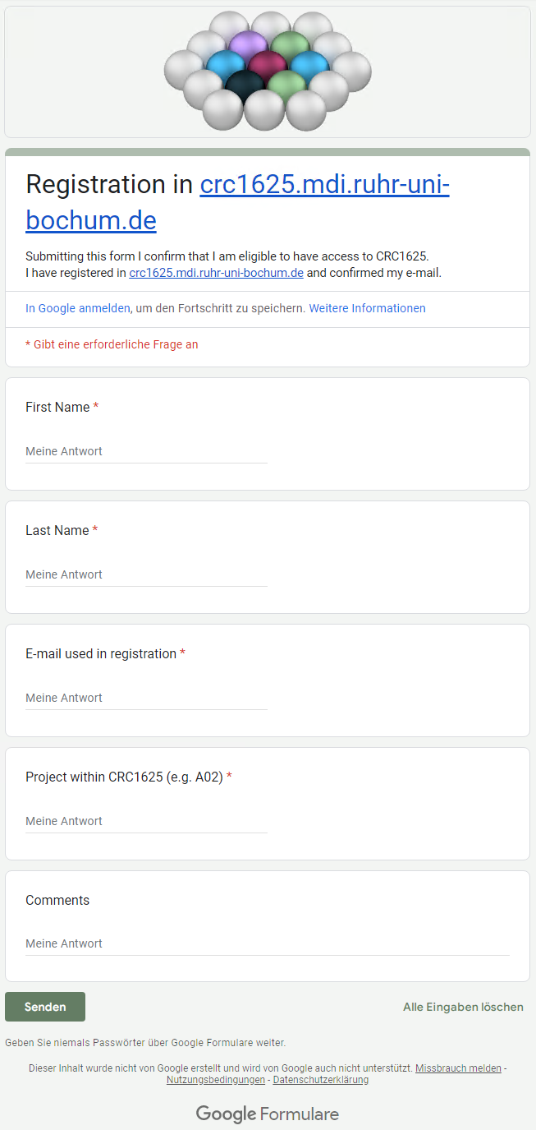
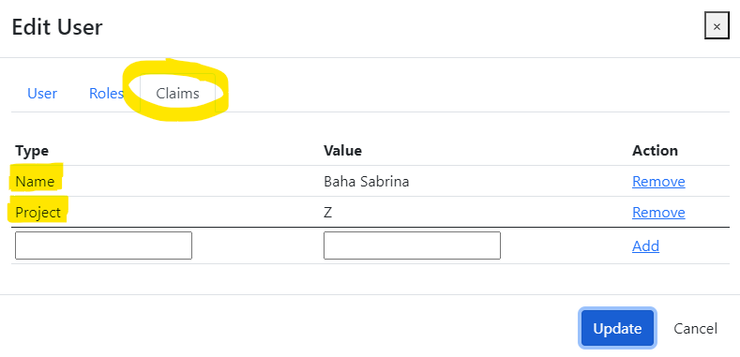
RDMS: how to register
No users from projects (as of 13.11.2024):
B02,
RTG.
Production (https://crc1625.mdi.ruhr-uni-bochum.de):
You need to register with Google account or create your own account (email/password) and confirm e-mail (warning: user created with no role assigned).
Fill the access request form https://forms.gle/F1kcKUoaFccBWHoBA, specifying your e-mail, used in registration, your name, project (e.g. A02) and optional comments.
Wait… After manual processing you will be assigned by default a PowerUser role and you are in power of adding data ))
Important for Administrators!
Please, assign the following claims:
Name
Project
Notes:
https://qr.io/

Slide 4
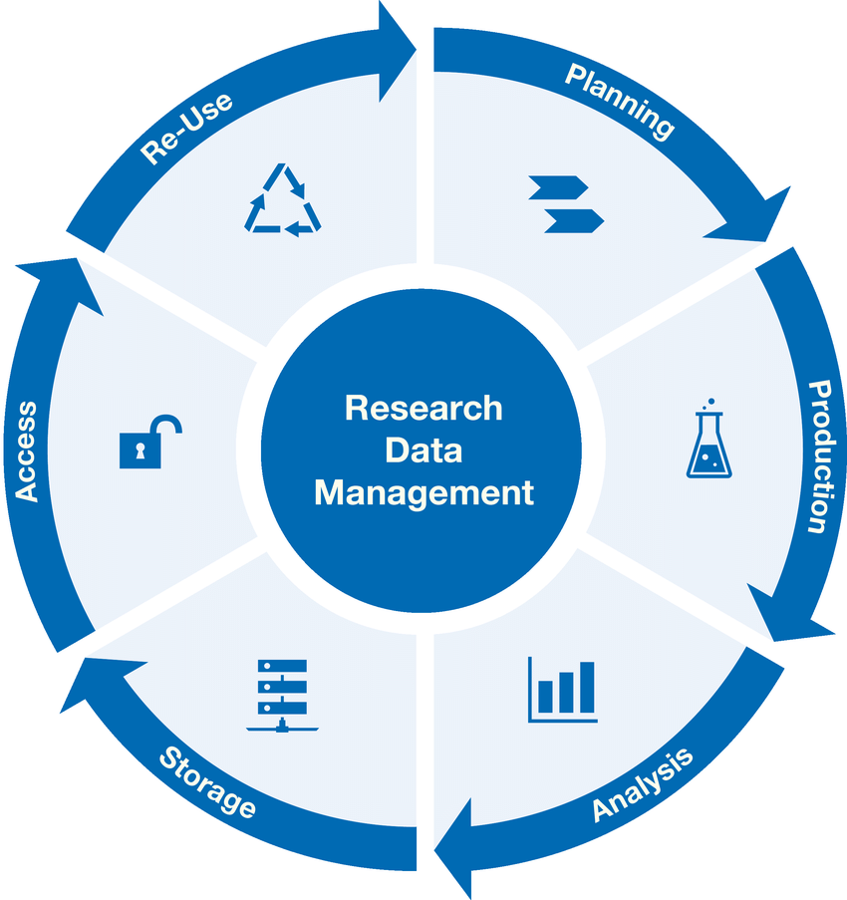
Research Workflow
and RDMS Object Types Interconnection
Research workflow support in RDMS
Defines characterizations
Provides report on samples & measurements
Idea or Plan
Calculation / Compu-tational Composition
Sample
Treatment:
annealing,
oxidation,
polishing, …
Sample_2
Report
Request for Synthesis
Characterisation:
EDX, XRD, Resistance, Bandgap, …
Characterisation:
EDX, XRD, Resistance, Bandgap, …
EDX – Energy-Dispersive X-ray spectroscopy (to determine composition) XRD – X-Ray Diffraction (to determine crystallographic structure)
RDM Image source: Yazdi, M., Politze, M. and Müller, M. (2024) ‘A Novel Approach to Outlining Research Data Management Life Cycle: A Case Study’, Research gate, accessed 15.05.2024

Slide 5
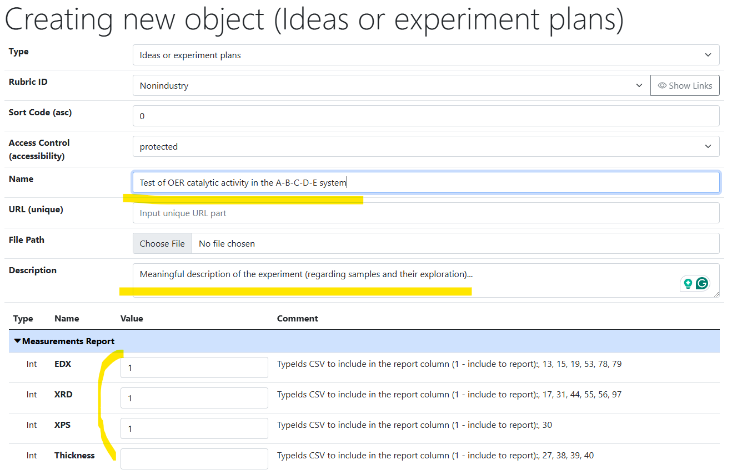
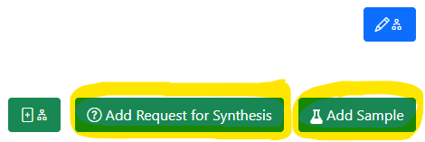
Idea or Experiment Plan
Motivation:
set up the workflow
by defining characterisation
for the experiment
(batch of samples)
Linked objects
https://mdi.matinf.pro/properties/edititem/103066
https://mdi.matinf.pro/object/standard-screening-crc-aka-tobias-report-103066

Slide 6
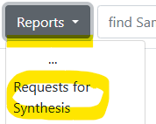
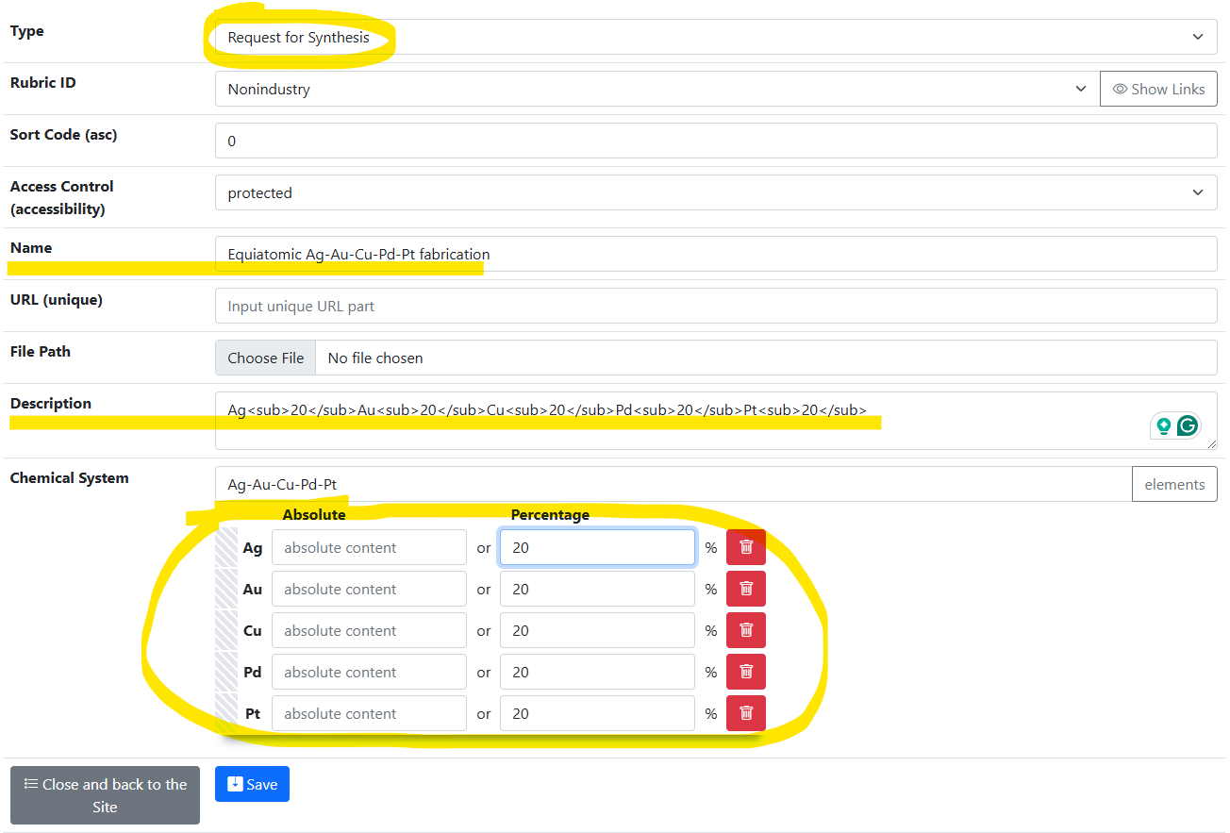
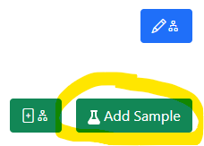
Request for Synthesis
Motivation:
provide technical task
by defining composition for sample synthesis
(batch of samples)
Linked objects

Slide 7
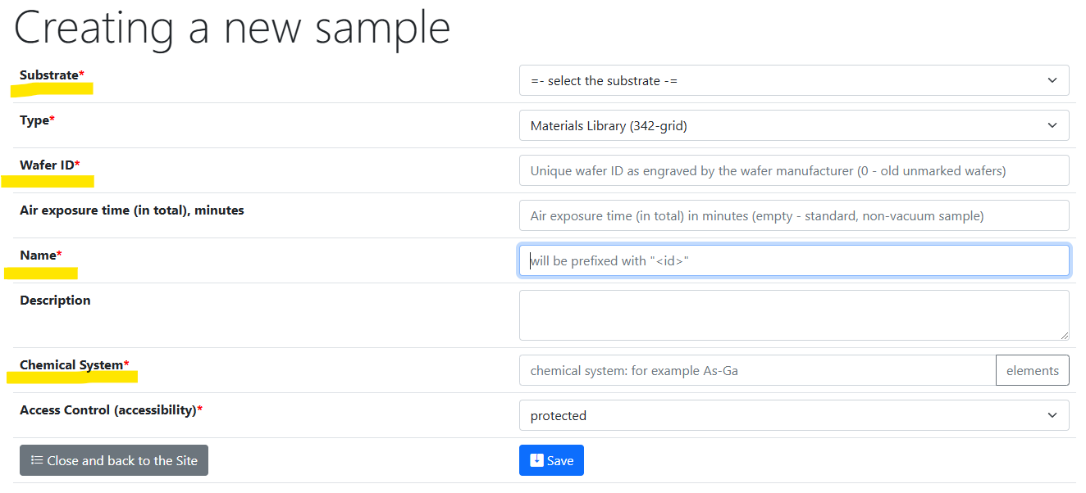
Samples
https://mdi.matinf.pro/custom/editsample/0/

Slide 8
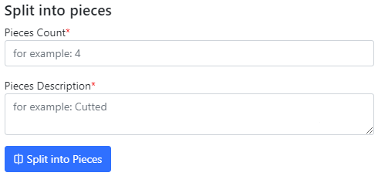
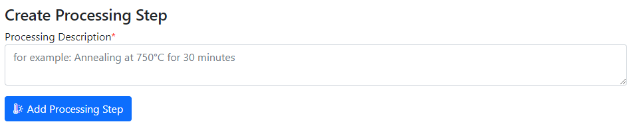
Use Case: Sample Transformation Workflow
Create Processing State & Split Sample
Sample_2a_2
(subsample 2a state 2)
polishing
Documents2a_2
Sample_2a
(subsample 2a)
Sample
(initial state)
annealing
Sample_2
(changed state 2)
splitting
Sample_2b_2
(subsample 2b state 2)
oxidation
Sample_2b
(subsample 2b)
documents
documents2
Documents2b_2

Slide 9
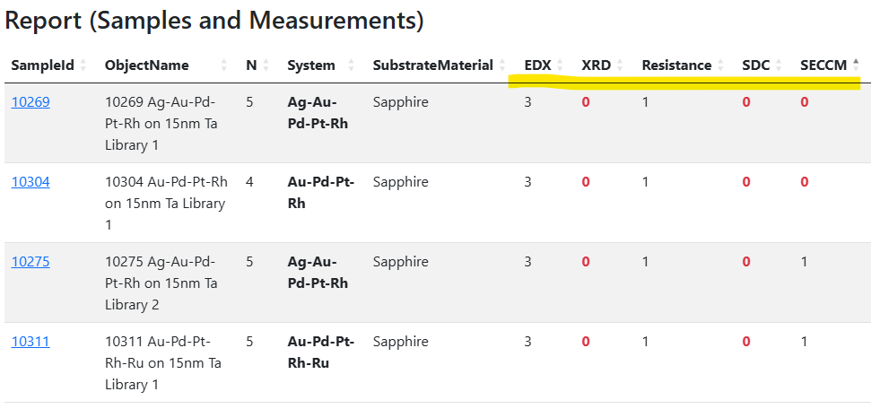
Report provided by “Idea or Experiment Plan”
Live monitoring: how well measurement workflows go to plan
Measurements according to the “Idea or Experiment Plan” object
Number of objects/documents according to measurement types
0 – no measurements done
https://mdi.matinf.pro/object/standard-screening-crc-aka-tobias-report-103066

Slide 10
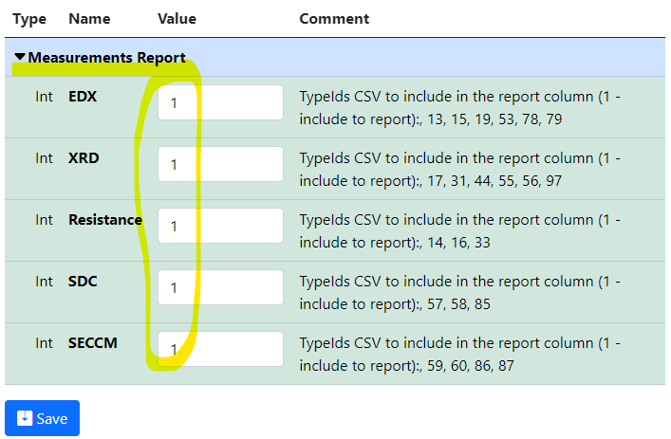
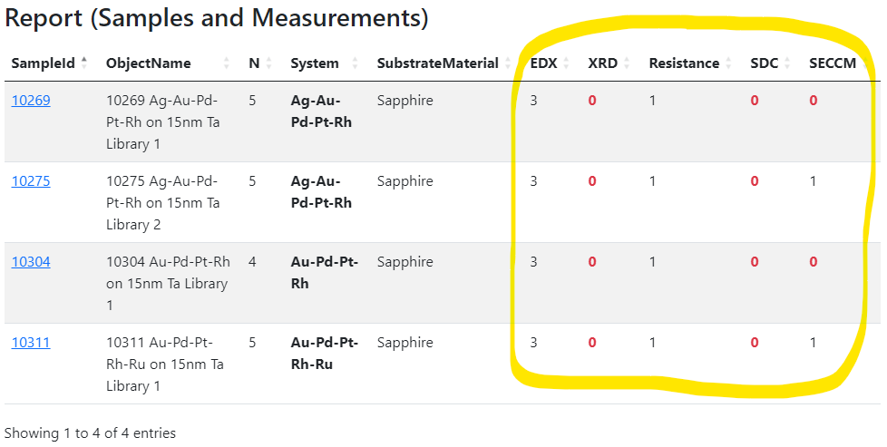
Idea or Experiment Plan: summary
Motivation: set up the workflow by defining characterisation for the experiment (idea or plan)
and track the progress.
Idea or Plan
1) Create “plan” object
2) Define characterisations
3) Add samples and
measurements…
4) Monitor workflows via reports in the “plan” object
https://mdi.matinf.pro/properties/edititem/103066
https://mdi.matinf.pro/object/standard-screening-crc-aka-tobias-report-103066

Slide 11
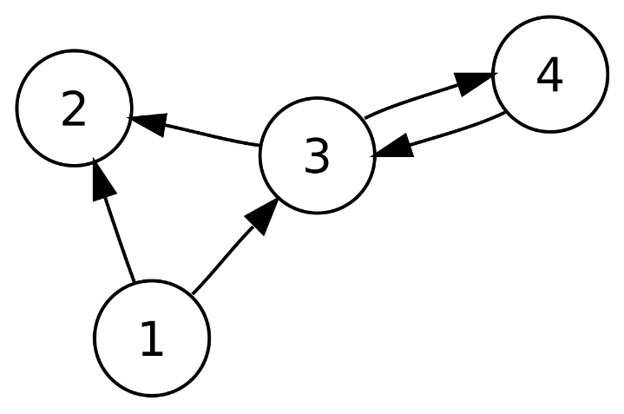
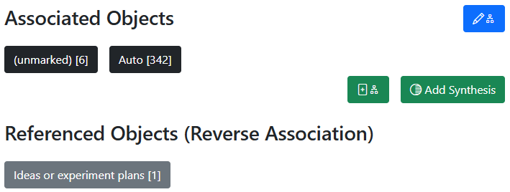
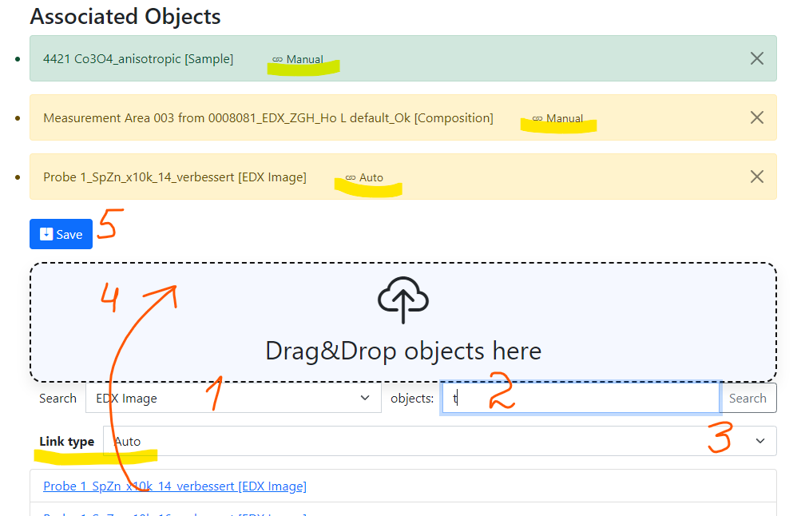
RDMS: Advanced Interlink Objects
a
a
c
Example: establishing graph above objects
b
directed graph
To add associated objects:
0) Go to “List edit” or select object to edit
1) Select associated object type (optional filter)
2) Input search phrase, contained in the Name of the desired object to be associated
3) Select (if required) link/association type object.
4) Drag & Drop desired object(s) from search result list to the area / adjust list
5) Save changes
Important: Reverse associations allow to browse reverse- directional associations.
User view: https://demo.mdi.ruhr-uni-bochum.de/object/ag2s-4870
Admin view: https://demo.mdi.ruhr-uni-bochum.de/adminobject/edititem/4870

Slide 12
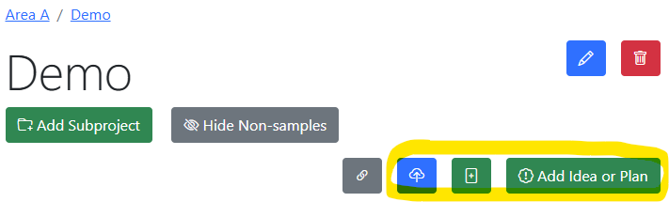
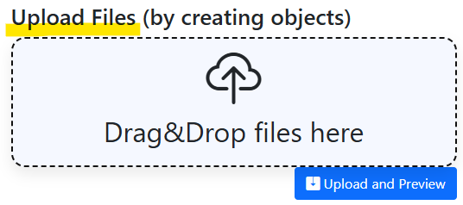
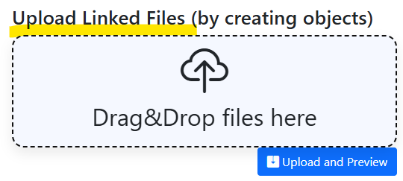
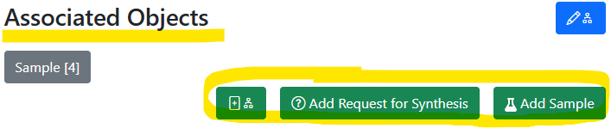
Graph: always think about object connections
In Project: add unlinked objects.
https://mdi.matinf.pro/rubric/industry
Add “top level” objects
Add “children/dependent” objects
In Object (under associated objects): add linked objects.
https://mdi.matinf.pro/object/standard-screening-crc-aka-tobias-report-103066
https://mdi.matinf.pro/rubric/industry
https://mdi.matinf.pro/object/standard-screening-crc-aka-tobias-report-103066

Slide 13
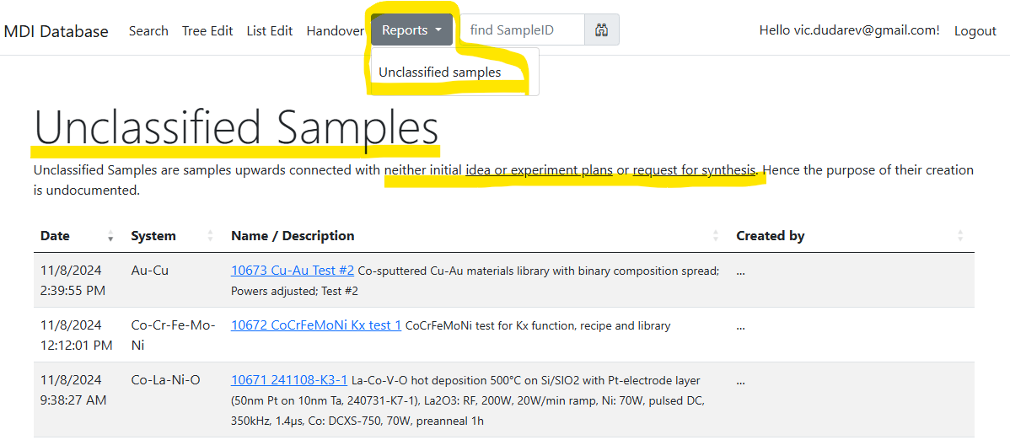
Unclassified samples: these should not exist anymore…
Goal: all samples should have a parent “Idea or Experiment Plan” / “Request for synthesis”
https://mdi.matinf.pro/report/unclassifiedsamples

Slide 14
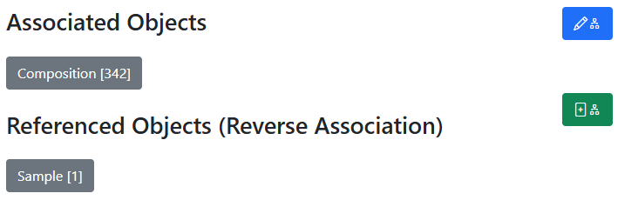
Oriented Graph: interlink & don’t mess up with directions
In all objects:
Control associated objects (children)
Child objects
Add a new (child) object + association
Parent objects
Idea or Plan
Sample
Synthesis
Request for Synthesis
Characterisations:
EDX, XRD, Resistance, Bandgap, …
342
x
Compositions

Slide 15
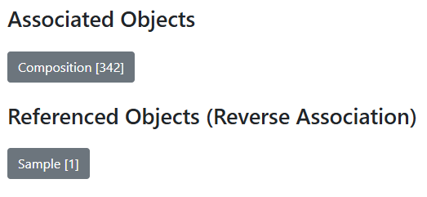
RDMS Quiz: do you know graph good enough?
Task: guess the object type by its associations
Type: ???
Sample
???
EDX CSV
Composition_1
…
Composition_342

Slide 16
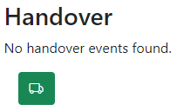
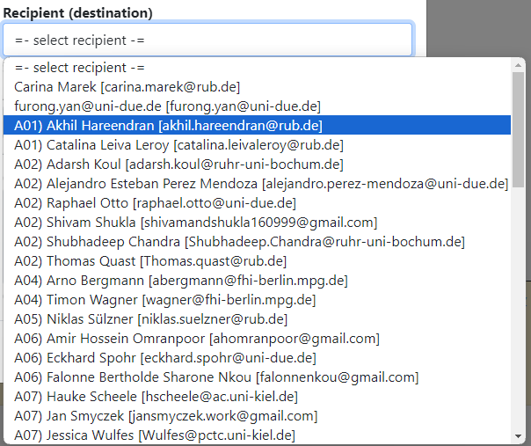
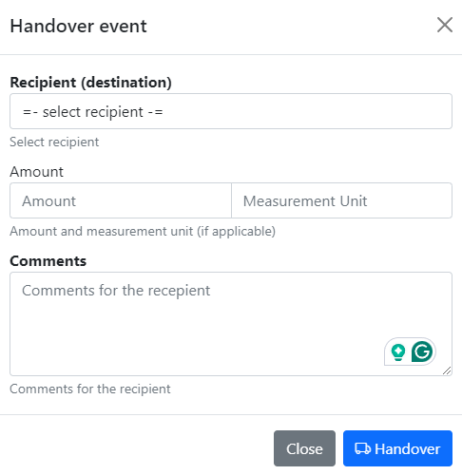
Tracking Samples or Handover event: initialisation
1) In “physically transferrable” objects (samples), find a green handover button
2) Fill in the form and press a blue button.
Select recipient
Specify Amount (optional)
Specify Comments
Click to initialise
Handover is available in any sample view form.

Slide 17
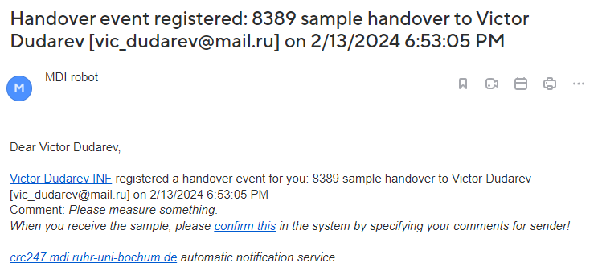
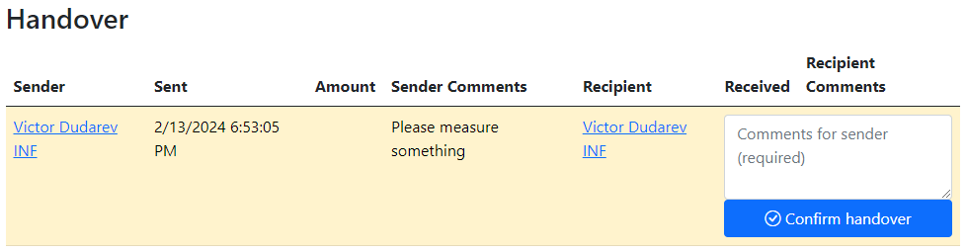
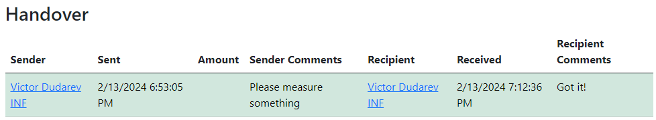
Tracking Samples or Handover event: delivering / delivered
1) Handover event is created & recipient is notified by e-mail
3) Recipient should add comments and confirm the handover.
2) Recipient can view pending handovers
4) The handover is confirmed
+ e-mail notification for sender
Creation by sender -> Recipient notification -> Recipient confirmation -> Sender notification.

Slide 18
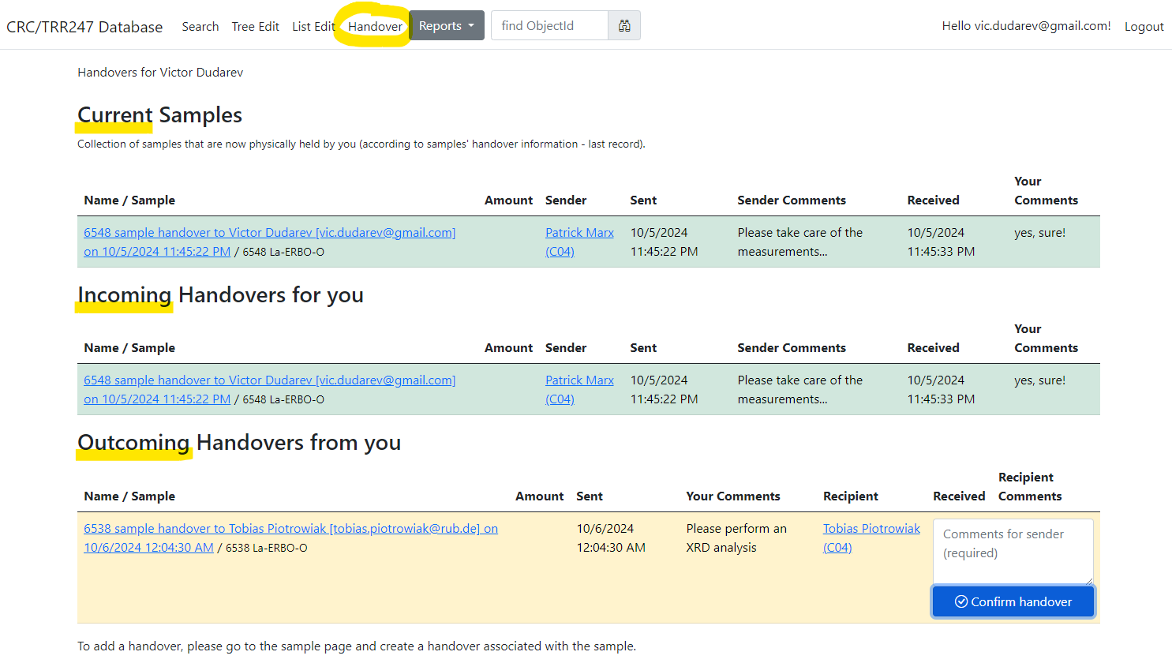
Tracking Samples or Handover event: user overview
Current samples
Incoming
Outcoming
User-dependent handover overview (example in CRC247 tenant):
https://crc247.mdi.ruhr-uni-bochum.de/handover

Slide 19
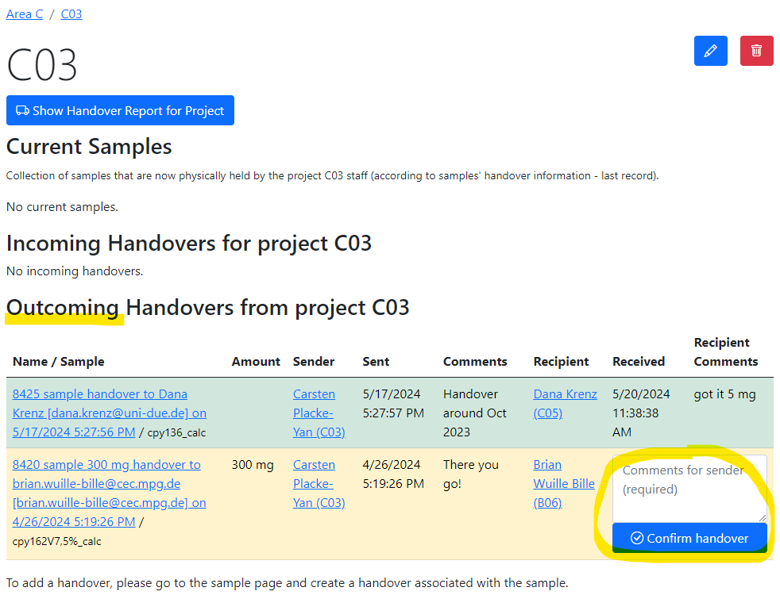
Tracking Samples or Handover event: project overview
Handover overview is displayed in project that matches by name with one of Project claims for users.
Contains overview for a group of users having the same Project claim.
Successful handover
Pending handover (unconfirmed)
Project (a group of users working on the same project according to Project claim) overview for handovers (in CRC247):
https://crc247.mdi.ruhr-uni-bochum.de/rubric/area-c_c03

Slide 20
Agenda
    Typical workflow:
      Idea or experiment plan (should be the top object)
      Request for synthesis
      Samples / characterisations
      Report in “Idea or Experiment Plan”
    Graph: interlinking objects (no orphaned objects, please)
    Handovers (use them to track samples)

Slide 21

Playground
https://inf.mdi.ruhr-uni-bochum.de/
Playground Inf
Playground to test RDMS (multiple tenants with shared users list):
https://inf.mdi.ruhr-uni-bochum.de/
Login and Password (User role): User1@user.org
Login and Password (PowerUser role): PowerUser1@user.org
Login and Password (Administrator role): Admin1@user.org
https://inf.mdi.ruhr-uni-bochum.de/

Slide 22
Thanks for your kind attention
Questions & Answers
Victor Dudarev
Victor.Dudarev@rub.de
https://vdudarev.ru

