Slide 1
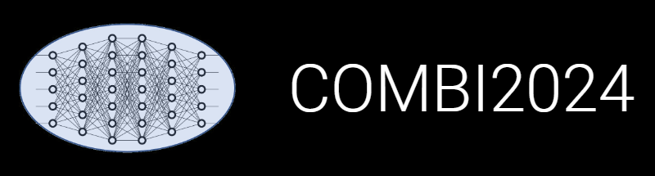

Updates on Research Data Management with hands-on session
Victor Dudarev, Markus Stricker, Alfred Ludwig

Slide 2
Blocking Factors?
Standards in electrochemical measurements need to be established
(ECSA for SDC and long-range SECCM)
      If different measurement protocols have a severe impact on the target values of the metric / benchmark, what can you expect from trying to take all the data into account?
Missing process standards (next slides):
Sample storage
Annealing
Characterization chain
ECSA – ElectroChemical Surface Area (ElectroChemically active Surface Area)
SDC – Scanning Droplet Cell
SECCM – Scanning ElectroChemical Cell Microscopy

Slide 3
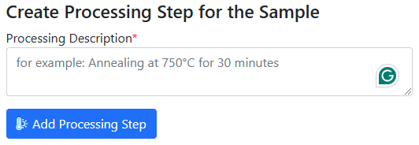
Sample storage (oxidation?): Air exposure time workflow
“Air-free” samples: Air exposure time must be specified for every sample state!
Air exposure time (in total): 0
Air exposure time (in total): 15
Treatment:
Air exposure
Next treatment:
Sample
Sample_2
…
characterisation of a sample that has not seen air
Characterisation:
XPS, EDX, XRD, Resistance, Bandgap, …
Characterisation:
XPS, EDX, XRD, Resistance, Bandgap, …
characterisation of a sample that saw air
https://crc1625.mdi.ruhr-uni-bochum.de/custom/editsample/0/

Slide 4
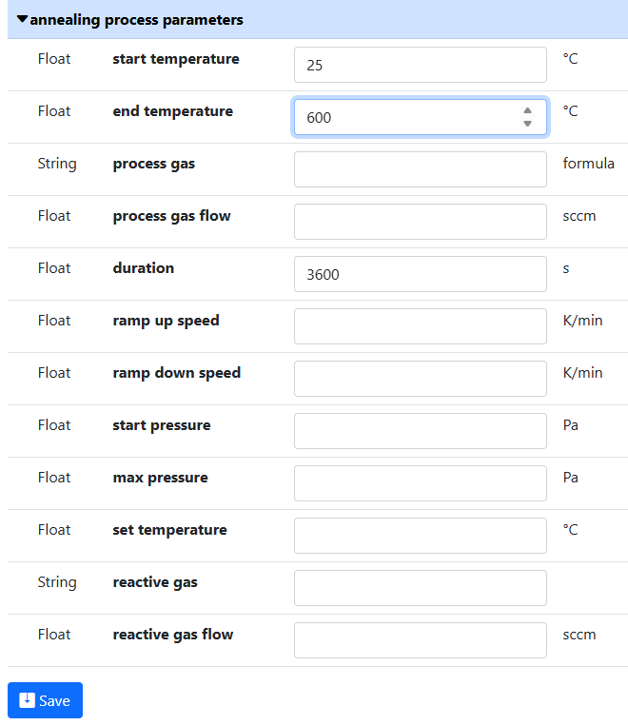
Missing process standards (annealing)
Sample
Treatment:
annealing,
oxidation,
polishing, …
Sample_2
Synthesis
Synthesis_2
Let’s consider life example (SampleID 10701):
https://crc1625.mdi.ruhr-uni-bochum.de/object/10701-agaupdpt-30-rpm-substrate-rotation-speed_2-27797
https://crc1625.mdi.ruhr-uni-bochum.de/object/10701-agaupdpt-30-rpm-substrate-rotation-speed_2-27797

Slide 5
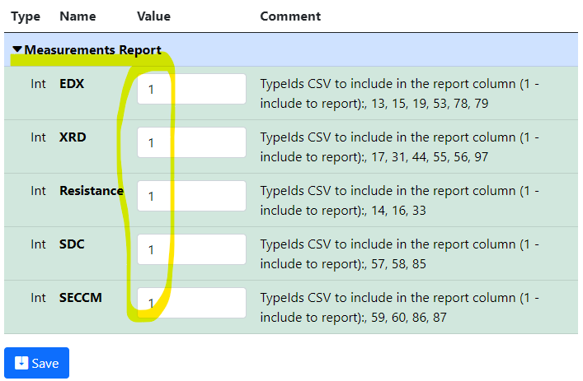
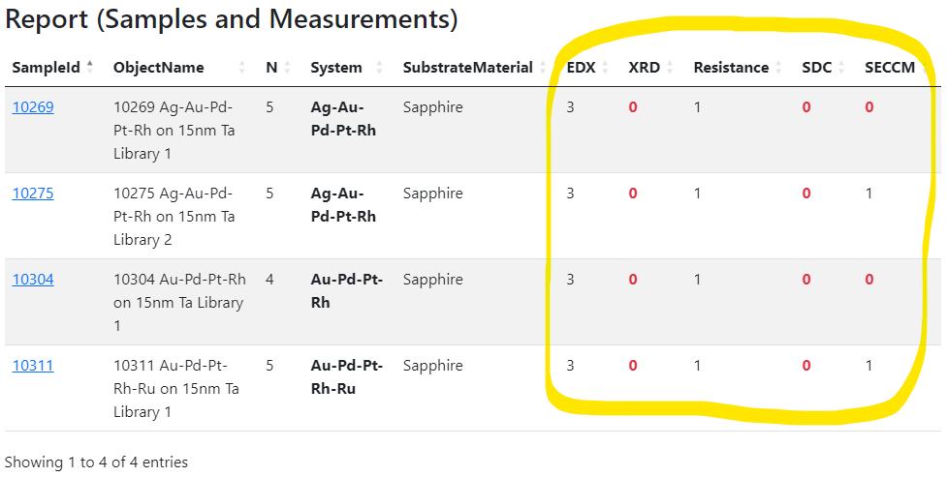
Missing process standards (characterization chain)
Solution: set up the workflow by defining characterisation for the experiment (idea or plan)
and track the progress.
Idea or Plan
1) Create “plan” object
2) Define characterisations
3) Add samples and
measurements…
4) Monitor workflows via reports in the “plan” object
https://crc1625.mdi.ruhr-uni-bochum.de/rubric/area-a
https://crc1625.mdi.ruhr-uni-bochum.de/object/standard-screening-crc-aka-tobias-report-103066

Slide 6
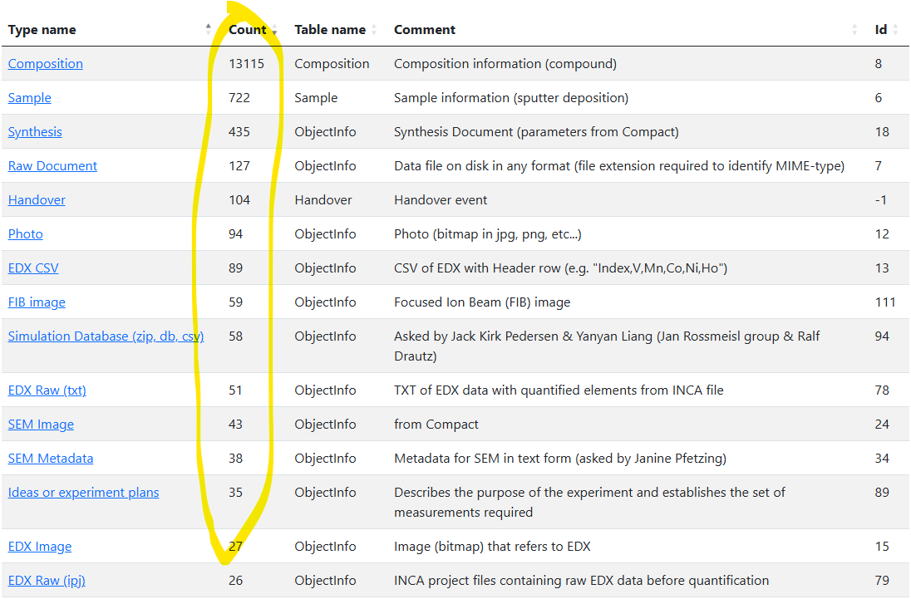
Types (Data formats)
Types (Data formats)
What data can you read?
https://crc1625.mdi.ruhr-uni-bochum.de/adminobject

Slide 7
What is machine-readable data?
Research data management is not about just storing files, but about storing also metadata and probably data, extracted from the files and effective search afterwards. We need a programmatic ability to EXTRACT meaningful data/metadata from the file.
A file format is in a "machine-readable" format for RDMS in either of two cases:
1) file format is standardised and well-described (from this description it should be obvious, how to get the required data, that researchers need => we can develop by ourselves);
2) The file format could be a proprietary one, but a program library/API exists that can extract required data (from the device manufacturer or some open-source packages).
There should be a clear understanding of what metadata (parameter names) should be extracted and stored in RDMS for effective search later.
Even having a machine-readable file is not enough, since it’s required to negotiate and standardise what would be meaningful parameters for the search / dataset generation regarding a particular data type.
Description for every type (measurement): what parameters, describing data/metadata are required to store and make it searchable!

Slide 8
Extensible Data Support in RDMS
    To support a new kind of document/measurement, we create a new type in RDMS.
    Questions:
    How to validate data?
    How to extract metadata?
    How to extract data?
    Two approaches
    Manual Automated
    Continuous Development
    Zero-code effort:
    No data validation on upload
    Templates to edit data/metadata
    Manual template guided data input, if required (file is considered raw, i.e. unprocessed)
    Write a Web-services for:
    Data validation on upload
    Data & metadata extraction
    Data visualization
    Everything is automated.

Slide 9
INF Meetings with projects
Team:
Prof. Markus Stricker (INF, A05)
Victor Dudarev (INF)
Doaa Mohamed (INF)
Behnam Mardani (A05)
Samuel García (A06)
Thank you for your input!
First+ round:
A01 (except computational)
A02
A03
B01
B03
B04
B05
C02
C03
C04
S
Still not covered:
A01 (computational)
A04
B02
C01*
Questions:
Research workflow
Expected Data Contributions (documents / properties)
Interaction with other projects data
Leverage Data Usage (FAIR)
  Imagine you have 10000+ documents:
  how would you structure them?
  what properties should be associated with every document (F - Findable)?
  what data you need to get from RDMS for your research (what format)?
* SECCM Long-range: https://crc1625.mdi.ruhr-uni-bochum.de/object/10648-her-seccm-long-range-raw-27785

Slide 10
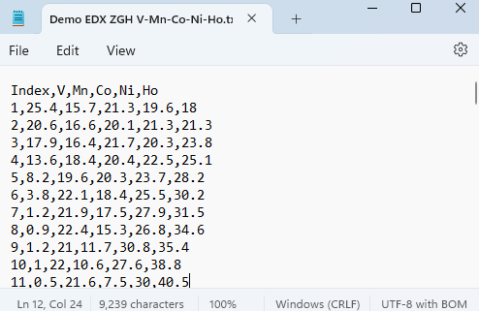
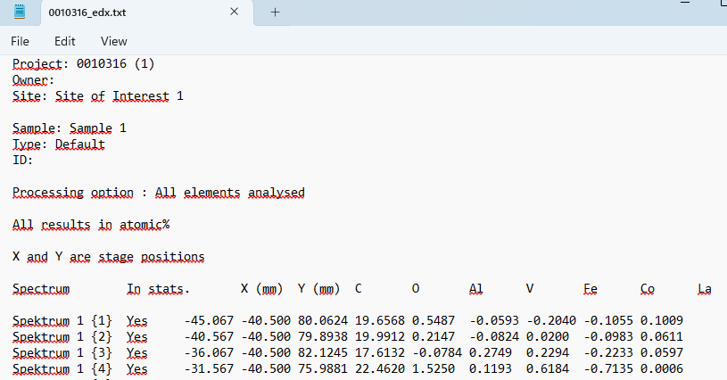
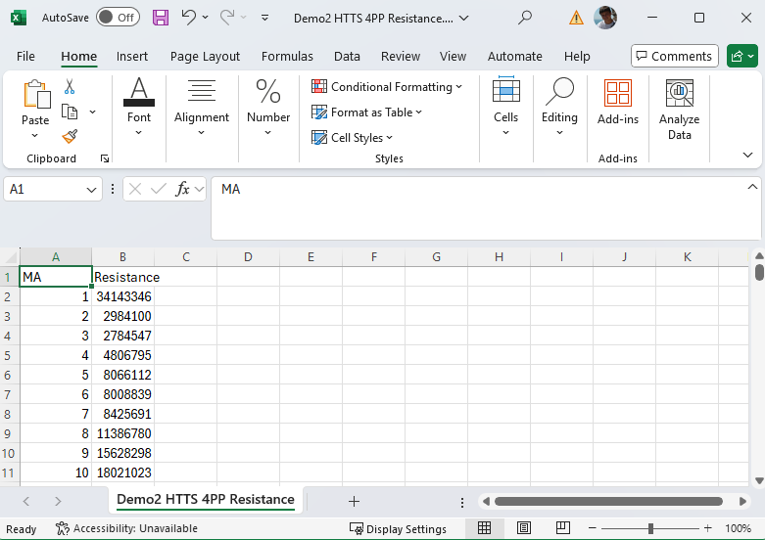
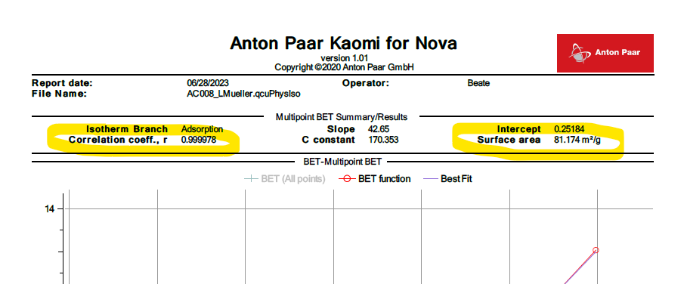
Supported Data Types & Formats
Supported data extraction: EDX, XRD Processed, BET Adsorption, Resistance, Thickness
CSV
TXT
Excel
PDF

Slide 11

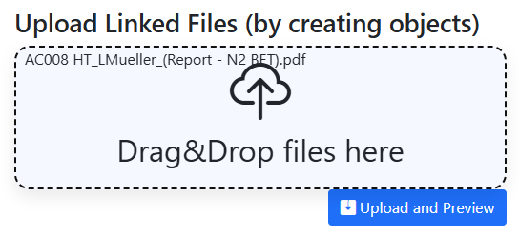

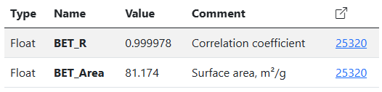
PDF Data Extraction: BET adsorption data
Goal: extract surface area from PDF measurement report
Sample
BET adsorption
Properties at the sample level:
Properties at the document level (BET adsorption report):
BET - Brunauer, Emmett & Teller (BET) equation Leon Müller, C02 (CRC 247)
https://crc247.mdi.ruhr-uni-bochum.de/object/ac008-ht_lmueller_report-n2-bet-25320
https://crc247.mdi.ruhr-uni-bochum.de/object/ac008-lacoo3-24922

Slide 12
Data Extraction
From File Name

Slide 13
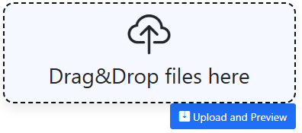

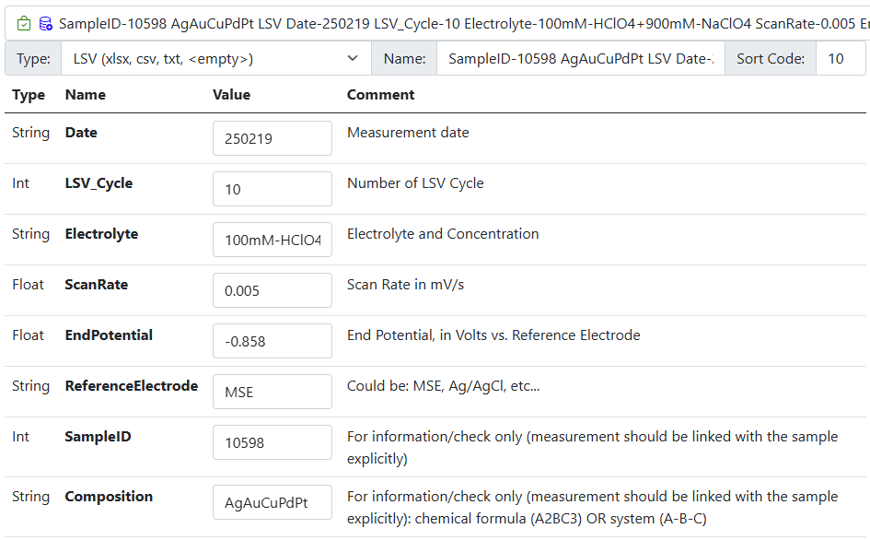
Parameters Extraction from File Name
File Name (Key1-Value1 Key2-Value2 … KeyN-ValueN):
Parsing of file name:
1) Split by " " (could be any other symbol);
=> collection of Key-Value pairs
2) Split by first "-" (could be any other symbol)
=> [ { key1, value1 }, … , { keyN, valueN } ]
SampleID-10598 AgAuCuPdPt LSV Date-250219 LSV_Cycle-10 Electrolyte-100mM-HClO4+900mM-NaClO4 ScanRate-0.005 EndPotential--0.858 ReferenceElectrode-MSE.csv
Sample ID: 10598
Date: 2019-02-25
ReferenceElectrode: MSE
ScanRate: 0.005 (5mV/s)
Composition: AgAuCuPdPt
LSV_MA: 10
EndPotential: -0,858 V
Electrolyte_Concentration: 100mM HClO4+900mM NaClO4
Together with С03

Slide 14
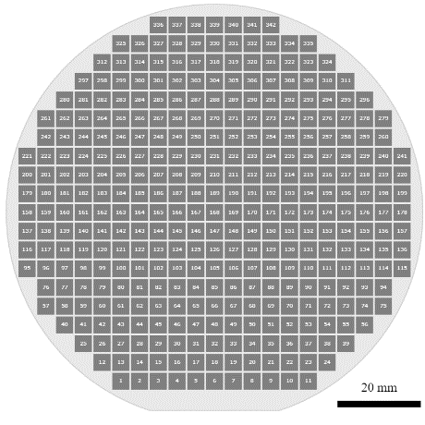
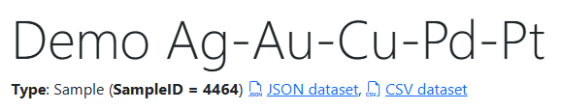
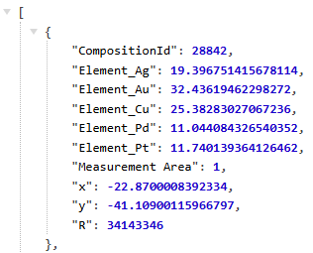

Materials Library: Data Integration
Sputtering & characterization:
Add Sample object (chemical system + substrate)
Add EDX CSV (or txt)
Add other characterization documents (repeat)
Get dataset on the sample page:
JSON
CSV
Measurement Area
(composition)
Phases: [ Phase₁,
…, Phase_{N} ]
Resistance: __ Ohm
Thickness: __ nm
Bandgap: __ eV
…
https://inf.mdi.ruhr-uni-bochum.de/object/demo-ag-au-cu-pd-pt-ti-28840

Slide 15
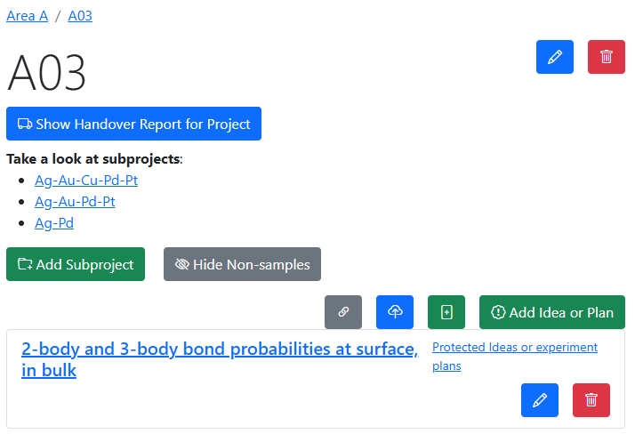
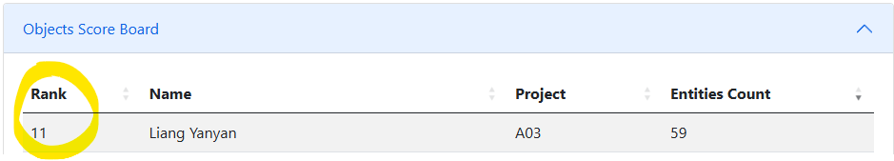
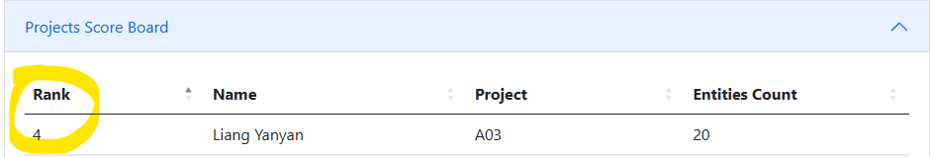

Interlinking objects: A03 use case (Liang Yanyan)
Summary:
Objects: 59
  Idea/experiment plan: 1
  Python Script (ipynb): 1
  Simulation Database (CSV): 57
Projects: 20
Links: 0
Data by Liang Yanyan:
https://crc1625.mdi.ruhr-uni-bochum.de/rubric/a03
https://crc1625.mdi.ruhr-uni-bochum.de/report/usersstatistics

Slide 16
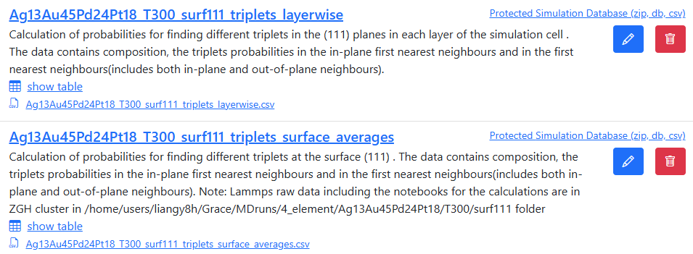
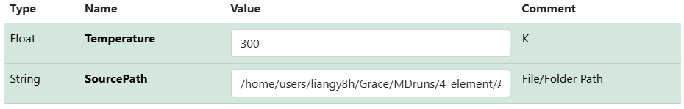

Establishing properties/template: A03 use case (Liang Yanyan)
Inconsistent description (w.r.t. folder path specification)
List of the objects:
Properties to extract:
Temperature
Data Source
Template:
Data by Liang Yanyan:
https://crc1625.mdi.ruhr-uni-bochum.de/rubric/a03_agaupdpt_ag13_au45_pd24_pt18_surface-segregation-in-111-at-t300k

Slide 17
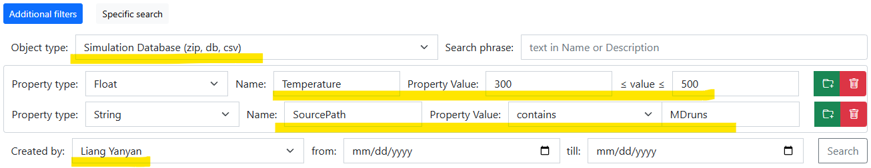



Search: A03 use case (Liang Yanyan)
Use properties on search:
Temperature in [300; 500] and SourcePath contains 'MDruns' and type is Simulation Database (zip, db, csv) and user-creator is Liang Yanyan
Data by Liang Yanyan:
https://crc1625.mdi.ruhr-uni-bochum.de/search/?typeid=94&createdbyuser=47&pr0name=Temperature&pr0type=Float&pr0min=300&pr0max=500&pr1name=SourcePath&pr1type=String&pr1max=3&pr1str=MDruns&prcnt=2

Slide 18
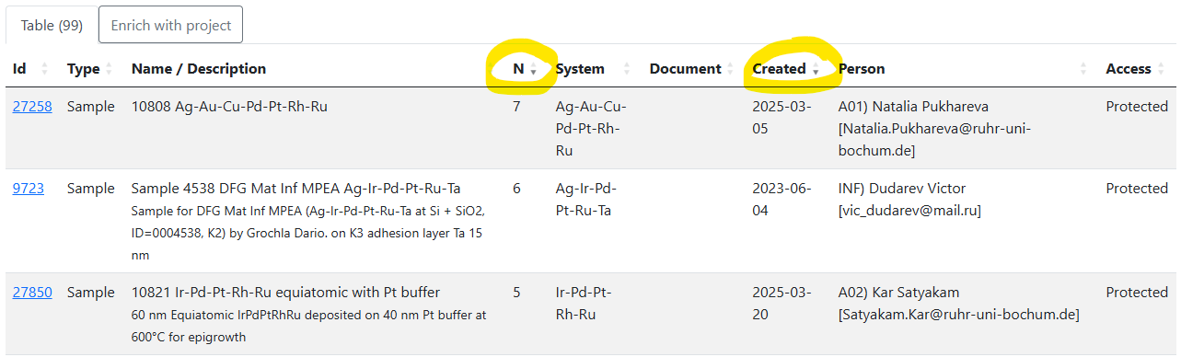
RDMS: Sort order in tables
Use case: get samples containing specific elements and order by arity of chemical system (N) and creation date
To sort in a complex way (by 2+ columns):
use "Shift" key while making the sort selection:
https://crc1625.mdi.ruhr-uni-bochum.de/search/?system=Pt-Ru&typeid=6

Slide 19
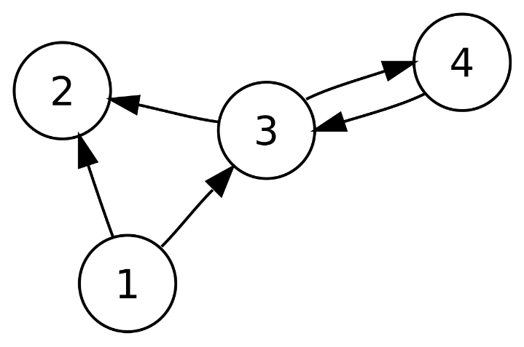
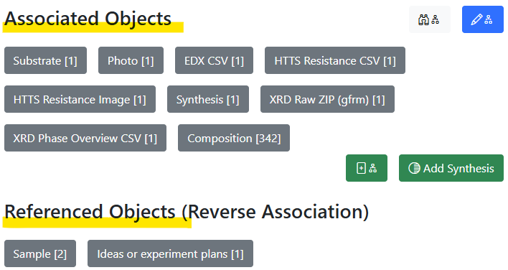
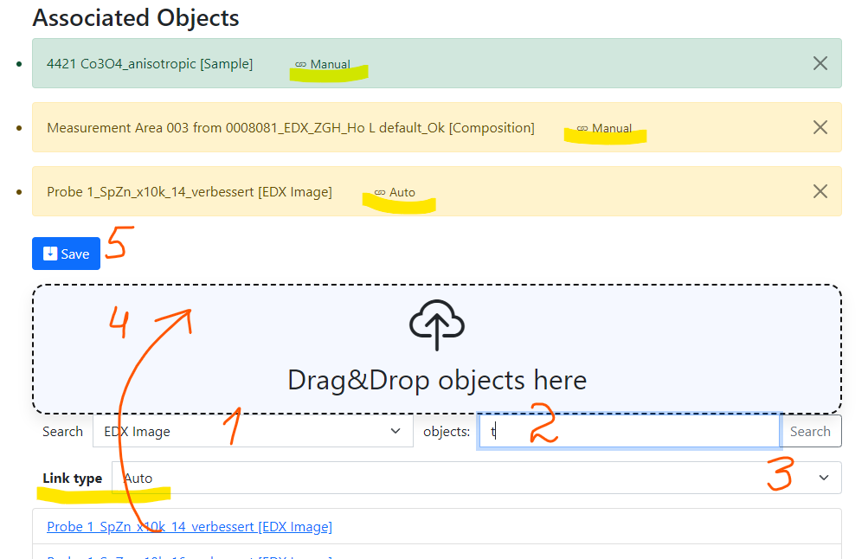
RDMS: Advanced Interlink Objects
a
a
c
Example: establishing graph above objects
b
directed graph
To add associated objects:
0) Go to “List edit” or select object to edit
1) Select associated object type (optional filter)
2) Input search phrase, contained in the Name of the desired object to be associated
3) Select (if required) link/association type object.
4) Drag & Drop desired object(s) from search result list to the area / adjust list
5) Save changes
Important: Reverse associations allow to browse reverse- directional associations.
User view: https://demo.mdi.ruhr-uni-bochum.de/object/ag2s-4870
Admin view: https://demo.mdi.ruhr-uni-bochum.de/adminobject/edititem/4870

Slide 20
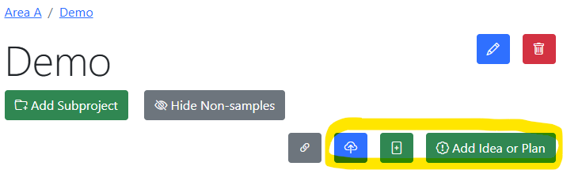
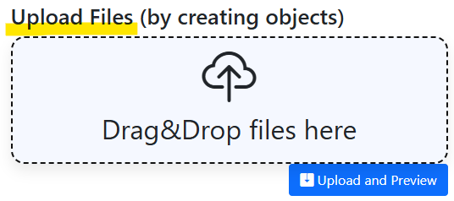
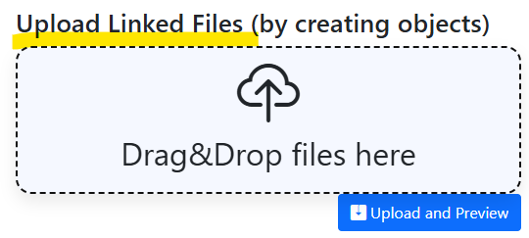
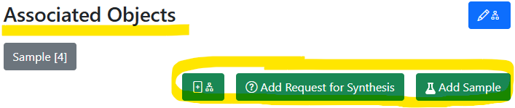
Graph: always think about object connections
In Project: add unlinked objects.
https://mdi.matinf.pro/rubric/industry
Add “top level” objects
Add “children/dependent” objects
In Object (under associated objects): add linked objects.
https://mdi.matinf.pro/object/standard-screening-crc-aka-tobias-report-103066
https://mdi.matinf.pro/rubric/industry
https://mdi.matinf.pro/object/standard-screening-crc-aka-tobias-report-103066

Slide 21
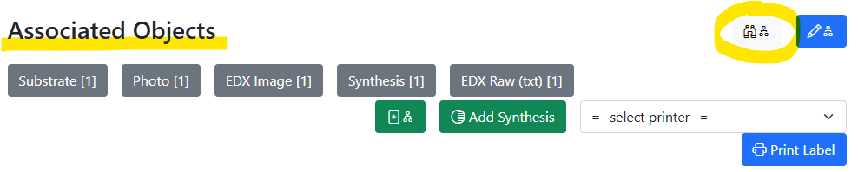
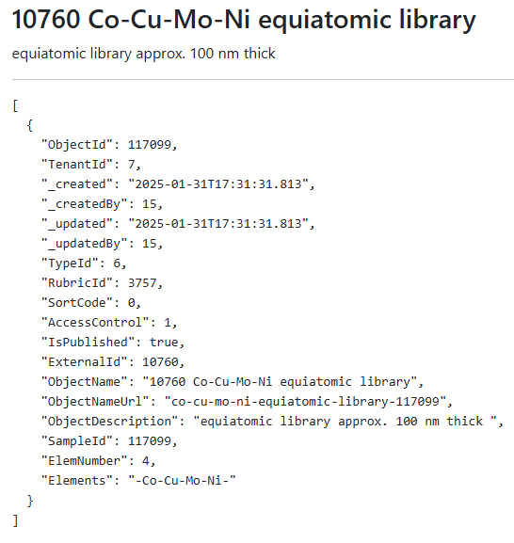
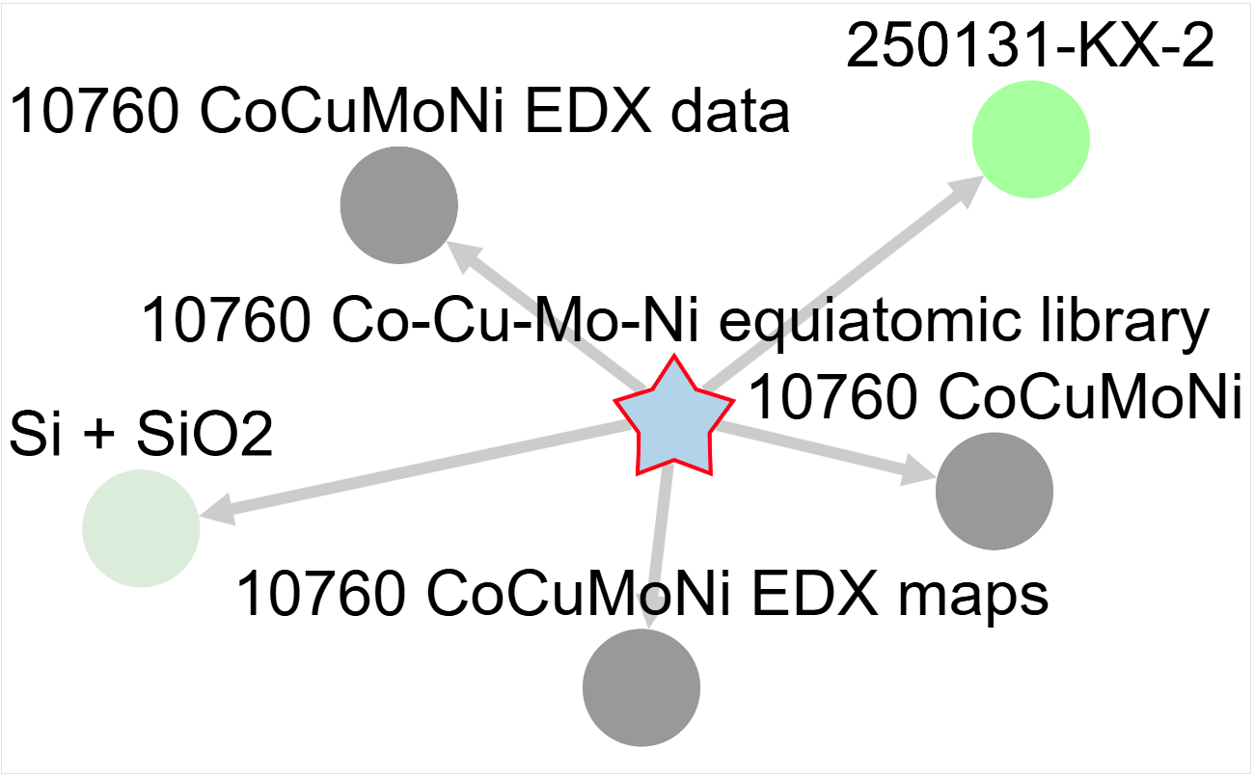
Graph visualisation
Motivation: understand relationship between objects
JSON description
Interactive graph
JSON
https://mdi.matinf.pro/object/co-cu-mo-ni-equiatomic-library-117099
https://mdi.matinf.pro/object/graph/co-cu-mo-ni-equiatomic-library-117099

Slide 22
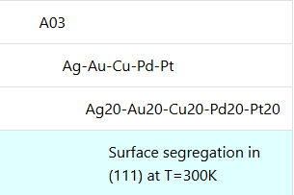
A03 use case: adding missing objects and links
Initial object structure: Idea, Simulation database
Desired object structure: Idea -> System -> Composition -> Simulation database
Motivation: fill the gap between Idea and Simulation database
Types: System: Calculation/Computational Sample
Composition: Calculation/Computational Composition
Idea or Plan
Missing part
System_1
System_N
…
Composition_1-1
Composition_1-K
Composition_N-1
Composition_N-L
Sim DB_{i}
Sim DB_{i}
Sim DB_{i}
Sim DB_{i}
Sim DB_{i}
Sim DB_{i}
Sim DB_{i}
Sim DB_{i}
https://crc1625.mdi.ruhr-uni-bochum.de/rubric/a03
https://crc1625.mdi.ruhr-uni-bochum.de/rubric/a03_ag-au-cu-pd-pt

Slide 23
Links to external resources
Use Case: Slack

Slide 24
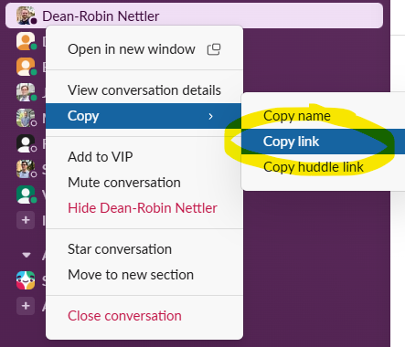
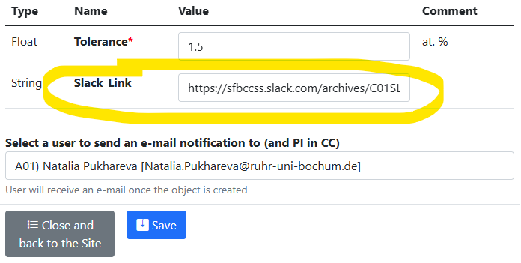

Link to a Slack chat / action team
Goal: establish a link to a Slack discussion (channel/section/personal), related to the subject
Example: Creation of a “Request for Synthesis” object:
paste
Link to the Slack channel:
Use Case Generalisation: any String property with “*_Link” name behaves like a hyperlink.
https://crc1625.mdi.ruhr-uni-bochum.de/adminobject/newitem/83?idr=226
https://crc1625.mdi.ruhr-uni-bochum.de/object/integrate-kg-and-rdms-25368

Slide 25
Context is a key!

Slide 26
EDX Upload: Context matters!
Motivation: process raw EDX data (txt from machine)
Sample
Chemical System: Co-Fe-La-O-V
Context
EDX
Goal: exclude substrate/contamination artefacts from composition
Solution: context-aware data processing (get chemical system)
(leave elements of interest only)
Context:
access to parent objects to get their data
https://mdi.matinf.pro/object/240409-k3-1-70357

Slide 27
Context Matters: implications
Definition: context includes data on all parent objects and their data
Parent_1
…
Parent_N
Implication 1 (self-evident):
object linkage matters!
Implication 2:
document upload could result in different data outcome.
Example: EDX.txt upload to samples with distinct chemical system results in different compositions outcome.
=> Show EDX Demo!
Context
Object

Slide 28
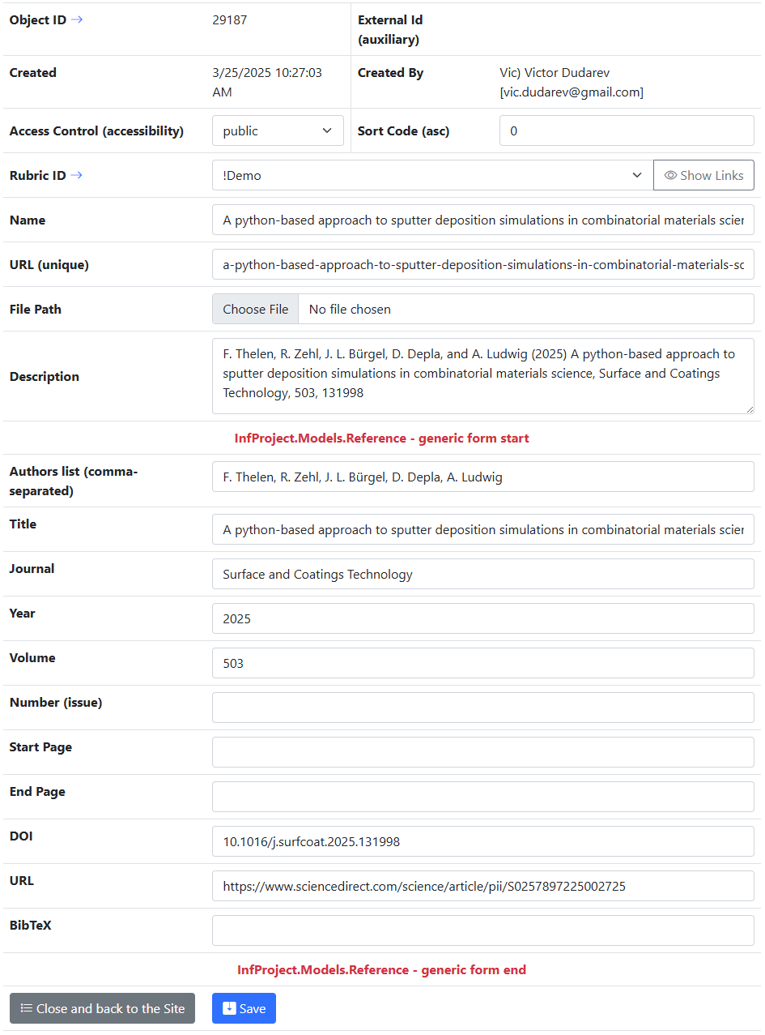
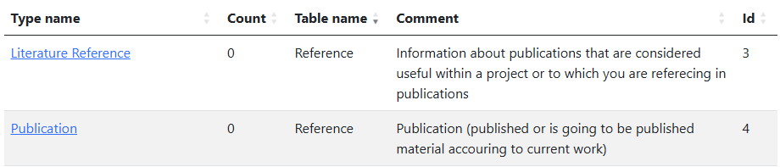
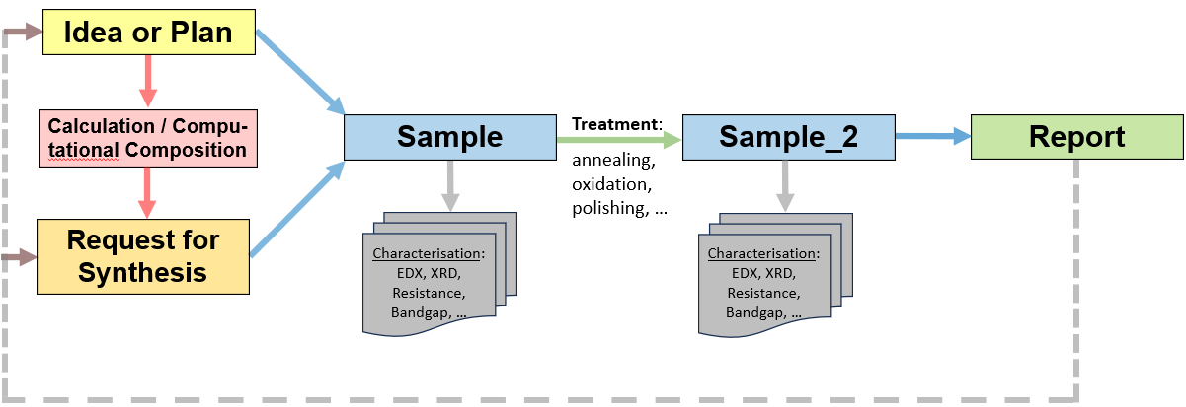
Publications in RDMS
Two types (based on Reference table):
Store publications / presentations / reports in RDMS:
Alternative types to conclude your findings:
PowerPoint Presentation Slides
Report
https://inf.mdi.ruhr-uni-bochum.de/rubric/demo_publications

Slide 29
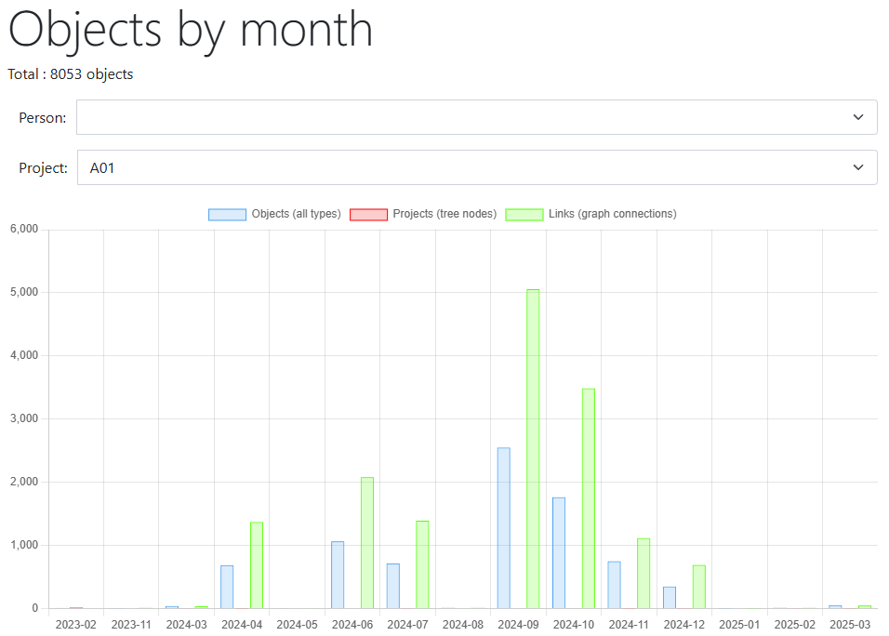
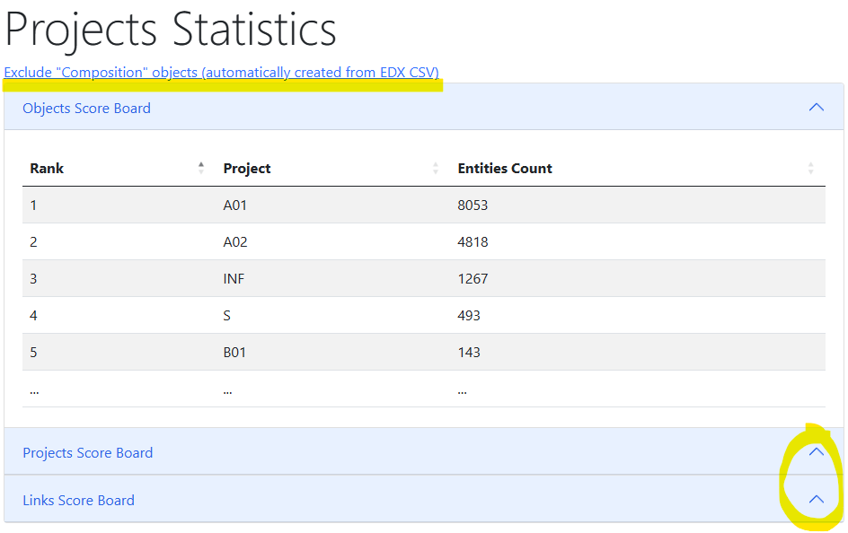
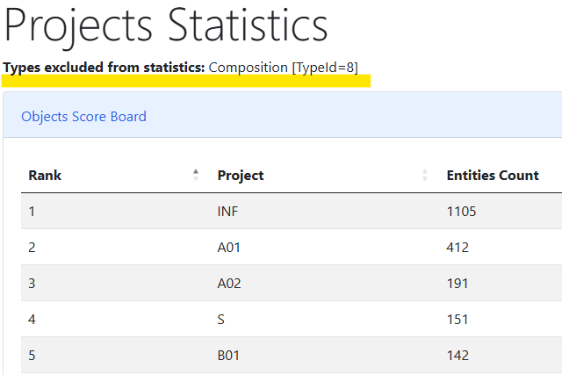
Reports: Projects contribution
New reports:
Objects by month
Project statistics
What other metrics could help?
https://crc1625.mdi.ruhr-uni-bochum.de/report/objectsbymonth?project=A01
https://crc1625.mdi.ruhr-uni-bochum.de/report/projectsstatistics
https://crc1625.mdi.ruhr-uni-bochum.de/report/projectsstatistics?excludeTypes=8

Slide 30
Data Contributions: Establishing KPI == Defining of clear goals
What needs to be uploaded?
Upload Data at all stages:
  Experiments plans
  Raw Data
  Processed data
  Reports/Presentations
What data contribution is good enough?
For every project define expected data contributions in RDMS (with numbers):
  How many chemical systems should be explored?
  How many samples should be synthesized?
  How many characterizations should be done?
  Other meaningful metrics (PIs need to define these explicitly!) => INF dashboard
How do you achieve data quality?
Object Type Design (type must contain metrics that allow comparing objects of the type)
  All documents should generate a fingerprint – set of properties, summarizing the data => Findable
  Ideally: no values should be put as text/description
KPI – Key Performance Indicator

Slide 31
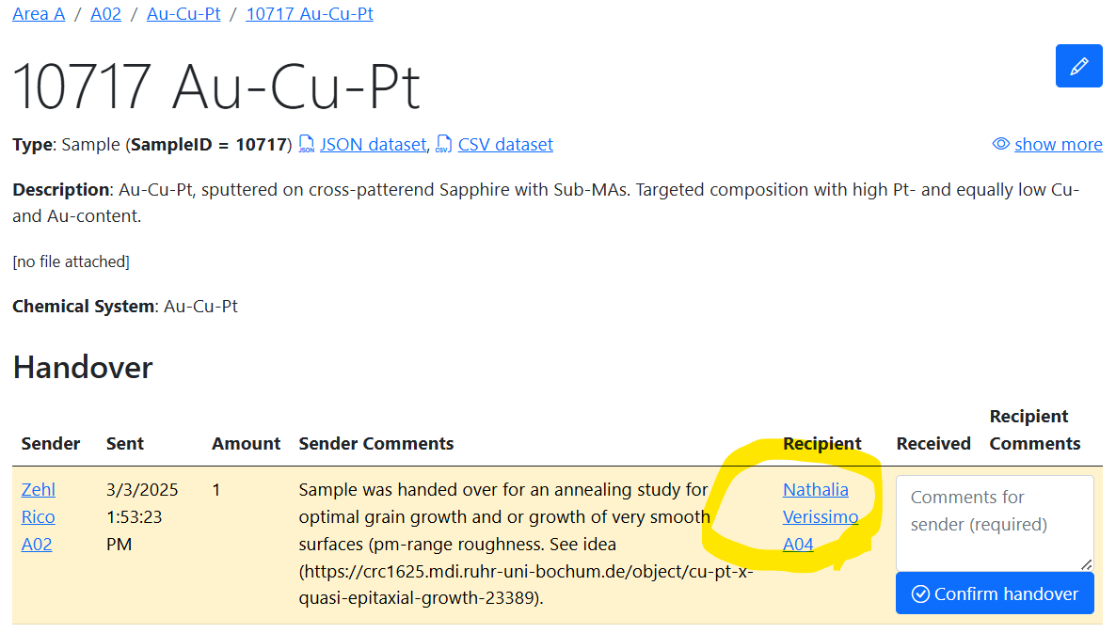
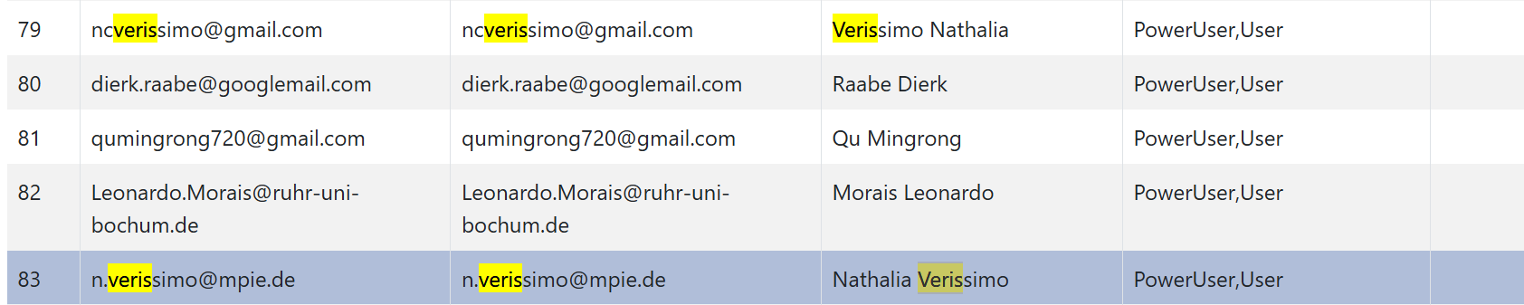
Attention: Mess up with users
  Double users!!!
  A02
  A04
https://crc1625.mdi.ruhr-uni-bochum.de/object/au-cu-pt-109560
https://crc1625.mdi.ruhr-uni-bochum.de/identitymanager/home/users

Slide 32

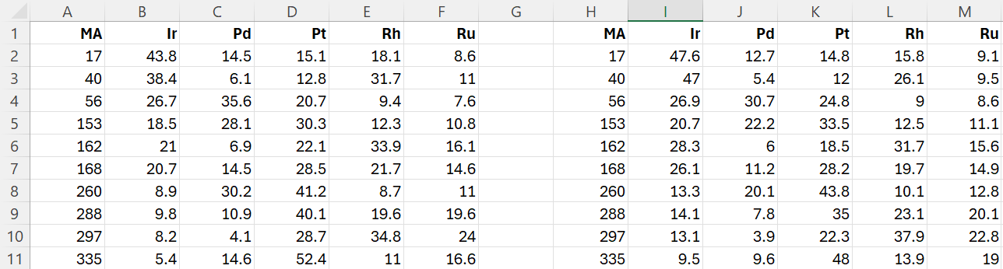
Attention: What are your data?
  A Bad Example of “table” Data for XPS (in CSV format)
  Who could explain it without contacting the author???
https://crc1625.mdi.ruhr-uni-bochum.de/object/ir-pd-pt-rh-ru-121870
https://crc1625.mdi.ruhr-uni-bochum.de/object/xps_10811_10_points-123069

Slide 33
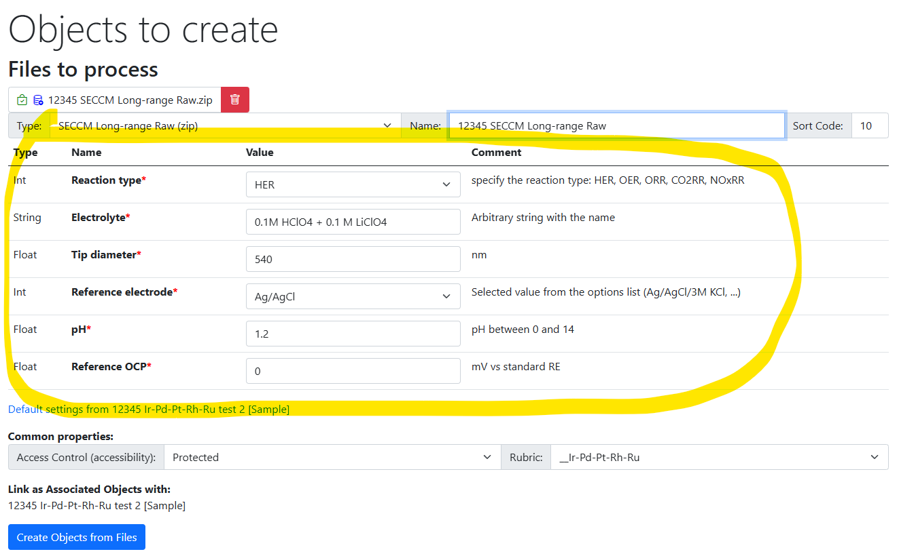
Improvements Summary
RDMS Core Improvements:
Enhanced templates:
  required properties
  properties-based validation
  properties forms on object creation / file upload
  properties with a controlled drop-down list
New Access Level: ProtectedNDA
Search results improvement (enrich with properties)
SQL / read only API
Advanced object linking: “link type” object to characterize edge in the graph
UDT Web Service Template in C# and Python
Documentation

Slide 34
Documentation
The link is in the footer on every page:
Documentation content:
User manual
  Many thanks to: Irina Roslyakova, Felix Thelen, Alan Savan, Tobias Piotrowiak, Jill Fortmann, Ellen Suhr, Sabrina Baha, Florian Lourens, Valerie Strotkötter, Rico Zehl, Patrick Marx, Aurelija Mockute, Elaheh Akbarnejad, Sigurd Thienhaus
Presentations, videos
Database structure description (tables and views)
User-defined type (UDT) system:
  Object type configuration
  UDT support API (validation, data extraction, visualization)
  UDT: supported formats (EDX, Resistance, Thickness)
System settings
Tenant settings
API
Source code
https://crc1625.mdi.ruhr-uni-bochum.de/home/doc

Slide 35
Future plans
Core improvements:
  Integrated dataset generation for a sample / group of samples
  Data pagination / lazy load (performance)
  Data write API (direct connection for external devices to RDMS)
User data formats integration (XRD (ICSD / Pearsons integration), SDC, SECCM)…
Integration with Jupyter Hub (data processing scripts / calculations / ML)
Integration with NFDI (NOMAD by FAIRmat)
External workflow support agent (notifications, TO DO lists, Slack integration)
… your wishes - feel free to suggest

Slide 36
Contributions are welcome

Slide 37
New Data Types & Formats Integration in RDMS
Motivation: add more validators/data extractors to enrich materials properties description.
Can be done in
any programming language
(Python/C# templates are available)
CSV
TXT
Excel
PDF
https://crc1625.mdi.ruhr-uni-bochum.de/home/doc

Slide 38
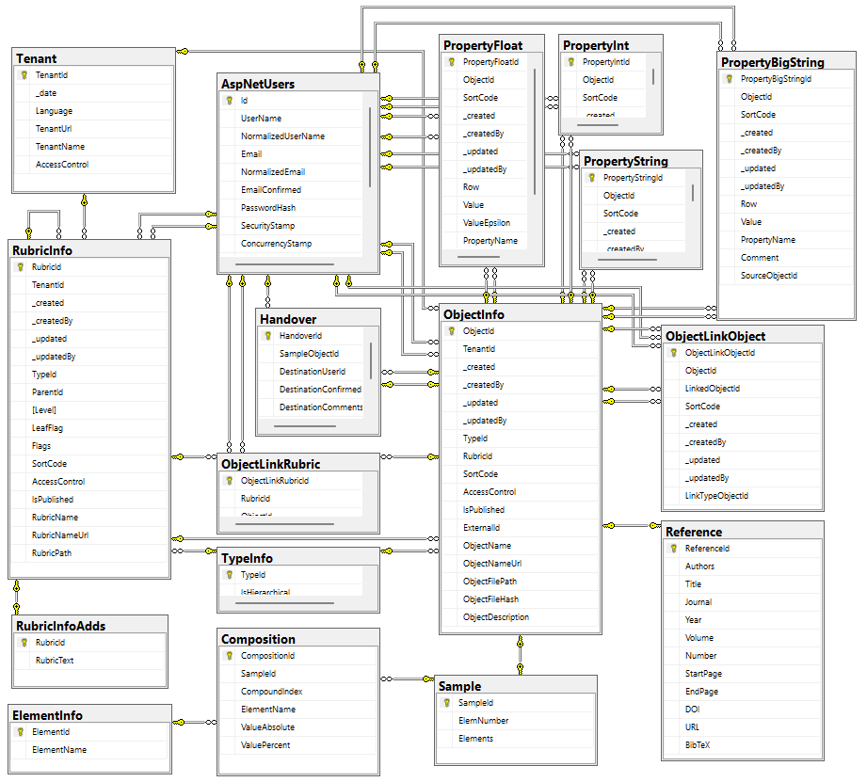

Data acquisition API: dashboards & datasets
The RDMS exposes all data as read-only views
and downloadable documents
API user can introduce any queries over views
POST /vroapi/v1/execute
Executes SQL statement and returns dataset (in JSON)
GET /vroapi/v1/download
Downloads document by specified identifier (ObjectId)
Database schema documentation:
https://crc1625.mdi.ruhr-uni-bochum.de/home/doc
https://crc1625.mdi.ruhr-uni-bochum.de/home/doc

Slide 39
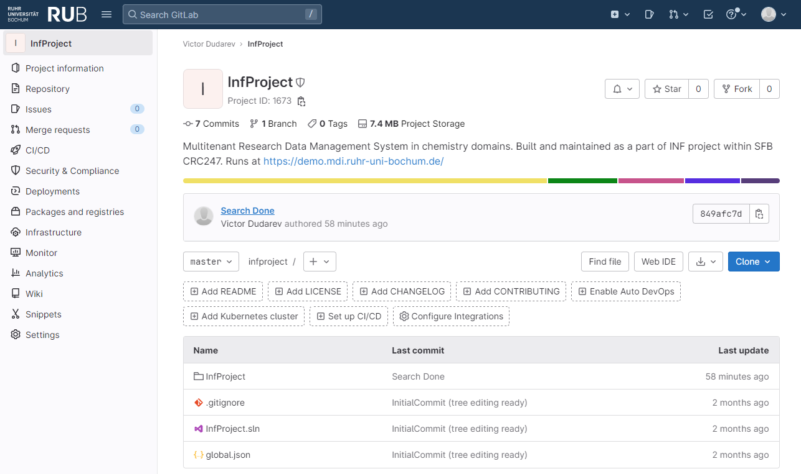

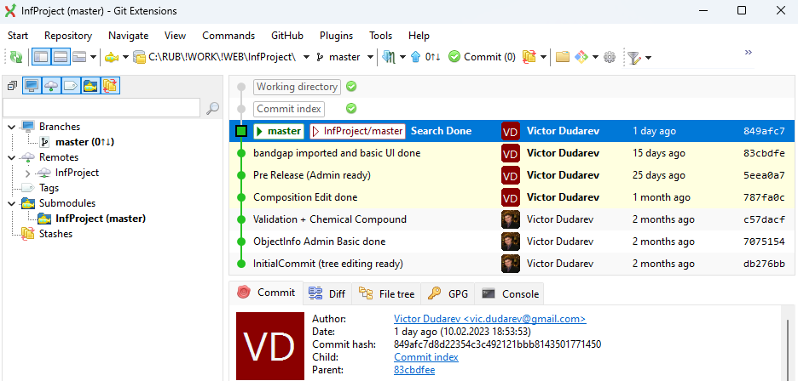



Core RDMS Contributions:
Pull Requests, etc
Everybody’s welcome!
Feel free to contribute to open source!
Core INF project:
https://gitlab.ruhr-uni-bochum.de/vic/infproject
Shared projects:
1) Administration User Interface (Identity Manager UI):
https://gitlab.ruhr-uni-bochum.de/vic/identitymanagerui
2) Web Application General Library (WebUtilsLib):
https://gitlab.ruhr-uni-bochum.de/vic/webutilslib
https://gitlab.ruhr-uni-bochum.de

Slide 40

RDMS Free Playground
  https://inf.mdi.ruhr-uni-bochum.de/
Playground to test RDMS (multiple tenants with shared users list):
https://inf.mdi.ruhr-uni-bochum.de/
Login and Password (User role): User1@user.org
Login and Password (PowerUser role): PowerUser1@user.org
Login and Password (Administrator role): Admin1@user.org
https://demo.mdi.ruhr-uni-bochum.de/
https://inf.mdi.ruhr-uni-bochum.de/
Notes:
https://qr.io/

Slide 41
Announcement: Second RDMS Hands-on Session
When:
Today at 15:20 (till 16:00)
What (possible topics):
  Questions and Answers Session
  Practical use of RDMS (How do I…)
    Upload data
    Create a template (set-up form / table format)
    Search for data
    Use API to extract the data
    Write my own data validation/extraction service & integrate it with RDMS
  Discussions on Data Management (features, workflows, reports, API, etc…)

Slide 42
Thanks for your kind attention
Questions & Answers
Victor Dudarev
Victor.Dudarev@rub.de
https://vdudarev.ru

Slide 43

Research Workflow
and RDMS Object Types Interconnection
Research workflow support in RDMS
Defines characterizations
Provides report on samples & measurements
Idea or Plan
Calculation / Compu-tational Composition
Sample
Treatment:
annealing,
oxidation,
polishing, …
Sample_2
Report
Request for Synthesis
Characterisation:
EDX, XRD, Resistance, Bandgap, …
Characterisation:
EDX, XRD, Resistance, Bandgap, …
EDX – Energy-Dispersive X-ray spectroscopy (to determine composition) XRD – X-Ray Diffraction (to determine crystallographic structure)
RDM Image source: Yazdi, M., Politze, M. and Müller, M. (2024) ‘A Novel Approach to Outlining Research Data Management Life Cycle: A Case Study’, Research gate, accessed 15.05.2024

