Slide 1
Current state of RDMS
Victor Dudarev
Dreams come true… but slowly
RDMS: Research Data Management System

Slide 2
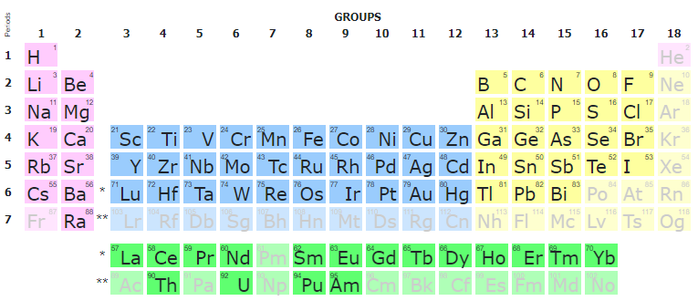

RDMS Core Features
Support for multiple Tenants;
Custom Project Tree & Objects Management
Batch Import of Documents
Extensible object Properties;
User-defined Object Type support:
  Document Validation
  Data Extraction
  Data Visualization
  Properties Templates
  Table Templates
Handover
Reporting
UI Customization
System
(qualitative composition)
Co-O
Substance
(quantitative composition)
Co₃O₄
Modification
(crystal structure type)
β-Co₃O₄
…
RDMS: Research Data Management System

Slide 3
Tenants
Multiple Tenant Support

Slide 4
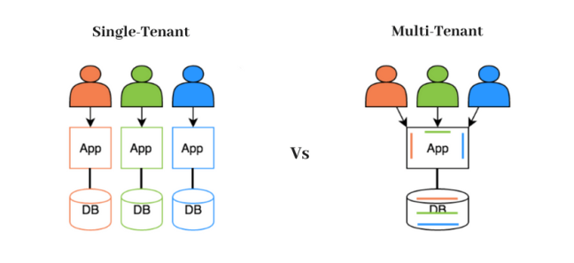
RDMS: Multiple Tenant Support
What is a Tenant?
Short answer:
Tenant – separate (distinct) instance of a software application that
is used by an organization / group of users / consortia.
Long answer:
Tenant is a customer account that has its own set of users, data, and configuration settings, and is isolated from other tenants in the same software application. This concept is commonly used in Software as a Service (SaaS) applications, where a single software application is hosted in the cloud and is made available to multiple customers as separate tenants. This allows each customer to have their own instance of the application, with their own data, settings, and customizations, while still sharing the underlying infrastructure and resources of the application.
Conclusion:
Tenants are useful for separate SFB projects / workgroups / materials data repositories. For example:
          MDI: https://mdi.matinf.pro
          CRC 1625: https://crc1625.mdi.ruhr-uni-bochum.de
Every tenant must have a unique URL!
https://en.wikipedia.org/wiki/Multitenancy

Slide 5
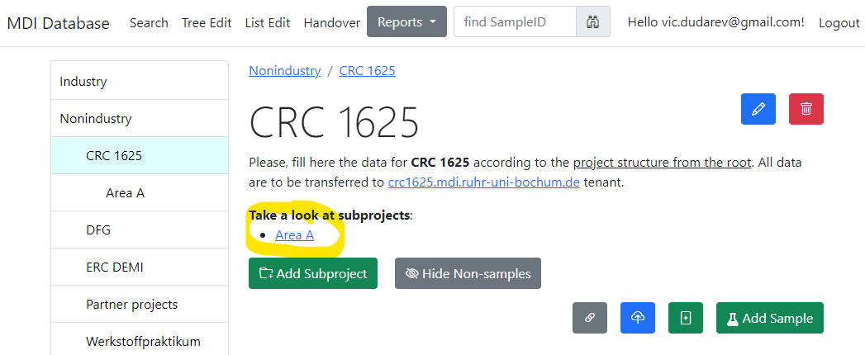
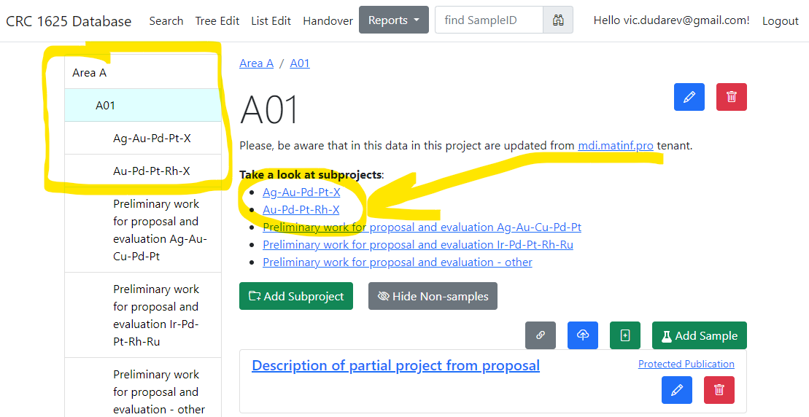
RDMS: Data transfer between tenants
Data from MDI tenant
(Nonindustry / CRC 1625 project) transferred to
CRC 1625 tenant
Automatic Data Transfer
(on a daily basis)

Slide 6

Security
Access levels, Roles, Authorization…

Slide 7
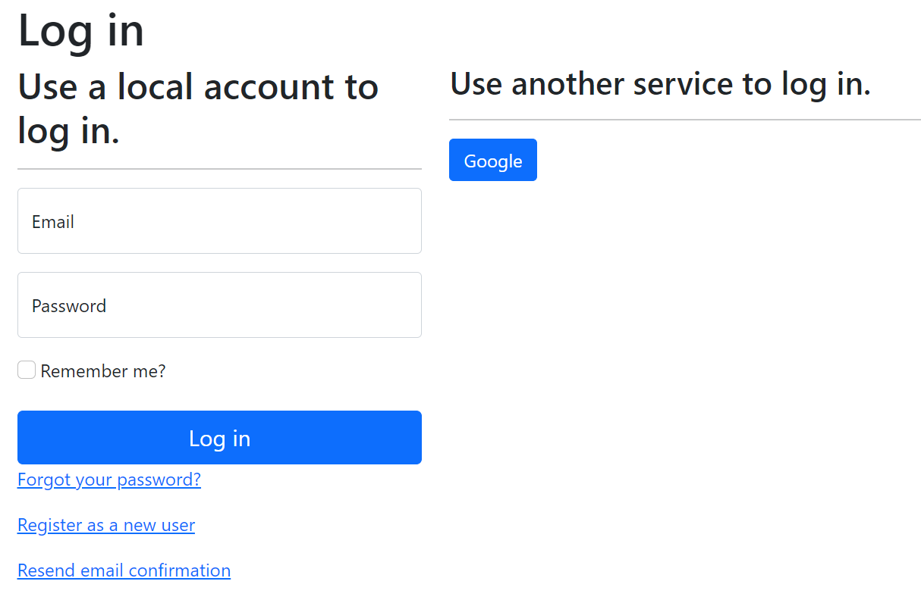
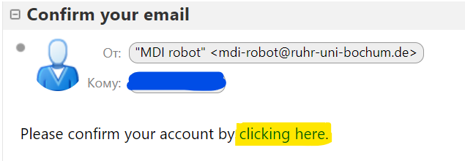
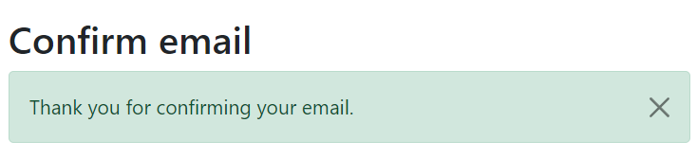
RDMS: Registration and Authorization
https://crc1625.mdi.ruhr-uni-bochum.de
Application access level is determined by the current user context.
Two-way registration (choose any):
using external provider (OpenID Connect), e.g. Google (external authentication authority is used, no credentials are stored locally).
using local account (credentials are stored internally);
In both cases, an e-mail address is required, and its successful verification is a prerequisite for access.
After e-mail confirmation, the user is considered active, but does not have an assigned user group.
https://openid.net
https://en.wikipedia.org/wiki/Authentication
https://en.wikipedia.org/wiki/Authorization

Slide 8
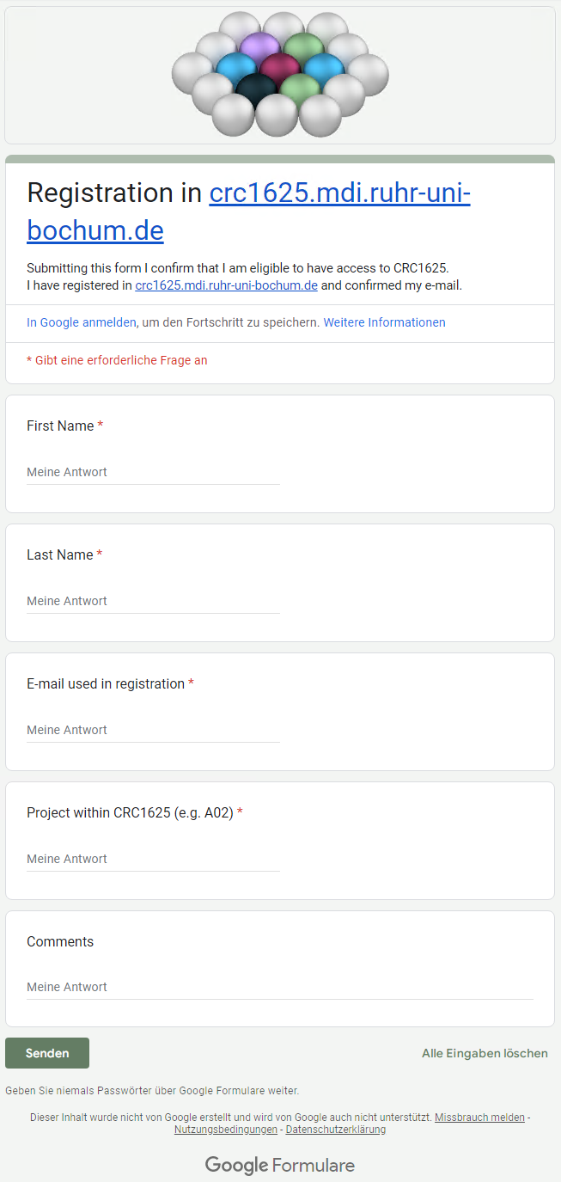
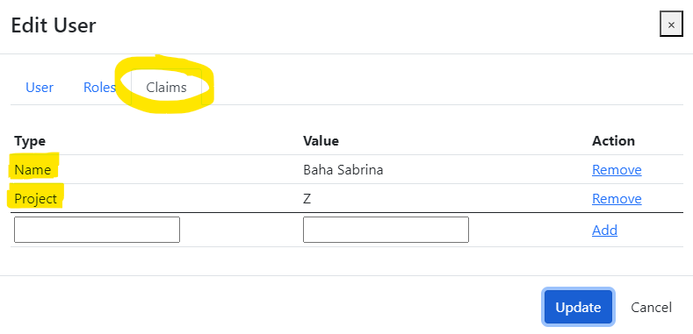
RDMS: how to register
Production (https://crc1625.mdi.ruhr-uni-bochum.de):
You need to register with Google account or create your own account (email/password) and confirm e-mail (warning: user created with no role assigned).
Fill the access request form https://forms.gle/F1kcKUoaFccBWHoBA, specifying your e-mail, used in registration, your name, project (e.g. A02) and optional comments.
Wait… After manual processing you will be assigned by default a PowerUser role and you are in power of adding data ))
Important for Administrators!
Please, assign the following claims:
Name
Project
Notes:
https://qr.io/

Slide 9
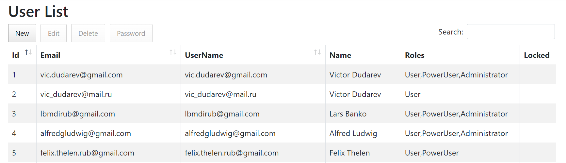
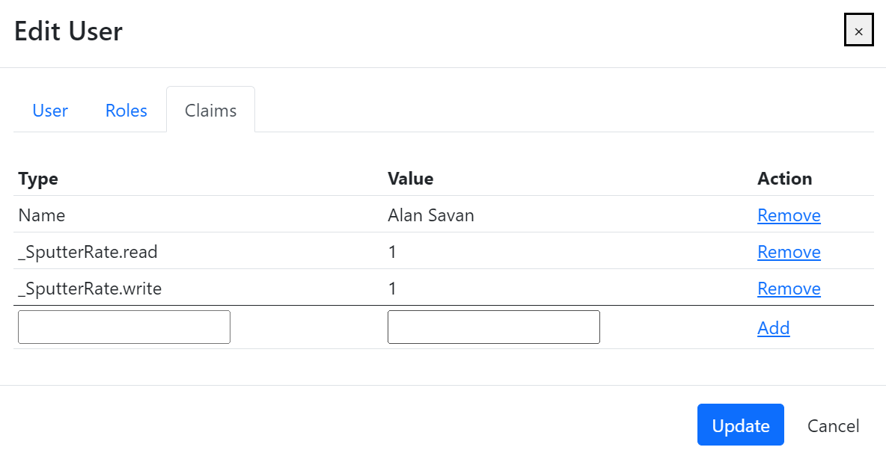
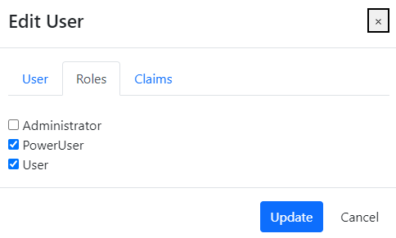
RDMS: Identity User Control Interface
Features:
Registered users management
Roles management
Claims management
Claim is a piece of information (key-value pair) that describes a user. Claims are stored in a user's identity and can be used to determine what actions a user is authorized to perform, such as accessing certain pages or resources.
https://learn.microsoft.com/en-us/aspnet/core/security/authentication/identity

Slide 10
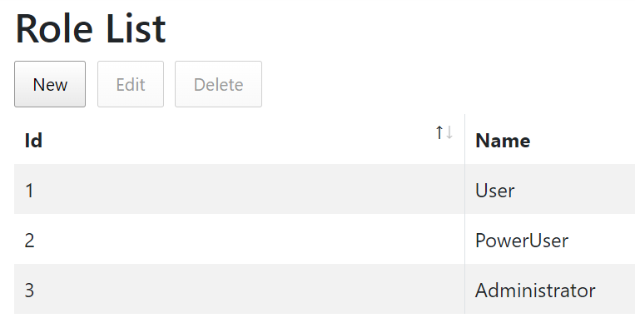
RDMS: Predefined Roles
Roles:
User:
    - read-only access to public and protected data
PowerUser:
- read-only access to public and protected data (+ private data, created by the current user)
- add data (+ write access to data, created by the current user)
Administrator:
- full access to all data (CRUD)
- user management
Anonymous (== registered user with no roles assigned):
- read-only access to public data only (be aware: internet search engines will index public data)
https://en.wikipedia.org/wiki/Role-based_access_control

Slide 11
RDMS: Setting the Object Access Level
What is an Object?
Object (=document) is a data entry within RDMS that has user-defined access level and reflects an object of the real world (e.g. sample) or its model. Ultimately, object has it’s unique Web page (with unique URL address).
To establish data access policy Data Access Levels are introduced in RDMS.
Four Access Levels:
Public (for anonymous users, search engines):
    objects are available to everybody regardless of authorization (visible to internet search engines);
Protected (by default, visible to the community only):
- objects are visible to the community (available to authorized users with at least User role assigned);
ProtectedNDA (restricted visiblility):
- objects are visible to the authorized users with NDA claim set OR to Administrators;
Private (person’s secret, but open for Administrators):
- objects are visible to the user-creator (at least PowerUser role assigned);
- objects are visible to all users of Administrator role.
Protected is default in CRC 1625
NDA - Non-Disclosure Agreement

Slide 12
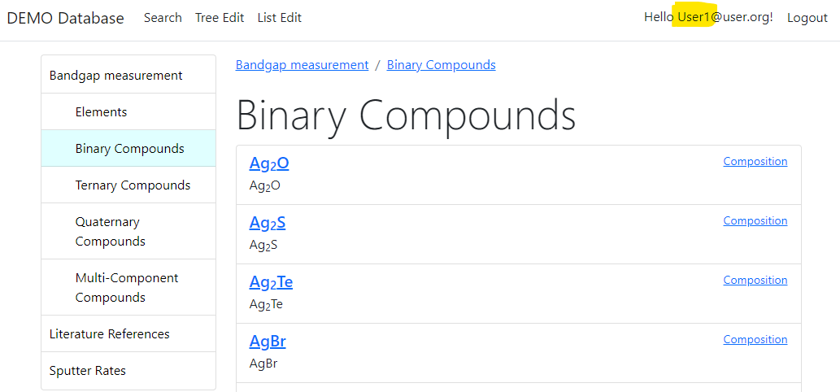
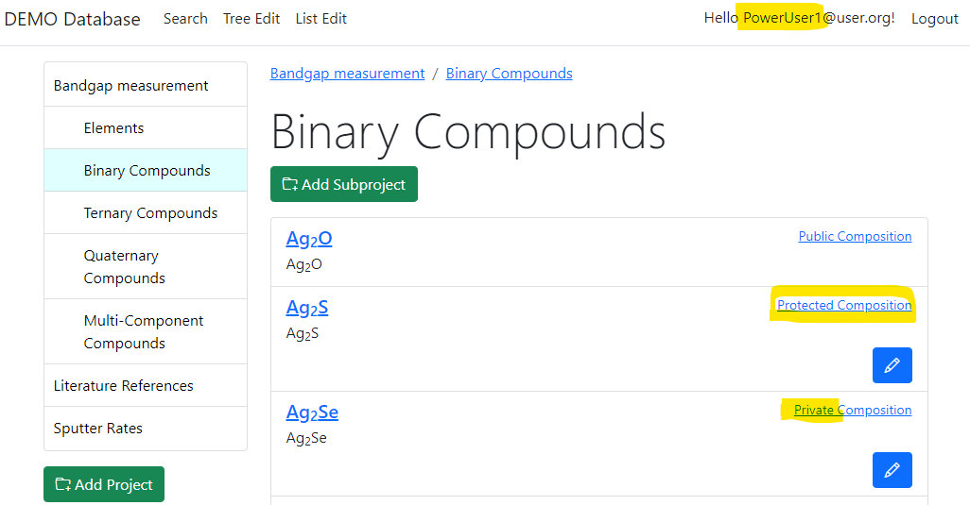
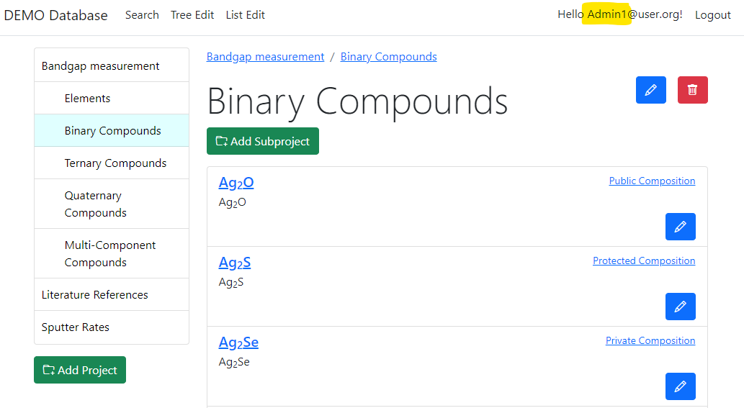
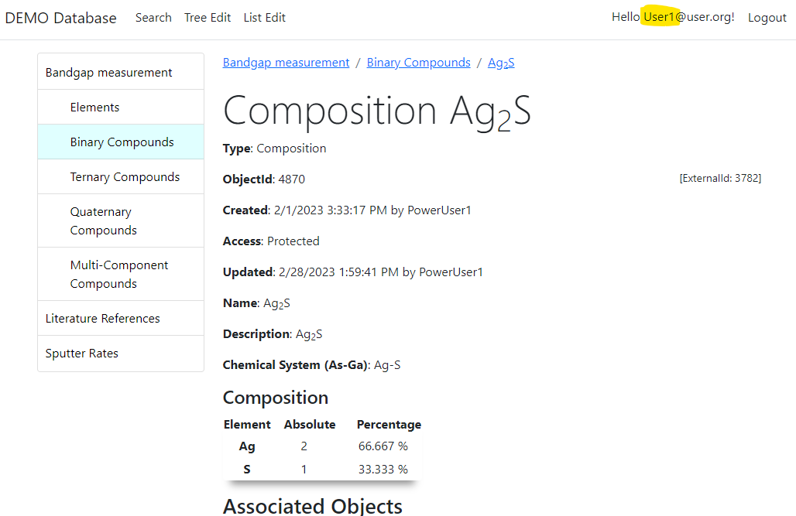
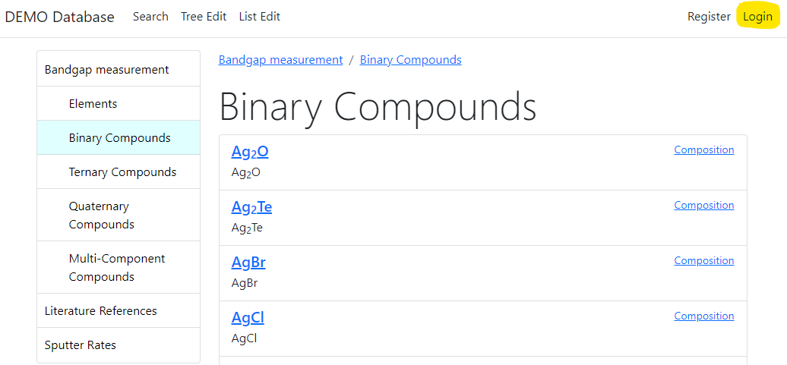

RDMS: Adjust Functionality According to User Permissions
User credentials (role) affects user interface: https://demo.mdi.ruhr-uni-bochum.de/rubric/binary-compounds
User1 (User role) PowerUser1 (PowerUser role) Admin1 (Administrator role)
Authorized CRC Community
User (no role) = Anonymous (search engine)
Preconditions:
Ag₂O created (public) by Admin1
Ag₂S created (protected) by PowerUser1
Ag₂Se created (private) by PowerUser1
Accessible (visible)
Denied (hidden)
Visit
https://demo.mdi.ruhr-uni-bochum.de/object/ag2s-4870
User => access granted
Anonymous => access denied
Credentials for demo.mdi.ruhr-uni-bochum.de tenant:
Login and Password (User): User1@user.org
Login and Password (PowerUser): PowerUser1@user.org
Login and Password (Administrator): Admin1@user.org

Slide 13
Content
Project Tree & Data Objects
Batch import

Slide 14
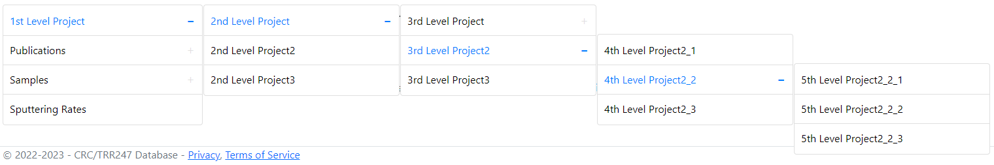
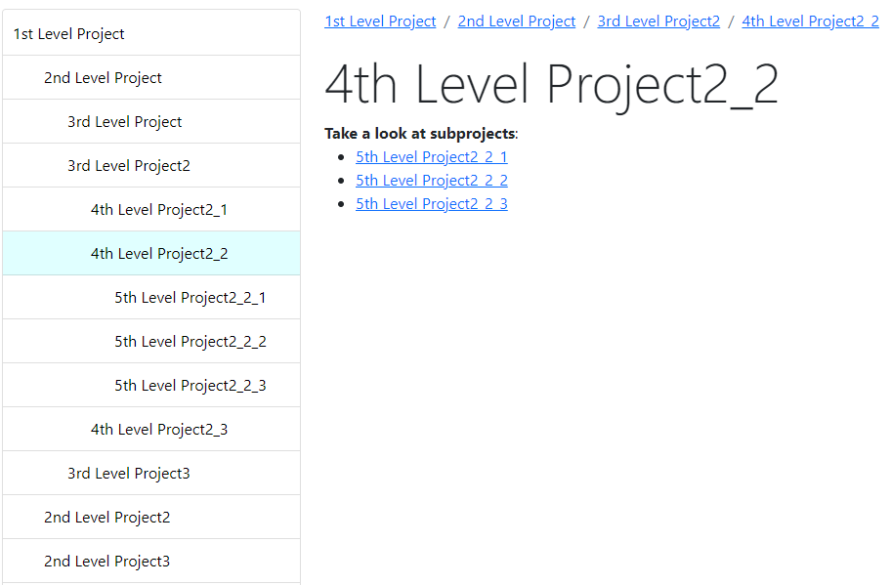
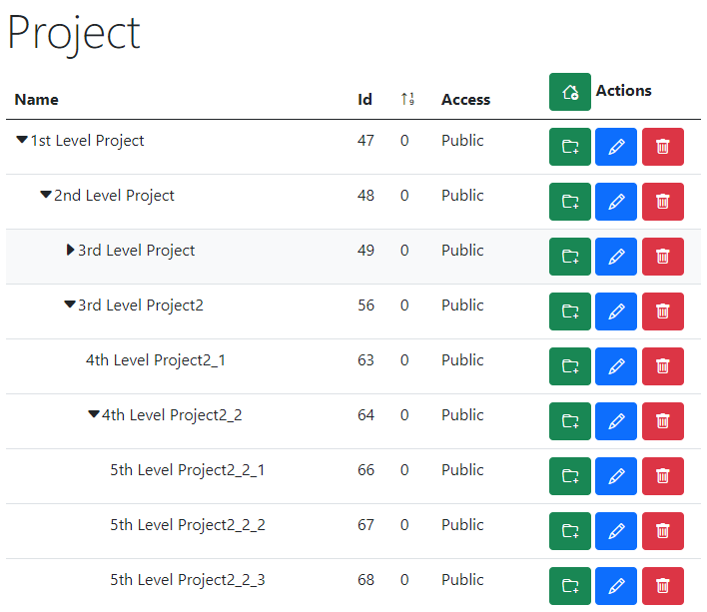
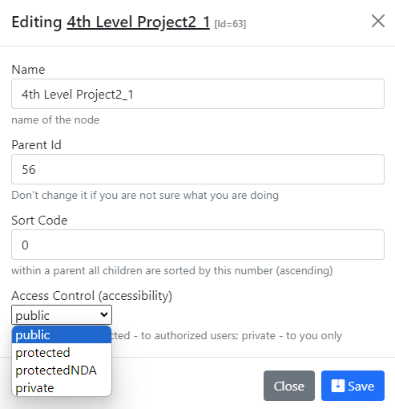
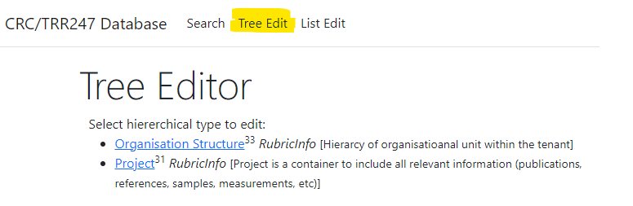
RDMS Project Tree: control and display
Display for users in Web Application
Control (admin):
Name
Parent Id
Sort Code
Access
https://demo.mdi.ruhr-uni-bochum.de/

Slide 15
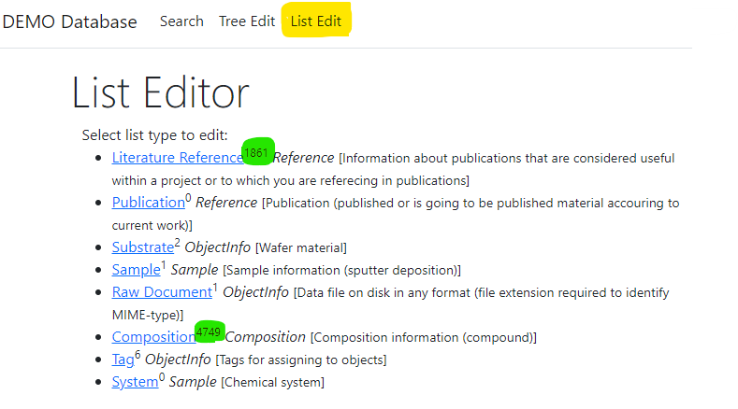
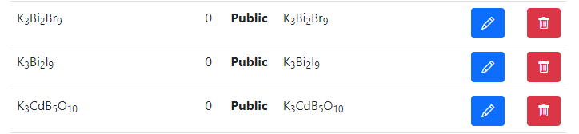
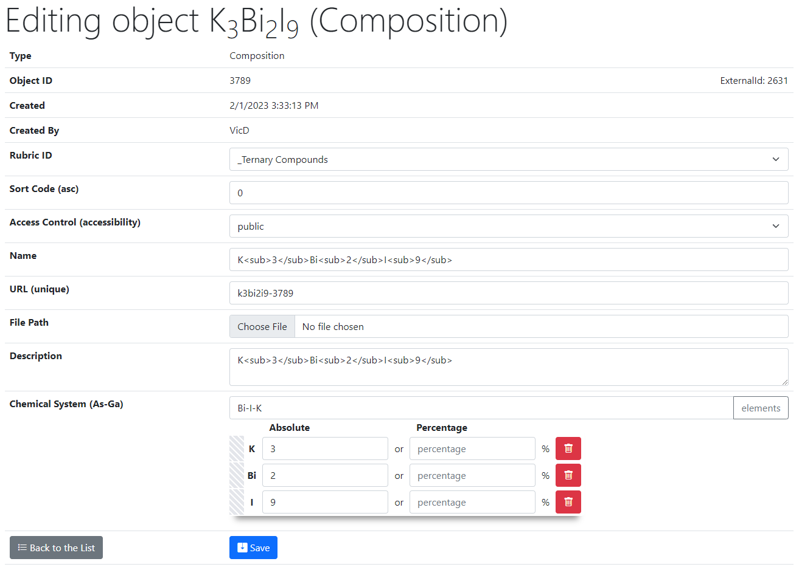
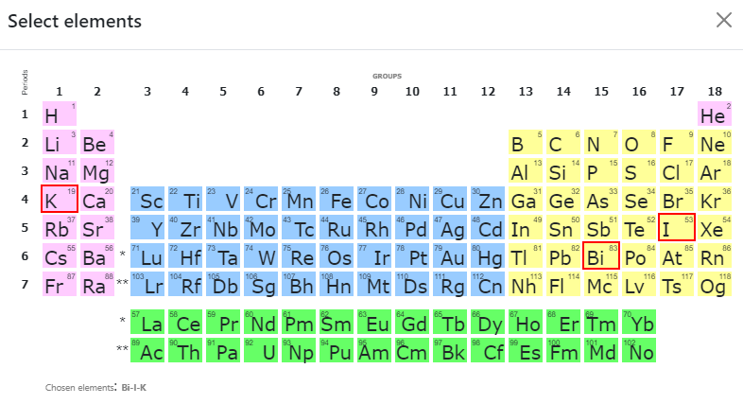
RDMS List Types: control
List of all objects (of type Composition):
Control (common to all objects):
Rubric Id;
Sort Code;
Access;
Name;
URL (adjustable*);
Attach File (document);
Description.
2
Type specific control (e.g. Composition):
Chemical System;
Composition (elements containment).
1
https://demo.mdi.ruhr-uni-bochum.de/
https://demo.mdi.ruhr-uni-bochum.de/adminobject/edititem/3789

Slide 16
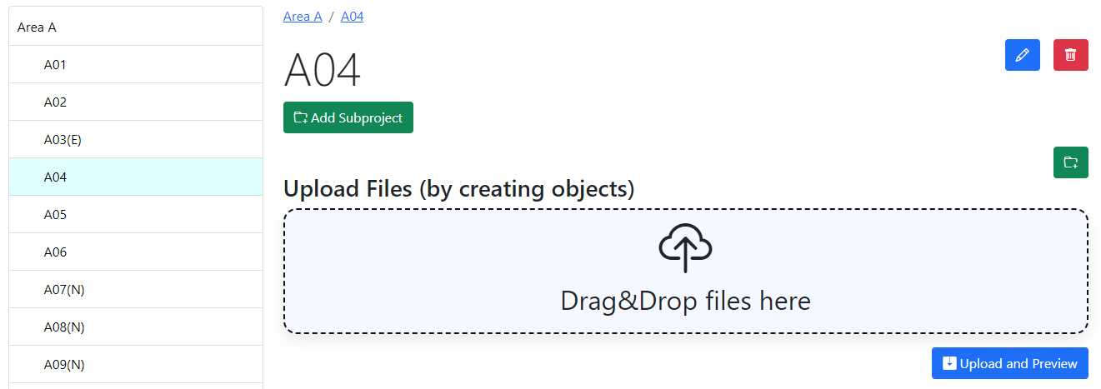
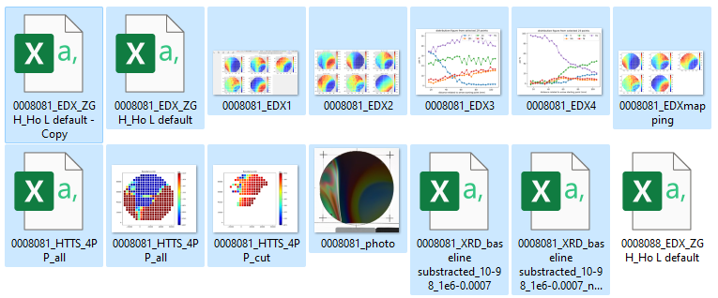
RDMS DropZone Tasks: Batch Data Validation & Import
Task: validate documents & import data
Implemented Features:
Automatic type detection;
Uniqueness check;
Data validation (build-in + external);
Data import.

Slide 17
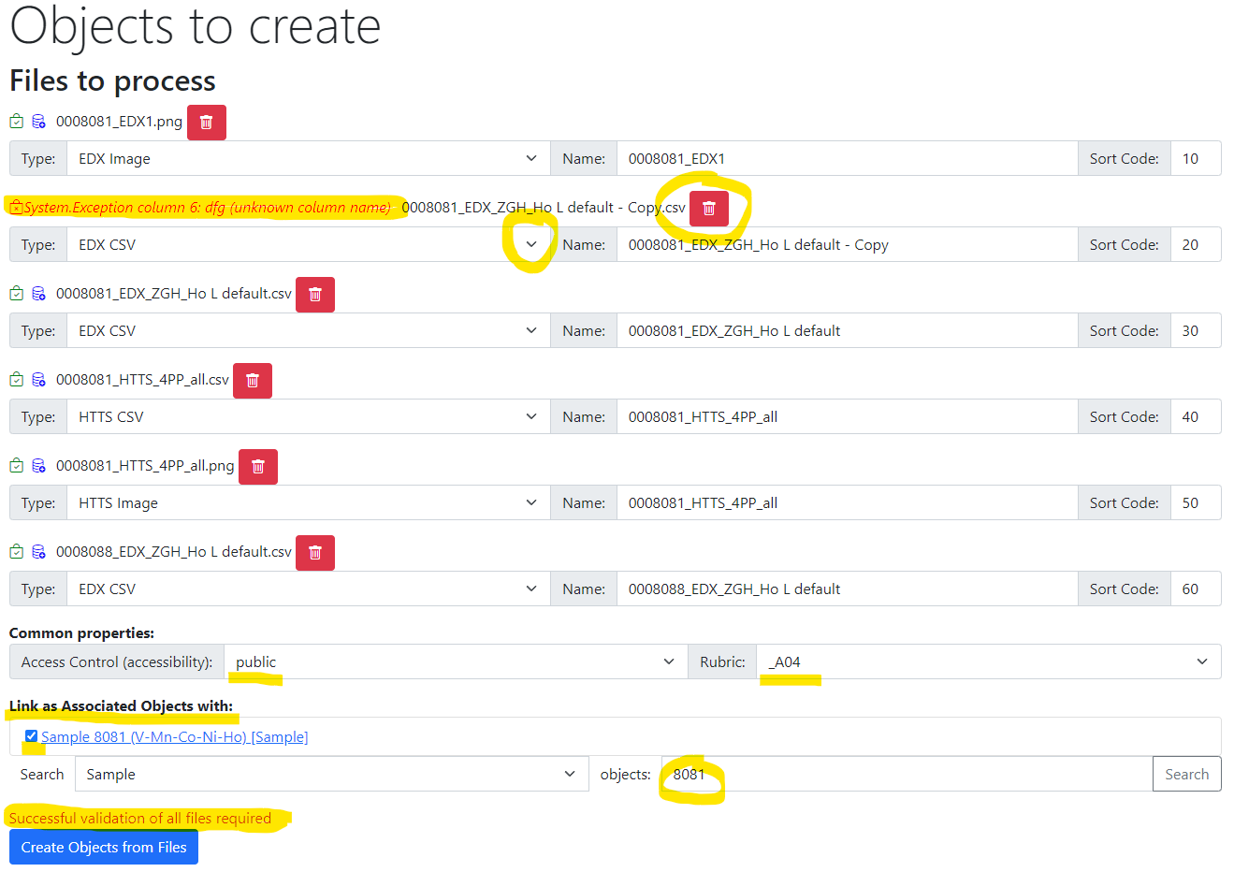
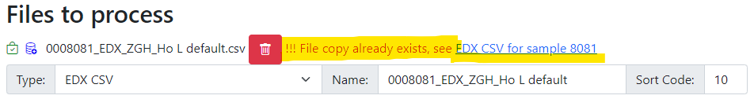
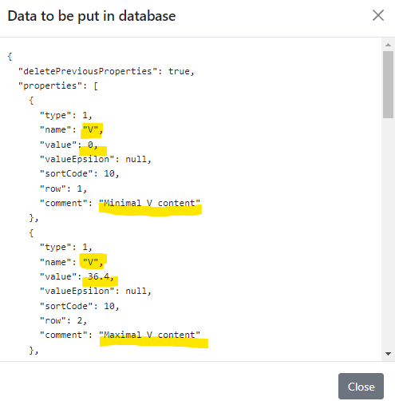
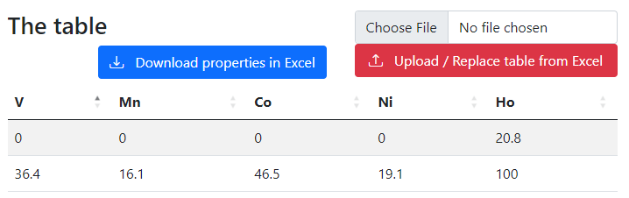
RDMS DropZone: Staged Files (before import)
Check for unique documents (based on SHA256 hash):
Check data to import:
Properties
(after import):
Workflow:
- validate every file;
- check/adjust all properties;
- Import files.

Slide 18
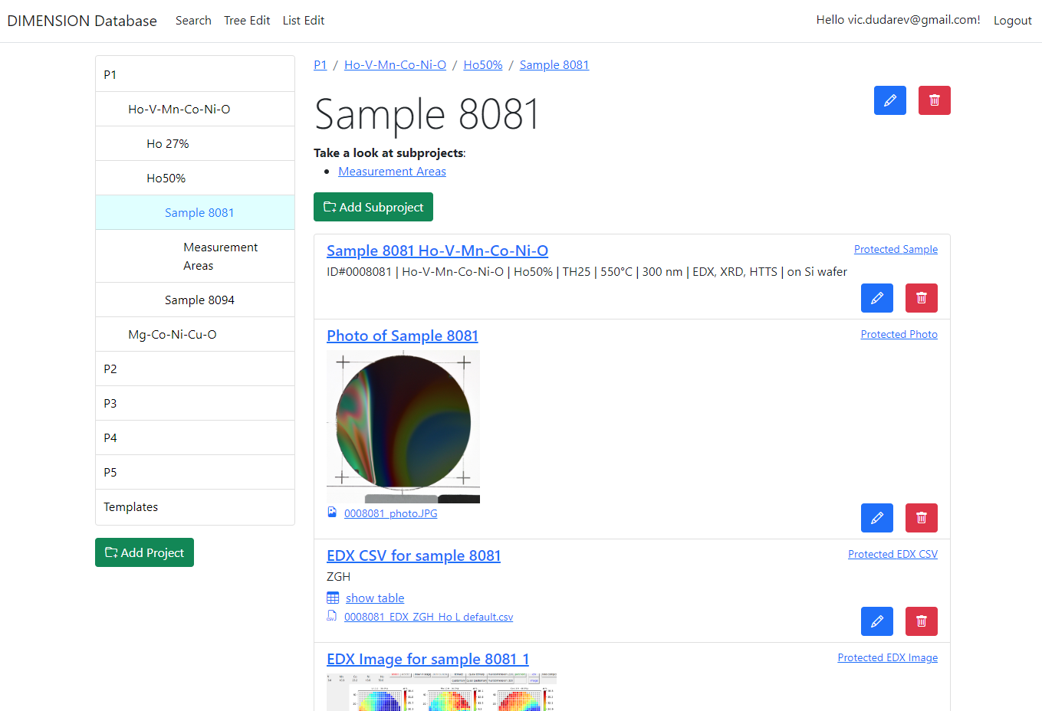

RDMS: Created Objects
After import:
- check all created objects (names, access level, etc…);
- share a link.

Slide 19
Properties
Extended Properties & Search

Slide 20
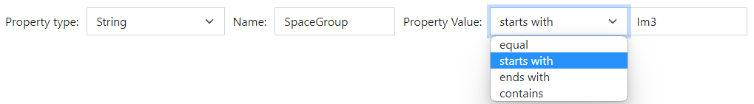
RDMS Extended Properties: the basics
Motivation: to extend object description by adding more data/metadata
All values are to be stored using appropriate data types!
DEFINITION: Data type is a collection or grouping of data values, usually specified by a set of possible values, a set of allowed operations on these values, and/or a representation of these values as machine types.
Supported data types (and their visualization in the search form):
Int – integer values (64-bit signed integer) in range [-9 223 372 036 854 775 808; 9 223 372 036 854 775 807].
Float – double-precision floating-point (8 bytes, IEEE-754), ±5.0×10⁻³²⁴ to ±1.7 × 10³⁰⁸.
String – any characters sequence no longer than 4096 symbols.
BigString – any characters sequence no longer than 2 147 483 647 symbols (2 Gb).
https://en.wikipedia.org/wiki/Data_type

Slide 21
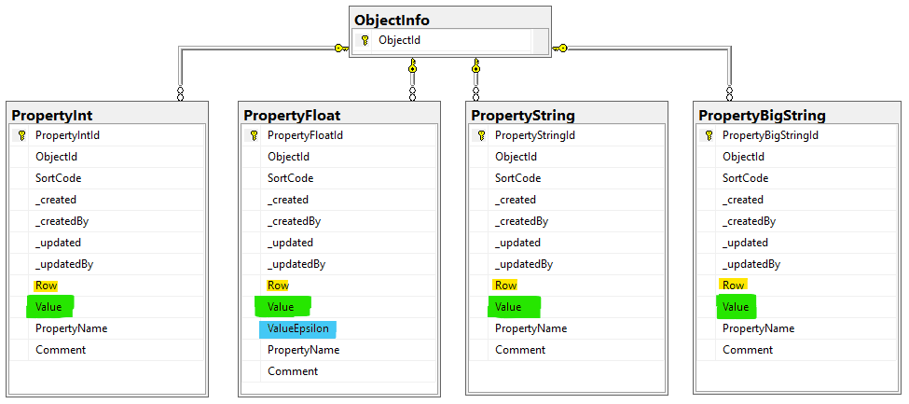
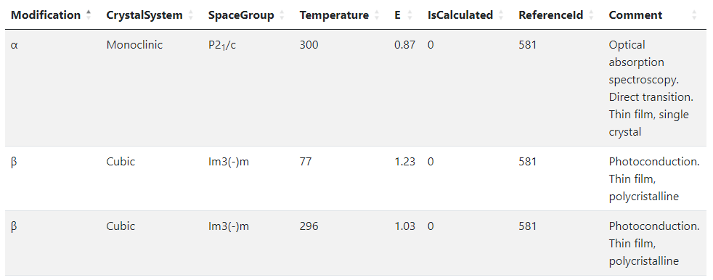
RDMS Extended Properties: Representing Table Data
Use case: add additional properties values (or even a table) to object and afterwards make search on them.
OR
When the existing fields set is not enough…
Task: associate table with object
Row=1
Row=2
Row=3
String x3
Float x2
Int x2
String
Solution: Decompose the table so, that each cell value is stored in Property* table according to cell value type.
Important attributes:
PropertyName – contains column name
Value – contains cell value
Row – contains row number (1, 2, 3, …). If no row number specified – value is threated as object’s property
User view: https://demo.mdi.ruhr-uni-bochum.de/object/ag2s-4870
Admin view: https://demo.mdi.ruhr-uni-bochum.de/adminobject/edititem/4870

Slide 22
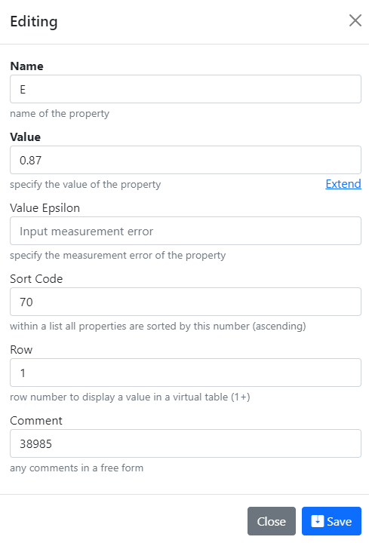
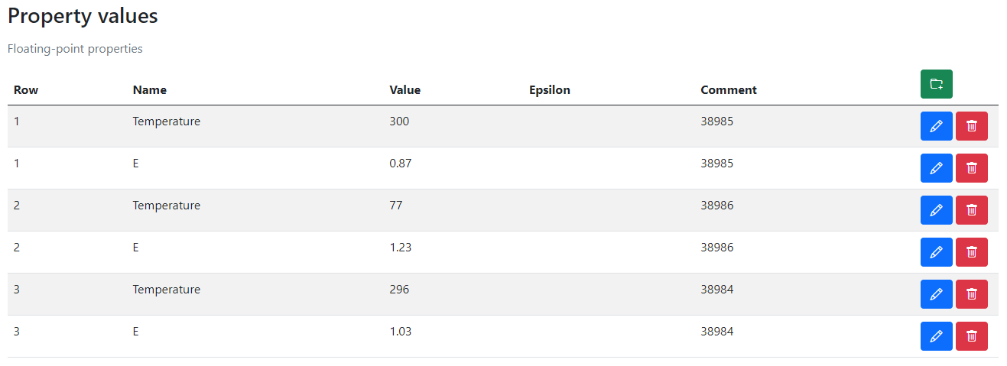
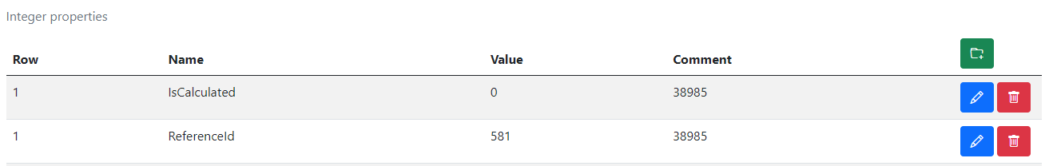
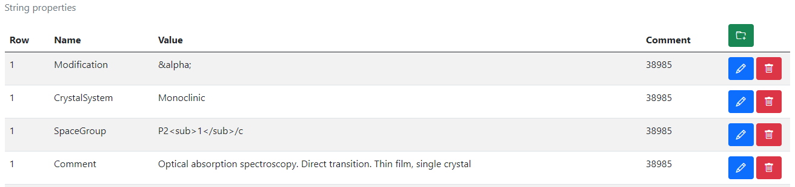
RDMS Extended Properties: Control
Extended Properties Control for object is available according to the object access managements in administration panel for objects.
User view: https://demo.mdi.ruhr-uni-bochum.de/object/ag2s-4870
Admin view: https://demo.mdi.ruhr-uni-bochum.de/adminobject/edititem/4870

Slide 23
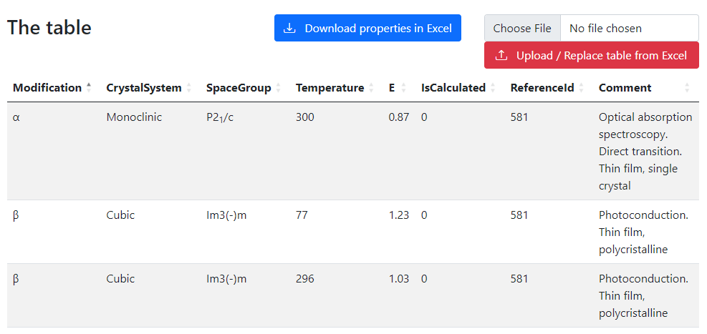
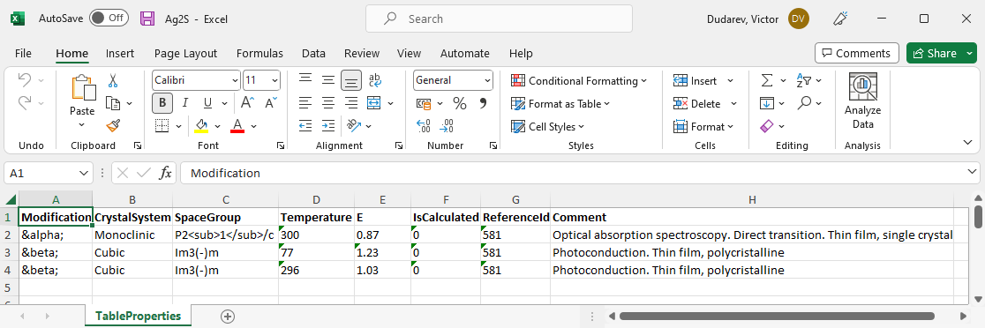
RDMS Extended Properties: Export and Import
Task: make properties modification easy
Steps:
Download data
Open in Excel and edit
Upload changed data back to the RDMS
Import
(requires permissions)
https://demo.mdi.ruhr-uni-bochum.de/object/ag2s-4870
Export
https://demo.mdi.ruhr-uni-bochum.de/object/ag2s-4870

Slide 24
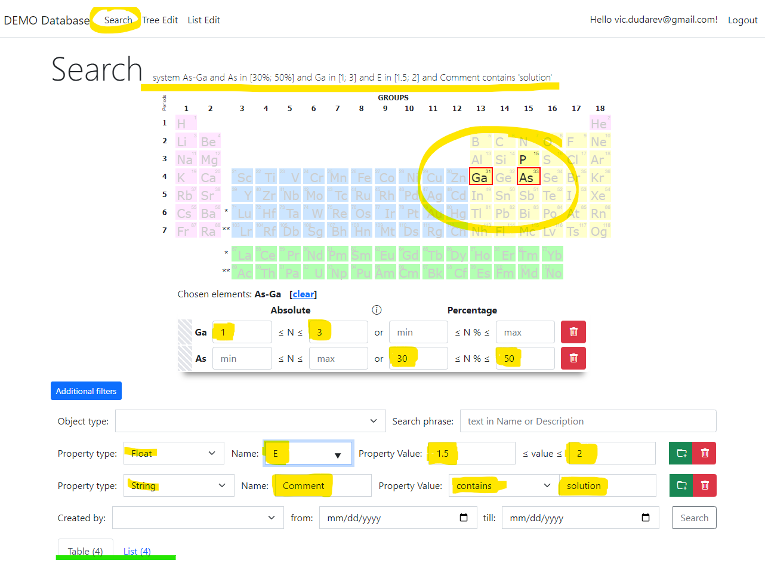
RDMS: Search
Search on:
Chemical system
Composition
Object type
Phrase in object’s Name or Description
Properties values (all available within tenant)
Person created
Creation date
Important feature:
persistent URL on search (share search results easily by URL*).
* - respecting current security context
https://demo.mdi.ruhr-uni-bochum.de/search/
https://demo.mdi.ruhr-uni-bochum.de/search/?system=As-Ga&typeid=8&Aspctmin=30&Aspctmax=50&Gaabsmin=1&Gaabsmax=3&pr0name=E%3Csub%3Eg%3C%2Fsub%3E&pr0type=Float&pr0min=1.5&pr0max=2&pr1name=Comment&pr1type=String&pr1max=3&pr1str=solution&prcnt=2
https://demo.mdi.ruhr-uni-bochum.de/search/?system=As-Ga&typeid=8&Aspctmin=30&Aspctmax=50&Gaabsmin=1&Gaabsmax=3&pr0name=E%3Csub%3Eg%3C%2Fsub%3E&pr0type=Float&pr0min=1.5&pr0max=2&prcnt=1

Slide 25
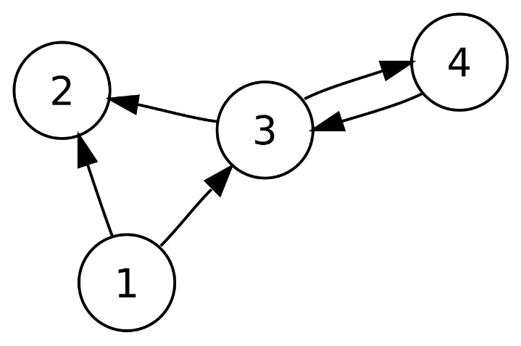
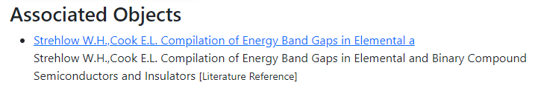
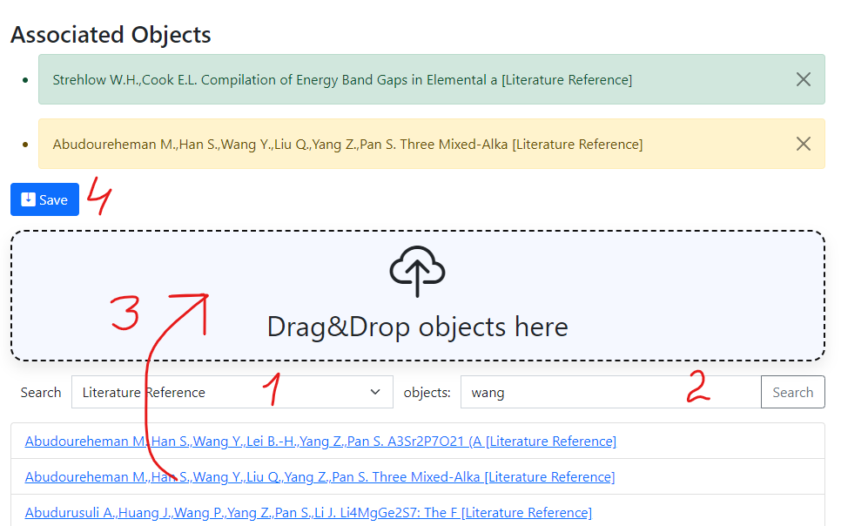
RDMS: Interlink Objects
Example: literature reference for published data on composition
To add associated objects:
0) Go to “List edit” or select object to edit
1) Select associated object type (optional filter)
2) Input search phrase, contained in the Name of desired object to be associated
3) Drag & Drop desired object(s) from search result list to the area / adjust list
4) Save changes
Important: Reverse associations allow to browse reverse- directional associations, such as finding all compounds mentioned in a particular literature reference.
User view: https://demo.mdi.ruhr-uni-bochum.de/object/ag2s-4870
Admin view: https://demo.mdi.ruhr-uni-bochum.de/adminobject/edititem/4870

Slide 26
UDT & Extensibility
User Defined Types & Customisation

Slide 27


User-Defined Type Support
Motivation: to support new user-defined object type (UDT) without modifying core RDMS source code
Given: New object type with/without a new arbitrary file format (could be new measurement type result).
Solution (or 5 keys to success):
Templates – define object model (data structure) in terms of key-value pairs / table (properties)
Search – enable search for UDT objects based on defined data model
Validation – provide check for data correctness (valid/invalid)
Data Extraction – if valid, extract data in terms of properties / related object creation
Visualization – display data, including drawing charts / diagrams, etc…
UDT – user-defined type

Slide 28
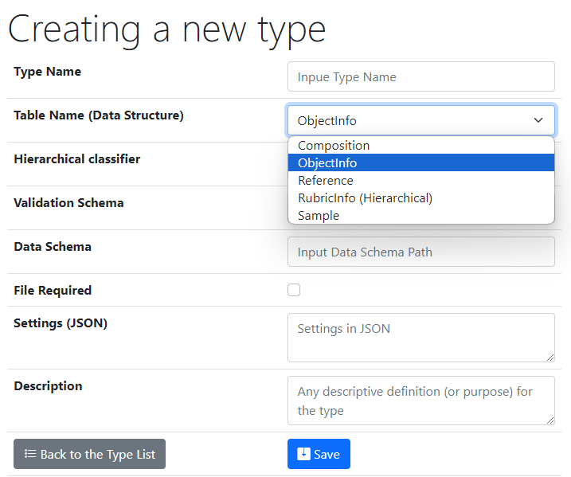
UI to create a new user-defined type
One of predefined base types
Type Name – user-defined type name
Core Object Types:
ObjectInfo – the simplest (bare) object
Sample – chemical system (set of chemical elements), for example Co-O
Composition – chemical composition (set of elements and quantities), for example Co₃O₄
Reference – literature reference (Authors, Title, Year, DOI, etc.)
Validation & Data Schema – only if you have external Web Services ready to validate & extract data from files
File Required – sets the file mandatory (boolean)
Settings (JSON) – type customization in RDMS
{ "CustomEditPath": "/custom/editsample",
"UrlPostVisualizer": "https://abc.de/VisualizeRT" }
Description – comments for type designation
Defining data & behavior
We can further enrich defined object specification by customized (templates!) properties of primitive types: Integer, Float, String.

Slide 29

Ways of customization
Basic (no-code)
  Introducing User-Defined Data Types:
    - List templates
    - Table templates
Simple (client-side code only)
  Page-code injection:
    - HTML
    - Javascript
    - CSS
Shortly illustrated in today’s talk
Development abstraction layers
easy hard
data layout workflow application
External API (server-side code only)
  Validation & Data Extraction for User-Defined Data Types (any language)
Complex (client- & server-side code)
  INF-code adjust (ASP.Net Core App)
    - C#
    - SQL
    - HTML/Javascript/CSS
Complexity

Slide 30
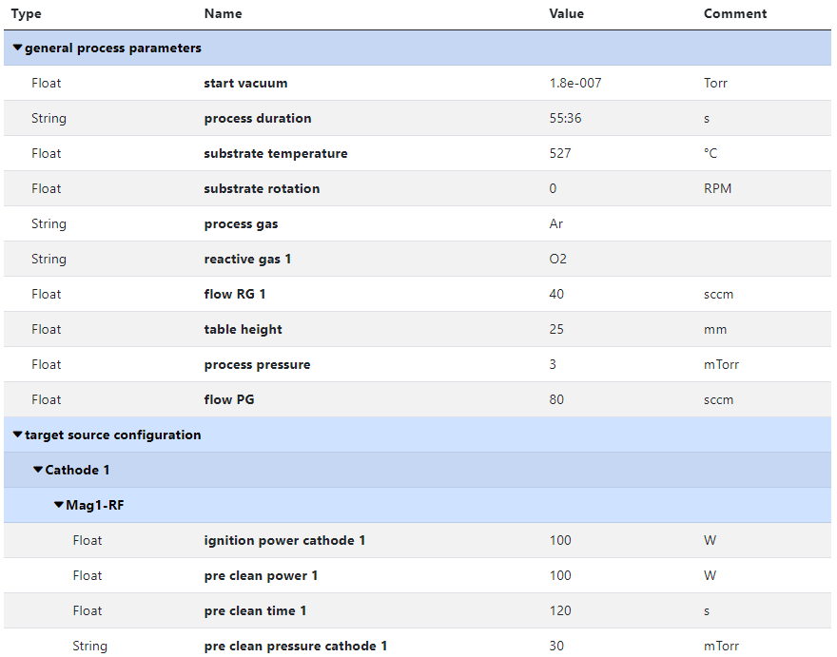
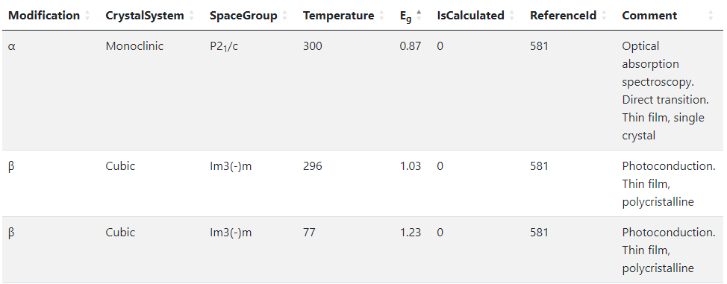



RDMS no-code customisation: Templates for object type
Template
List
(specify sorted properties list with separators)
Create an object with “_Template” name
Specify properties set for a type
Table
(specify table structure: columns & types)
Data in a table with predefined structure
Key-value pairs
https://crc247.mdi.ruhr-uni-bochum.de/object/synthesis-for-sample-8220-co-deposition-221111-k3-3-1922
https://demo.mdi.ruhr-uni-bochum.de/object/ag2s-4870

Slide 31
Customisation via External Services
Motivation: support new data formats (models) without RDMS code change
Solution: RDMS can calls external services to get assistance dealing with new data formats with respect to:
Validation
Data Extraction
Visualisation
To provide full object type support (as if it was natively implemented in RDMS) one needs to implement three Web Services

Slide 32

Validation from RDMS perspective: API makes it flexible
Provide a validator for every object type in configuration:
type: built-in type (object instantiated by class name);
https: URL to a REST Service (OpenAPI specification).
{
"Code": 0,
"Message": null,
"Warning": null
}
type:TypeValidationLibrary.TypeValidator_EDX_CSV (interface IFileValidator)
https://validation.matinf.pro/edx/validation
valid
Validation result
via external API call
External service decision
invalid
type
{
"Code": 500,
"Message": "error text",
"Warning": null
}
API – Application Programming Interface
URL – Uniform Resource Locator
REST – REpresentational State Transfer

Slide 33
Type configuration: Data Extraction (external Web Service)
Data extraction & conversion to table tasks are delegated to an external service
Data Extraction
Request URL: HTTPS_DataSchema + ("/databasevaluesbody" | "/tablebody")
Example: Data Schema (for EDX): https://validation.matinf.pro/edx/data
/databasevaluesbody
/tablebody
Data
IDatabaseValuesGetter: properties, compositions, properties for measurement areas
Table
ITableGetter: arbitrary table
(used for table visualisation)
Request URL (data): https://validation.matinf.pro/edx/data/databasevaluesbody Request URL (table): https://validation.matinf.pro/edx/data/table
see next slides…
Data schema values (current status):
{
"DataTable": [
{
"Index": "1",
"V": 31.3,
"Mn": 2.7,
"Co": 22.6,
"Ni": 6,
"Ho": 37.4
},
...
],
"Coordinates": {
"CoordinateNames": [],
"HasCoordinates": false
},
"Dependencies": {
"DependencyNames": [
"Index"
],
"HasDependencies": true
}
}
Data Schema | Comments | Author
type:TypeValidationLibrary.TypeValidator_EDX_CSV | EDX | Victor
https://validation.matinf.pro/edx/data | EDX | Victor
https://htts.matinf.pro/resistance/csv/data | HTTS Resistance CSV | Azadeh
https://htts.matinf.pro/resistance/txt/data | HTTS Resistance TXT | Azadeh
https://thickness.matinf.pro/thickness/xlsx/data | Thickness XLSX | Azadeh
https://thickness.matinf.pro/thickness/txt/data | Thickness TXT | Azadeh
https://validation.matinf.pro/

Slide 34



RDMS: Data Visualization
Materials Library Visualization
Configurable XY-charts
https://dim.mdi.ruhr-uni-bochum.de/file/csv/6691

Slide 35





Sample Customised Form
List from subproject
- Customised sample input
List from JS-template
Standard chemical system
Customisation with UI form / JS
https://crc1625.mdi.ruhr-uni-bochum.de/custom/editsample/0/?idr=1079&returl=%2Frubric%2Fa01_ag-au-pd-pt-x

Slide 36


Use Case: Sample Transformation Workflow
Create Processing State & Split Sample
Sample_2a_2
(subsample 2a state 2)
polishing
Documents2a_2
Sample_2a
(subsample 2a)
Sample
(initial state)
annealing
Sample_2
(changed state 2)
splitting
Sample_2b_2
(subsample 2b state 2)
oxidation
Sample_2b
(subsample 2b)
documents
documents2
Documents2b_2
https://crc1625.mdi.ruhr-uni-bochum.de/custom/editsample/11098/?idr=1079&returl=%252Frubric%252Fa01_ag-au-pd-pt-x

Slide 37
Materials Libraries
Heterogeneous Measurement Data Integration
Reporting
Handover

Slide 38

Materials Library: integrating heterogeneous data
Typical Materials Library Data Lifecycle:
Sputtering:
Add Sample object (chemical system + substrate)
Add Synthesis object (sputtering parameters)
Characterisation:
Add processed EDX (342 Composition objects)
  Composition == Measurement Area
Add Other Characterisation Documents (Photo, XRD, Resistance, Thickness, Bandgap, etc…)
Storage, Curation, Search (on properties retrieved from devices / file formats), Reporting:
Find compositions with given properties in a certain range (across all known materials libraries)
Find by synthesis parameters
Find by chemical system / creation date / author / text / properties, etc…
Reports
Measurement Area
(composition)
Phases: [ Phase₁,
…, Phase_{N} ]
Resistance: __ Ohm
Thickness: __ nm
Bandgap: __ eV
…
ML – Materials Library
EDX – Energy-dispersive X-ray spectroscopy
XRD – X-ray diffraction analysis

Slide 39
Data extraction: adding data to Compositions (MAs)
{
"CompositionsForSampleUpdate": [
{
"Predicate": {
"Properties": [
{
"Type": 2,
"Name": "Measurement Area",
"Value": 1
}
]
},
"DeletePreviousProperties": false,
"Properties": [
{
"PropertyId": 0,
"Type": 1,
"Name": "R",
"Value": 34143346,
"ValueEpsilon": null,
"SortCode": 10,
"Row": null,
"Comment": "Resistance (Room Temperature) for Measurement Area 1"
}
]
},
...
],
"DeletePreviousProperties": true,
"Properties": [
{
"PropertyId": 0,
"Type": 1,
"Name": "R",
"Value": 97692.43229,
"ValueEpsilon": null,
"SortCode": 10,
"Row": 1,
"Comment": "Minimal Resistance (Room Temperature) of Materials Library (of all 342 MAs)"
},
{
"PropertyId": 0,
"Type": 1,
"Name": "R",
"Value": 34143346,
"ValueEpsilon": null,
"SortCode": 10,
"Row": 2,
"Comment": "Maximal Resistance (Room Temperature) of Materials Library (of all 342 MAs)"
}
]
}
Use case: adding characterization data after EDX is done.
Resistance for MA 1
Sample
EDX
composition
R
Resistance
x 342
Resistance range for object (whole ML)
Data import:
Locate parent sample object.
Find measurement area collection.
Find a certain Measurement Area (corresponding to a predicate, e.g. MA index).
Add properties values to a composition corresponding to a measurement area index.
http://htts.matinf.pro/

Slide 40

Use Case: Sample -> EDX -> Resistance & Search
Create Project
Add Sample to Project
Add EDX document (342 Measurement Areas (MA), i.e. 342 Compositions)
Add Resistance document (associate property values to every MA)
Search for Composition with a given Resistance
Composition – object representing one of 342 measurement area
Container for other properties, associated with a certain measurement area
https://crc1625.mdi.ruhr-uni-bochum.de/search/?system=Ni-V&typeid=8&Nipctmin=15&Nipctmax=20&pr0name=R&pr0type=Float&pr0min=10000000&pr0max=11111111&prcnt=1

Slide 41



Tracking Samples or Handover event: initialisation
In “physically transferrable” objects (samples), find a green handover button
Select the recipient and press a blue button.
Select recipient
Specify Amount (optional)
Specify Comments
click

Slide 42



Tracking Samples or Handover event: delivering / delivered
Handover event is created
Recipient is notified by e-mail
3) Recipient should add comments and confirm the handover.
4) Confirmed
+ e-mail notification for sender

Slide 43

Tracking Samples or Handover event: user overview
Incoming
Outcoming
https://crc247.mdi.ruhr-uni-bochum.de/handover

Slide 44

Tracking Samples or Handover event: project overview
Pending handovers (unconfirmed)
Successful handover
https://crc247.mdi.ruhr-uni-bochum.de/rubric/area-c_c03

Slide 45


Reports & Statistics: Objects
Objects Statistics:
Objects (w.r.t. types)
Projects
Object Links
Feature:
Filter by person
https://crc247.mdi.ruhr-uni-bochum.de/report/objectsstatistics

Slide 46


Reports & Statistics: Users
Users Statistics:
Objects
Projects
Links
https://crc247.mdi.ruhr-uni-bochum.de/report/usersstatistics

Slide 47



Project-wide Statistics / Person-wide Statistics
Even more is to be implemented…
Questions:
How productive is project/person in terms of adding data (objects creation)?
Is project subtree clearly structured (for manual subprojects traversing)?
What is the most referenced / liked object?
Awards from INF (the winner is…):
The most productive data creator award project/person
The people’s choice award: project subtree clarity
The citation / popularity award
?

Slide 48






Source Control (GitLab)
Everybody’s welcome!
Feel free to contribute to open source!
Core INF project:
https://gitlab.ruhr-uni-bochum.de/vic/infproject
Shared projects (WebCompact):
1) Administration User Interface (Identity Manager UI):
https://gitlab.ruhr-uni-bochum.de/vic/identitymanagerui
2) Web Application General Library (WebUtilsLib):
https://gitlab.ruhr-uni-bochum.de/vic/webutilslib
https://gitlab.ruhr-uni-bochum.de

Slide 49


RDMS Free Playground
  https://demo.mdi.ruhr-uni-bochum.de/ https://inf.mdi.ruhr-uni-bochum.de/
Playground to test RDMS (multiple tenants with shared users list):
https://demo.mdi.ruhr-uni-bochum.de/
https://inf.mdi.ruhr-uni-bochum.de/
Login and Password (User role): User1@user.org
Login and Password (PowerUser role): PowerUser1@user.org
Login and Password (Administrator role): Admin1@user.org
https://demo.mdi.ruhr-uni-bochum.de/
https://inf.mdi.ruhr-uni-bochum.de/
Notes:
https://qr.io/

Slide 50
Thanks for your kind attention
Questions & Answers
https://vdudarev.ru

Slide 51
Placement: an Extensible Materials Repository Framework
Target audience – materials repository creators and users:
  Scale: from private users to enterprises;
  Accessibility for everybody: Open source / Free of charge.
What does it do?
  Facilitates customisable multitenant materials repositories creation.
Which aspects of FAIR does it cover?
  Findable: yes (internal search & external public search via SEO);
  Accessible: yes (UI and API: 24x7 on the internet);
  Interoperable: yes (OpenAPI, REST API);
  Reusable: yes (create and customize new tenant).

