Slide 1
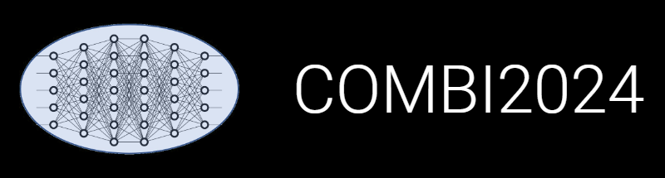

INF: Updates on Research Data Management
Victor Dudarev, Markus Stricker, Alfred Ludwig

Slide 2
Current Publications
1) Dudarev V., Banko L., Ludwig A.
"An extensible open-source solution for research digitalisation in materials science".
npj Comput Mater, 2025, 11, 116. DOI: 10.1038/s41524-025-01618-1
2) Hiege F., Sicking L., Kanokkanchana K., Cignoni P., Dudarev V., Ludwig A., Tschulik K.
The Crucial Role of Rotation Speed on the Determination of Tafel Slopes of Electrocatalysts in Rotating Disk Electrode Experiments
ACS Electrochemistry, 2025. DOI: 10.1021/acselectrochem.5c00210
3) Dudarev V., Kiselyova N., Ludwig A.
"Flexible Materials Properties Management System as a Basis for Data-Centric Systems in Inorganic Materials Science".
In: J. Baixeries et al. (Eds.): DAMDID/RCDL 2023.
Communications in Computer and Information Science, 2024, v.2086, pp. 91-103. DOI: 10.1007/978-3-031-67826-4_7
Some publications are pending…
https://crc1625.mdi.ruhr-uni-bochum.de/rubric/inf_publications

Slide 3
Current (RDMS-related) Status of Work
Achieved results:
Hardware & Basic Software Infrastructure (upgrade and monitoring);
New object types integration (validators, data extractors, visualisers);
“External” Applications: Tafel slope analysis;
RDMS core improvement:
  New “Partner” access level (for external collaborators);
  Read-only API (execute a read-only SQL query over read-only views / download);
  UDT support API (validate / extract data);
  IAM4NFDI: NFDI Infrastructure Proxy integrated;
  Data Integration: building sample*-datasets (from several documents).

Slide 4

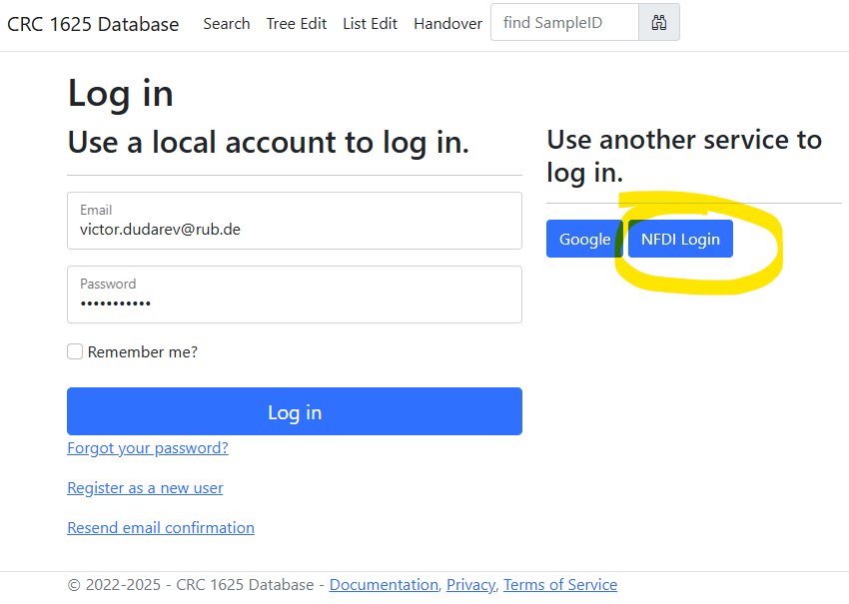
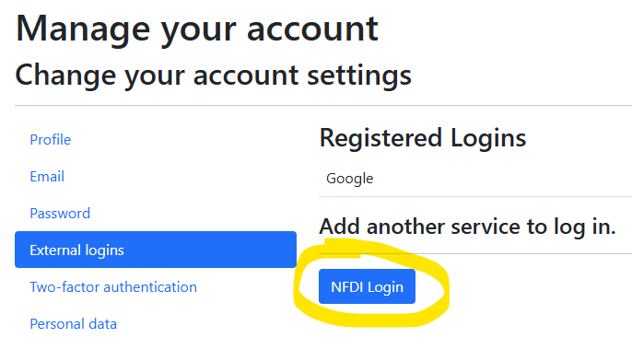
NFDI Login: use your institutional account in RDMS
Motivation: allow use any institutional account to log in.
Hint for existing users: bind with institutional account:
Go to your profile
Select “External Logins”
Click on “NFDI Login” and follow the instructions
The best case: password + Google + Institutional Account (NFDI Login / Helmholtz ID).
https://base4nfdi.de/projects/iam4nfdi
https://iam.services.base4nfdi.de

Slide 5
Access Level Update: New “Partner” Access Level
Motivation:
Enable external collaborators to have limited data access in the RDMS (objects with Public and Partner access levels are visible/accessible).
Data access policy is controlled via Data Access Levels.
Five Access Levels:
Public (for anonymous users, search engines):
    - objects are available to everybody regardless of authorization (visible to internet search engines);
^{NEW} Partner (for external users / collaborations)^{NEW}:
    - objects are visible to the authorized users with a Partner claim (and at least User role assigned);
Protected (by default, visible to the community only):
- objects are visible to the community (available to authorized users with at least User role assigned);
ProtectedNDA (restricted visibility):
- objects are visible to the authorized users (at least User role assigned) with NDA claim set OR to Administrators;
Private (person’s secret, but open for Administrators):
- objects are visible to the user-creator (at least PowerUser role assigned);
- objects are visible to all users of Administrator role.
relaxed
User’s Access Claim:
Partner
NDA
strict
Protected is default access level in CRC
NDA - Non-Disclosure Agreement

Slide 6
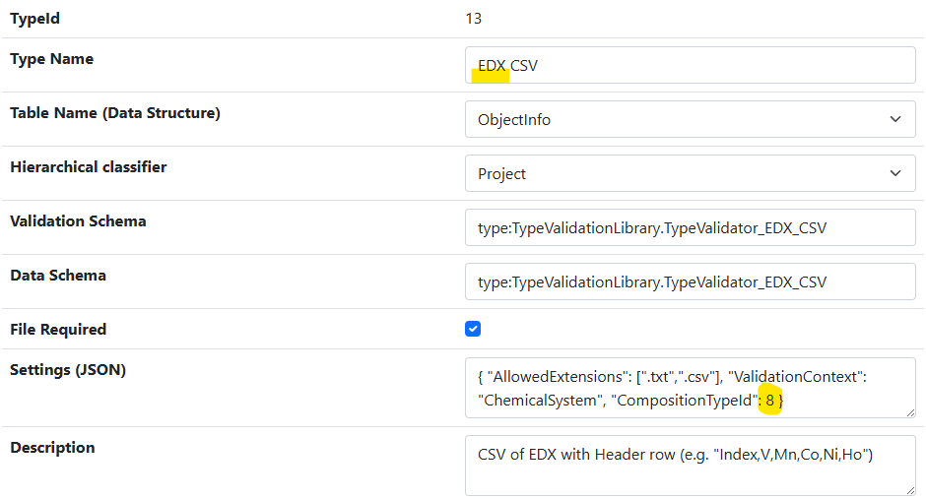
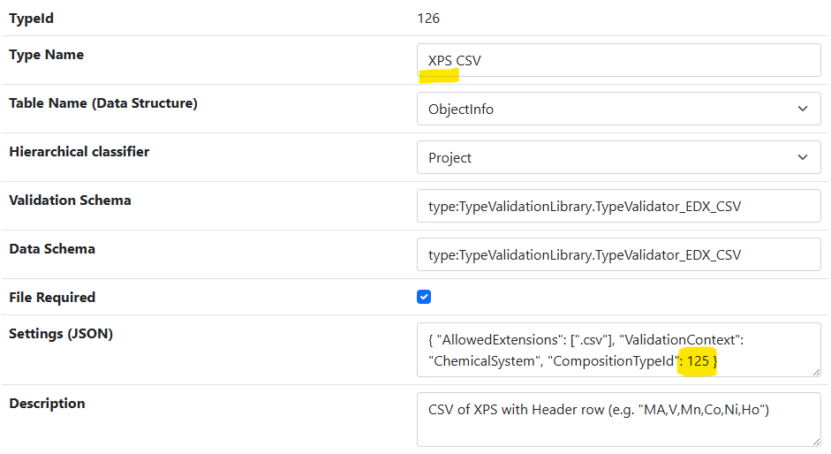
New Types: “XPS CSV” and “Surface Composition”
Motivation: distinguish between volume and surface composition
Workflows:
EDX CSV → 342 x “Volume Composition”
XPS CSV → 342 x “Surface Composition”
The “Volume Composition” type was previously called “Composition”.
efficient code reuse
https://crc1625.mdi.ruhr-uni-bochum.de/admintype/edititem/13
https://crc1625.mdi.ruhr-uni-bochum.de/admintype/edititem/126

Slide 7
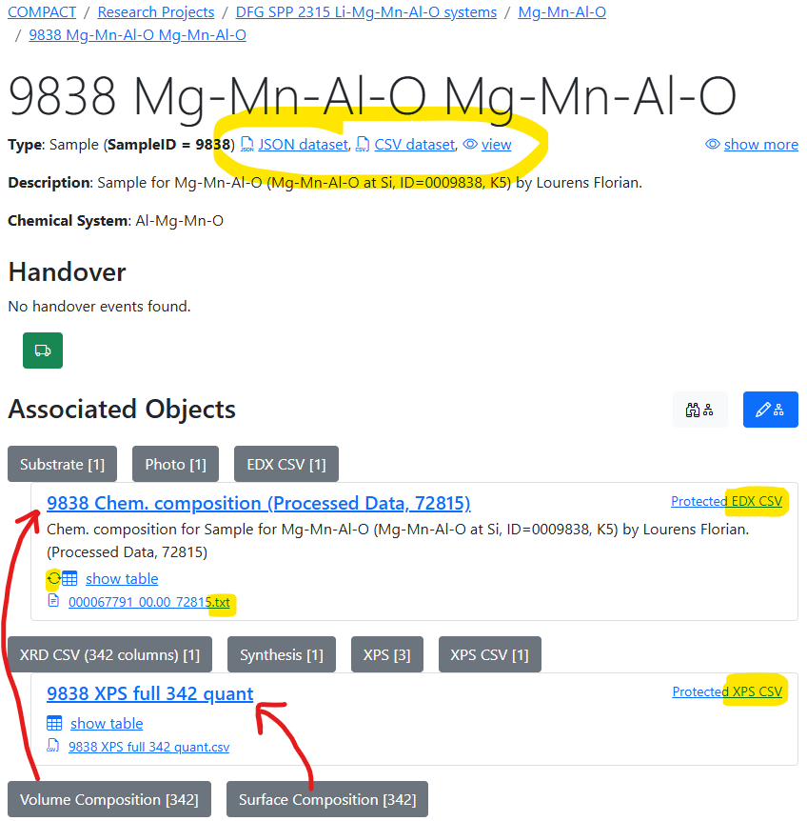
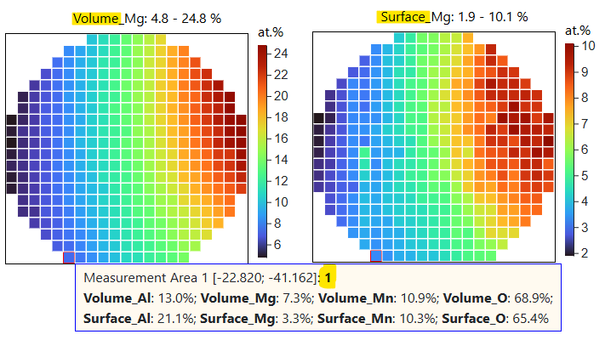
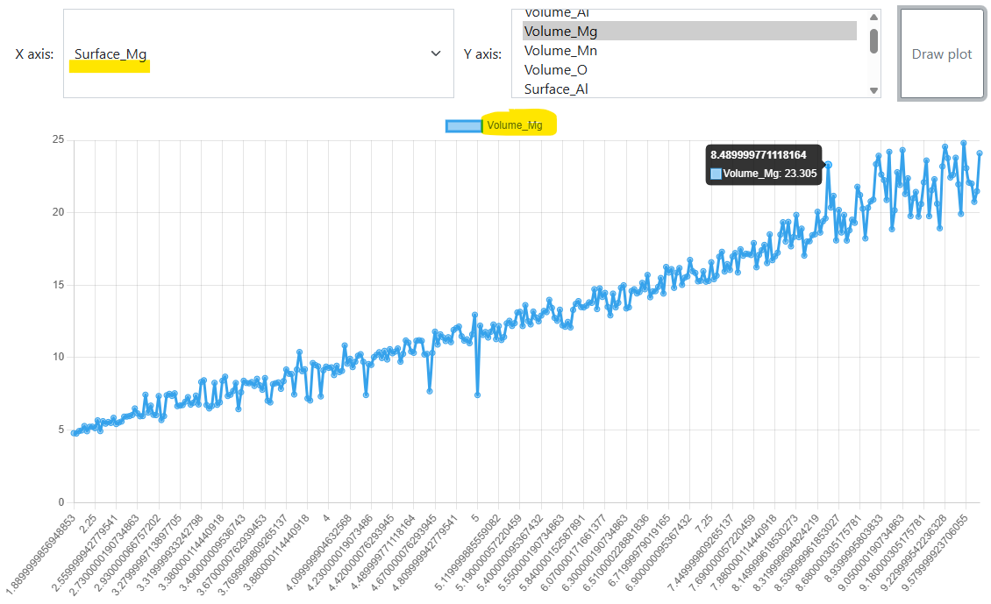
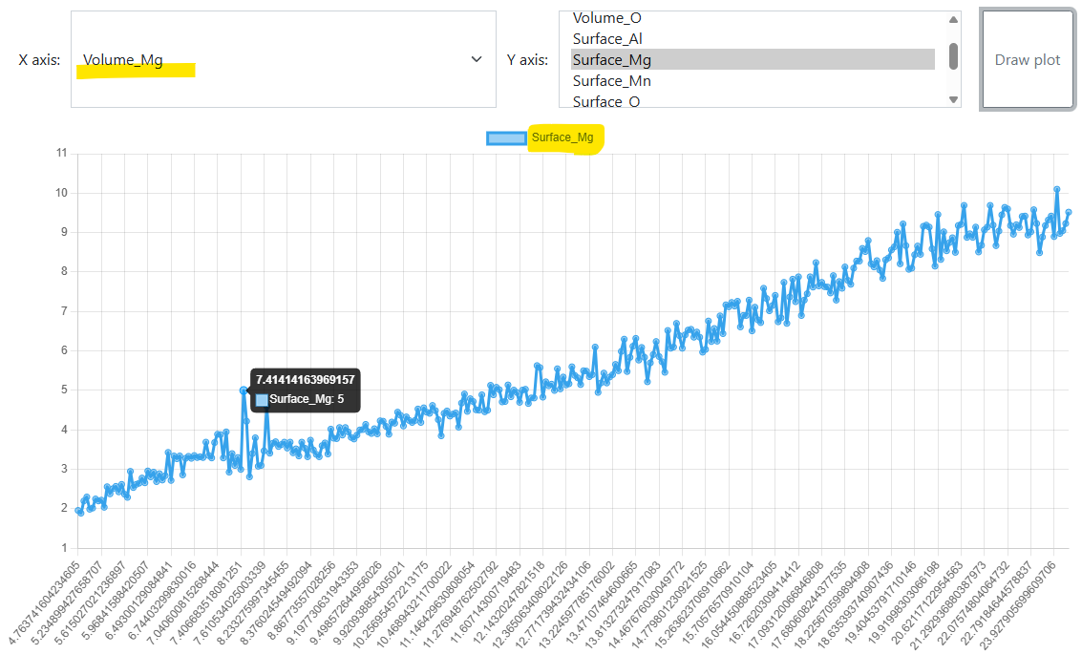
Sample 9838: EDX & XPS
Comparison: volume vs surface composition
Mg: Volume vs Surface Mg: Surface vs. volume
https://inf.mdi.ruhr-uni-bochum.de/object/sample-demo-29196 Source: https://mdi.matinf.pro/object/9838-mg-mn-al-o-mg-mn-al-o-56489

Slide 8
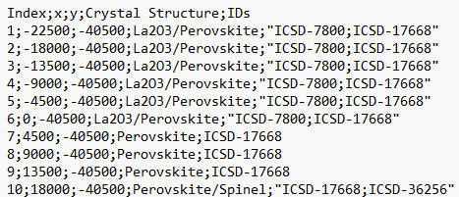
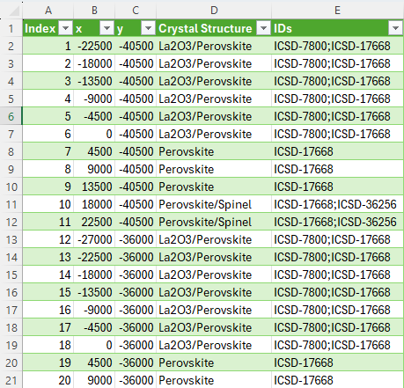
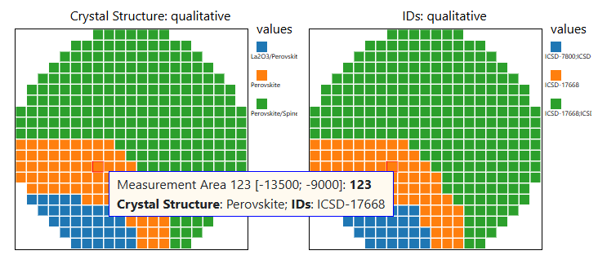
Type: XRD Phase Overview CSV
Motivation: Identify phases in every Measurement Area
Qualitative data plots:
https://inf.mdi.ruhr-uni-bochum.de/object/10316_xrd-phase-overview-29897
https://inf.mdi.ruhr-uni-bochum.de/file/download/29897

Slide 9
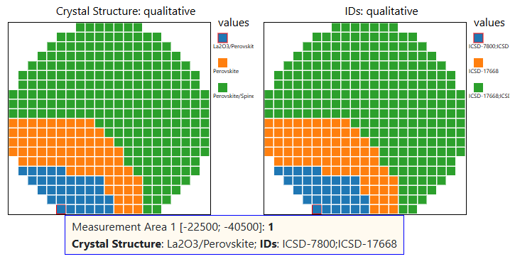
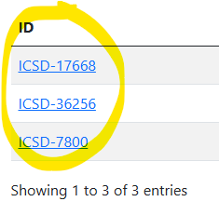
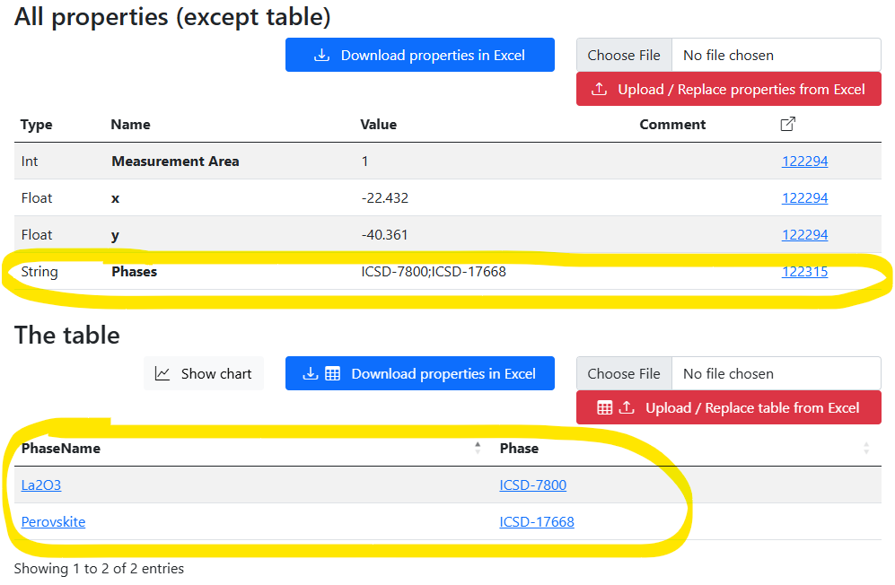
Data flow on XRD Phase Overview CSV upload
XRD Phase Overview
Sample
Table Properties:
342 x Volume composition
https://inf.mdi.ruhr-uni-bochum.de/object/10316_xrd-phase-overview-29897

Slide 10

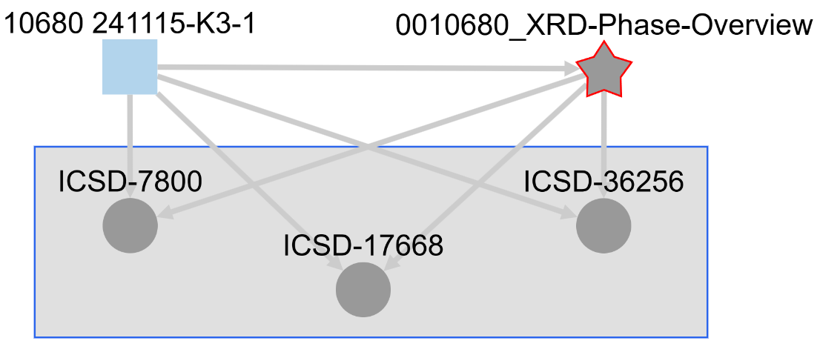
Type: Phase or Crystal Structure (cif)
Motivation: add Composition-based objects with CIF-files
Sample
XRD Phase Overview CSV
Phase or Crystal Structure (cif)
CIF-files
CIF - Crystallographic Information File
https://mdi.matinf.pro/object/graph/0010680_xrd-phase-overview-122315

Slide 11
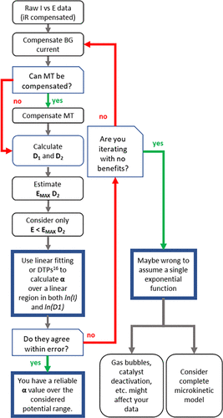
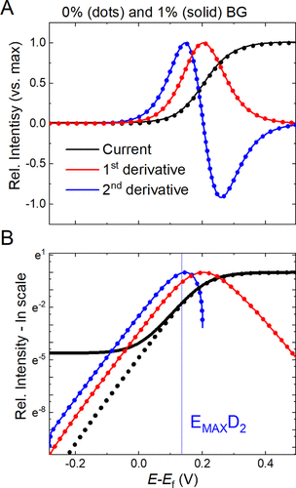
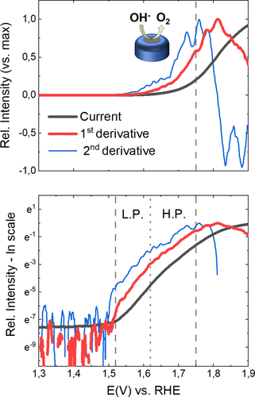
Catalyst Benchmark: Differential Tafel Analysis
Motivation: evaluate catalysts
Manuel Corva, Niclas Blanc, Christoph J. Bondue, and Kristina Tschulik
Differential Tafel Analysis: A Quick and Robust Tool to Inspect and Benchmark Charge Transfer in Electrocatalysis
ACS Catalysis 2022 12 (21), 13805-13812. DOI: 10.1021/acscatal.2c03581
https://pubs.acs.org/doi/10.1021/acscatal.2c03581

Slide 12
Source Data: diverse csv&txt formats (different potentiostats)
File............: lsv_lsv1_case_a_19_07_2023_12_19_42_0001 - JUL,19.2023
System..........:
Temperature.....: 49.2+-0.0C
Time............: 12:19:42-12:22:50
Scan mode.......: 5mV/s
Comment.........:
Electr.area/sqcm:
Reference.......: 0.4500929, 0.3194414 PO,PF,Imi-4.0e-01 ,Ima 4.0e-01 , -2, 11272
Lines: 187
Columns: 3
Number Time/s Potential/V Current/A
1 0 0.000 -3.800e-05
2 1.004 0.003 -1.086e-05
3 2.005 0.008 -7.868e-06
4 3.006 0.013 -6.100e-06
5 4.006 0.018 -4.871e-06
6 5.007 0.023 -3.926e-06
7 6.008 0.028 -3.146e-06
8 7.009 0.033 -2.464e-06
9 8.01 0.038 -1.842e-06
10 9.019 0.040 -1.873e-06
Experiment:, charge balanced
Start date:, 08 April 2025
Start time:, 18:08:35 +02:00
Time (s), Voltage (V), Current (A), Reverse I (A), Charge (C), V Range (), I Range ()
1029.63, -0.01006696, -9.316599e-06, , 0.001817496, 1, 5
1029.64, -0.009909317, -8.931254e-06, , 0.001817407, 1, 5
1029.65, -0.01006696, -9.187112e-06, , 0.001817315, 1, 5
1029.66, -0.01006696, -8.931254e-06, , 0.001817225, 1, 5
1029.67, -0.01006696, -1.038215e-05, , 0.001817121, 1, 5
1029.68, -0.01006696, -9.085705e-06, , 0.001817031, 1, 5
1029.69, -0.009751666, -8.836088e-06, , 0.001816942, 1, 5
1029.7, -0.009751666, -8.811126e-06, , 0.001816854, 1, 5
1029.71, -0.009594016, -8.432022e-06, , 0.00181677, 1, 5
1029.72, -0.009594016, -9.441408e-06, , 0.001816675, 1, 5
1029.73, -0.009594016, -8.533429e-06, , 0.00181659, 1, 5
1029.74, -0.009594016, -9.32284e-06, , 0.001816497, 1, 5
1029.75, -0.009594016, -8.851689e-06, , 0.001816408, 1, 5
WE(1).Potential (V) WE(1).Current (A) Time (s)
0.442474365234375 2.40173339843749E-06 1178.14680902547
0.44500732421875 2.08740234375E-06 1180.5882150193
0.447357177734375 1.89819335937499E-06 1183.02962101314
0.4498291015625 1.873779296875E-06 1185.47102700697
0.45233154296875 1.82189941406249E-06 1187.91243300081
0.4547119140625 2.20947265625E-06 1190.35383899465
0.457122802734375 1.910400390625E-06 1192.79524498848
0.45953369140625 2.6123046875E-06 1195.23665098232
0.462005615234375 1.8890380859375E-06 1197.67805697615
0.4644775390625 2.3651123046875E-06 1200.11946296999
0.466888427734375 1.7974853515625E-06 1202.56086896383
0.469329833984375 2.4444580078125E-06 1205.00227495766
0.47174072265625 2.81982421875E-06 1207.4436809515
0.474151611328125 2.57263183593751E-06 1209.88508694533
https://en.wikipedia.org/wiki/Potentiostat

Slide 13
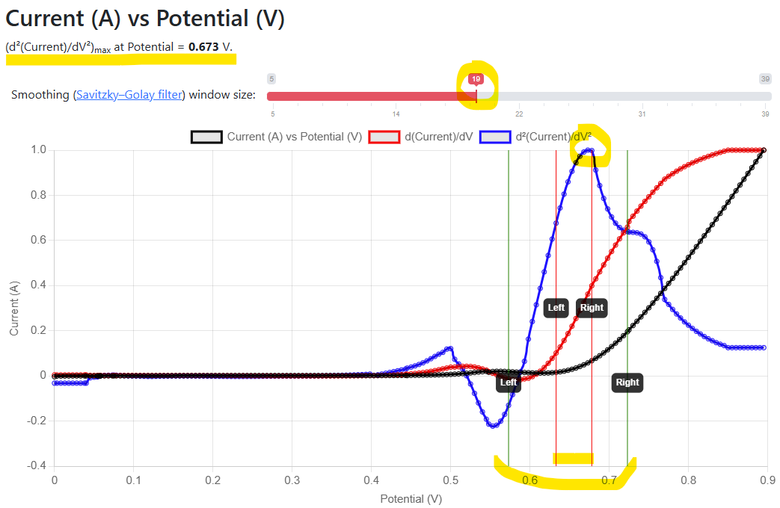
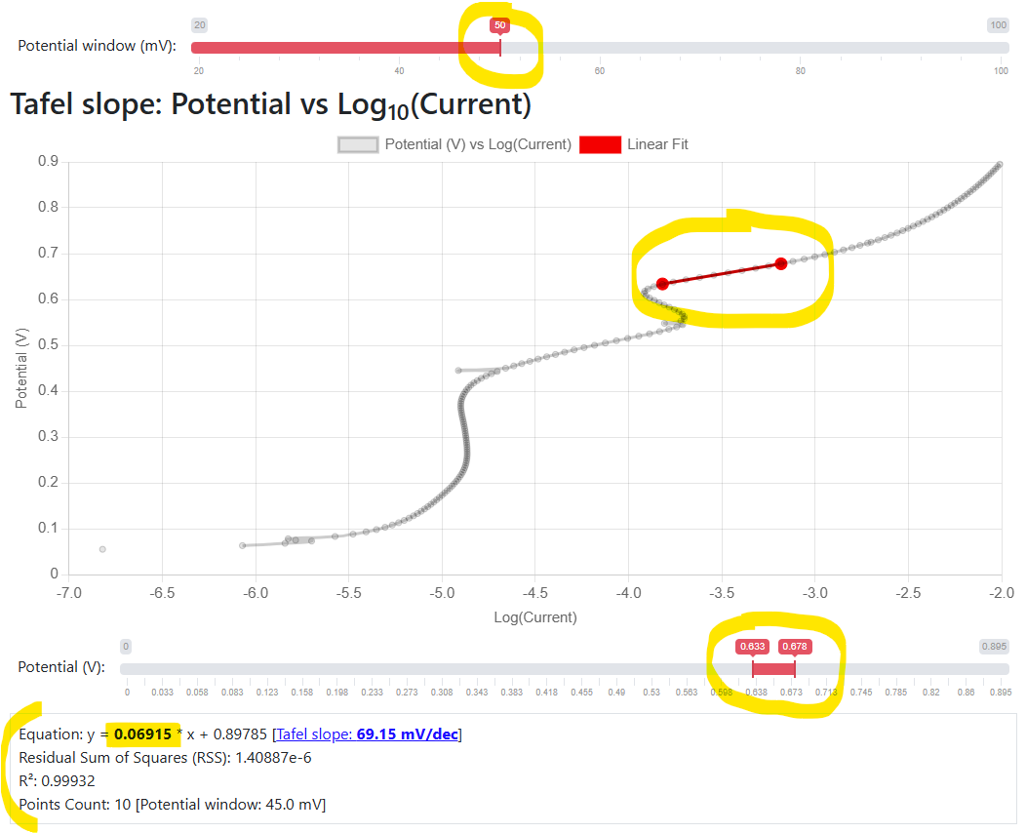
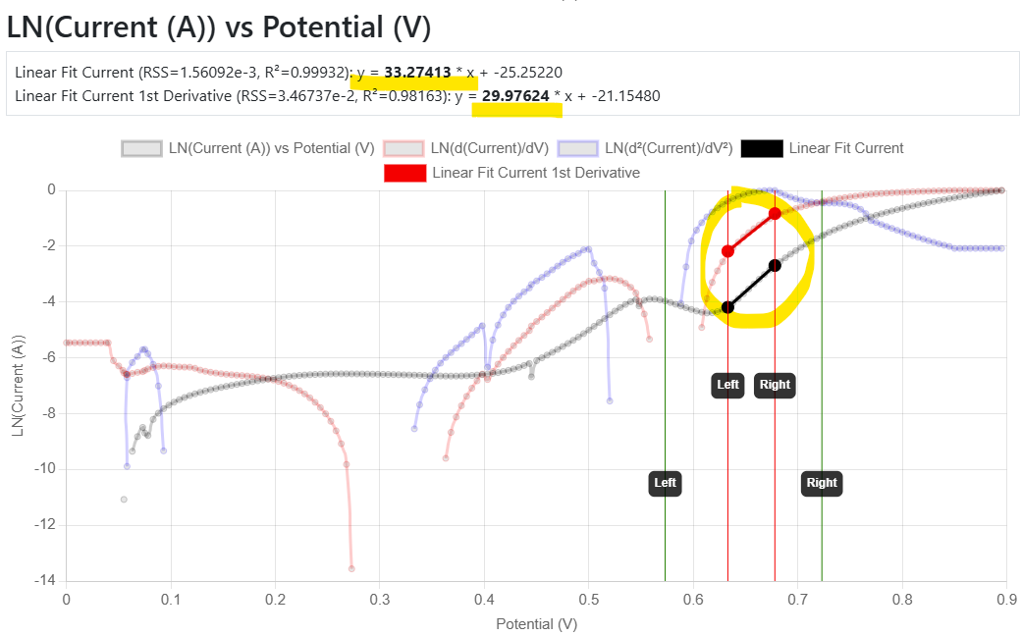
Demo: Tafel slope calculation
Motivation: provide a standard benchmark to evaluate catalysts
https://inf.mdi.ruhr-uni-bochum.de/object/lsv_900mv_5mvpers_19_07_2023_cpy88_0_calc_ecbalanced_04_co3o4nps-on-gc_01-m-koh-29544

Slide 14
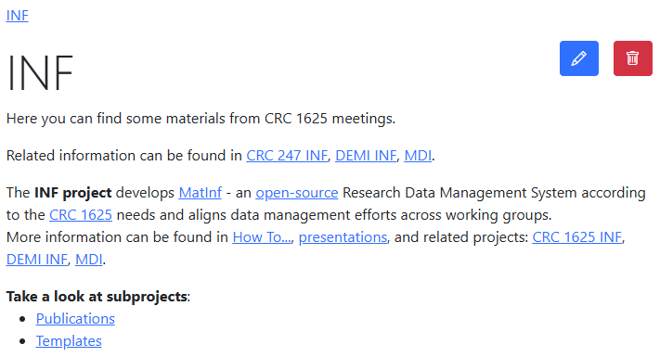
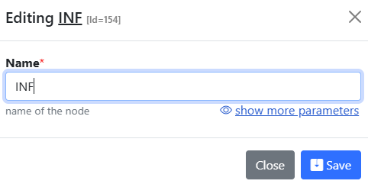
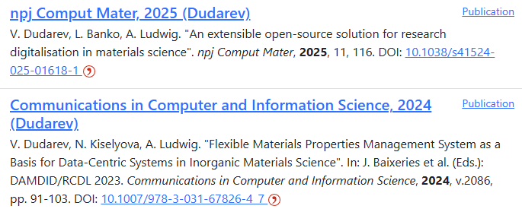
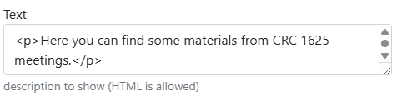
Project Page and Publication List
Please provide the project description and publication list on your project page:
https://crc1625.mdi.ruhr-uni-bochum.de/rubric/inf_publications
https://crc247.mdi.ruhr-uni-bochum.de/rubric/area-c_c04

Slide 15
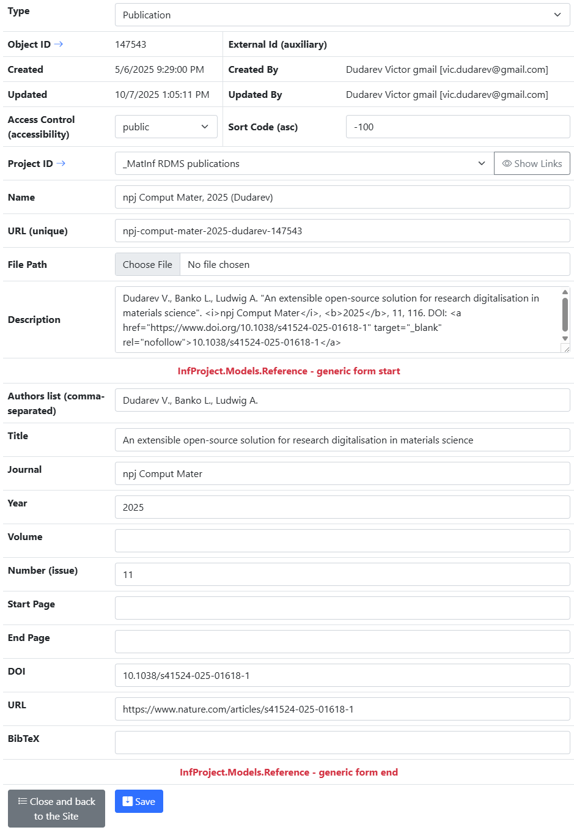
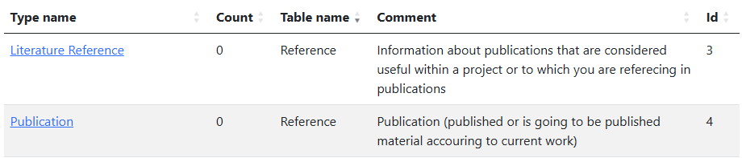
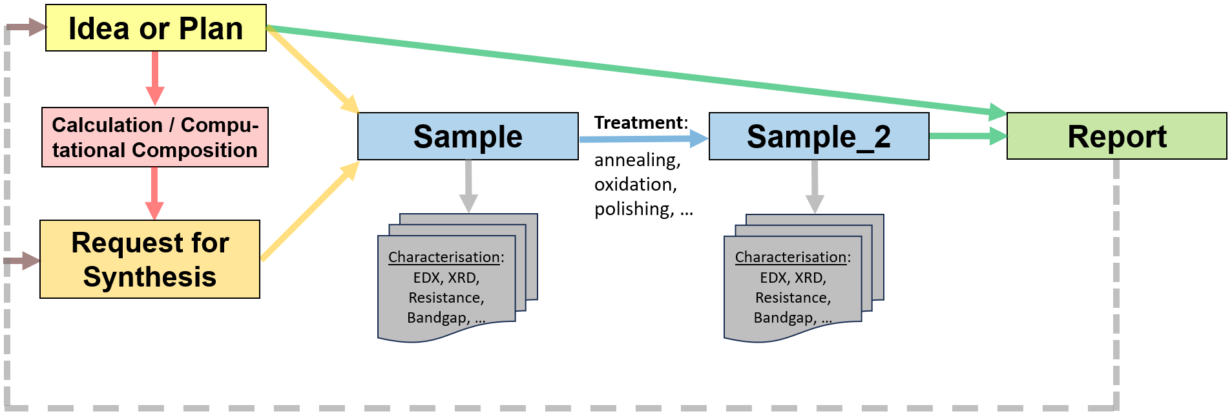
Publications in RDMS
Two types (based on Reference table):
Store publications / presentations / reports in RDMS:
Alternative types to conclude your findings:
PowerPoint Presentation Slides
Report
Video
Audio
https://crc1625.mdi.ruhr-uni-bochum.de/rubric/inf_publications
https://crc247.mdi.ruhr-uni-bochum.de/rubric/area-c_c04

Slide 16
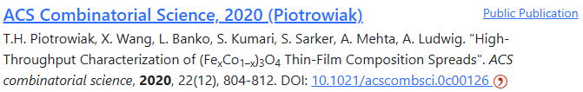
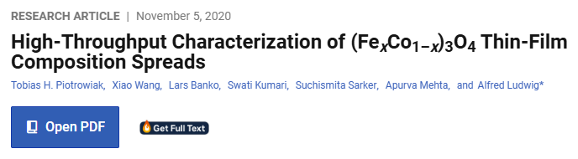
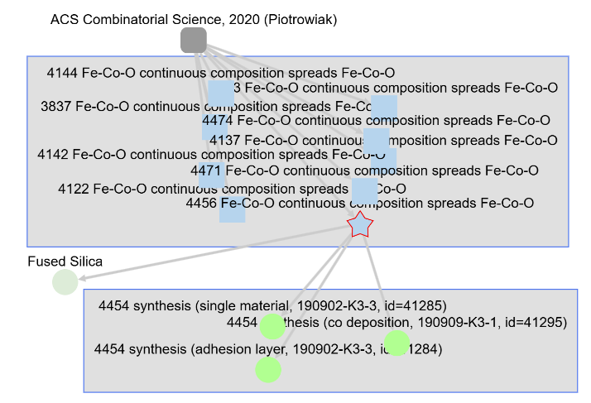

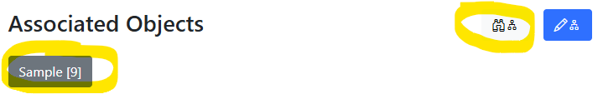
Good Publication = Publication with Data
Publication in RDMS
Article text on publisher’s web site
Objects/data accessible from the publication object
Related objects/data
https://crc247.mdi.ruhr-uni-bochum.de/rubric/area-c_c04
https://pubs.acs.org/doi/10.1021/acscombsci.0c00126

Slide 17
Hands-on Session
Topics:
“DMP Light”: adding data description for your project;
Publication List Management: adding publications.
Home Assignment:
prepare short text (1-2 paragraphs) describing your project in terms of data contributions:
  What do you add?
  What types do you use?
  Your suggestions: What is missing (types/parameters/workflow)?
prepare a list of project publications (including DOI, URL);
prepare a list of literature references, relevant for your project and guiding your research (including DOI, URL).
Date&Time of hands-on session will be announced in the agenda.
DMP – Data Management Plan

Slide 18
Next Steps (future plans)
RDMS Core Interoperability:
  RDMS REST API (low-level CRUD access to RDMS);
  Message Bus (asynchronous message broker, Apache Kafka).
Building datasets (for publications / data analysis):
  Building datasets across samples (based on “Ideas or Experiment Plans”);
  Building datasets for a chemical system.
Interoperability with external infrastructures (external, might be done as separate projects):
  Research Object Crate (RO-Crate) support;
  Zenodo API (data publication to support publications);
  RUB ReSeeD API (once the API is published);
  Exposing data via OPTIMADE API;
  FAIRmat: NOMAD integration (NeXus format support);
  NFDI-MatWerk: Materials Science and Engineering Knowledge Graph (MSE-KG);
  SPARQL endpoint, EMMO-based (wrapper on the top of API).

Slide 19
Thanks for your kind attention
Questions & Answers
Victor Dudarev
Victor.Dudarev@rub.de
https://vdudarev.ru

