Slide 1
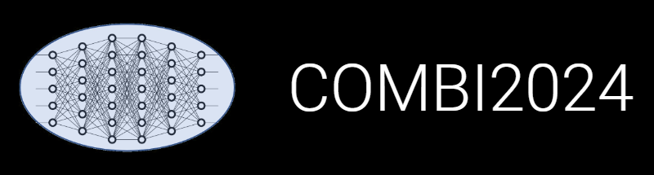


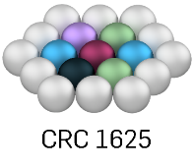

INF: Research Data Management System
Update
Victor
Dudarev
Enabling Data Publication

Slide 2
Agenda
Sliders in data visualizations
Licenses in objects
Public objects registry
Data publication:
  Access Levels consistency
  License consistency
  Contributors/authors list
  Script to create “experiment snapshot”: (meta)data + documents
Default search results limitation

Slide 3
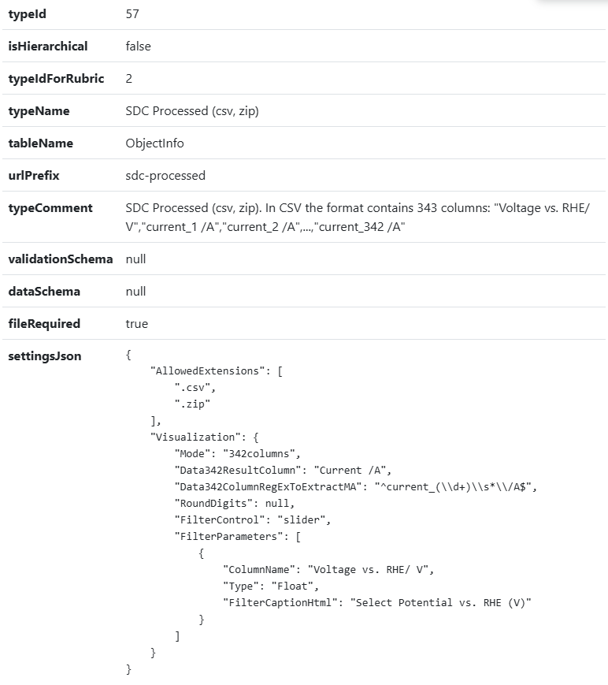
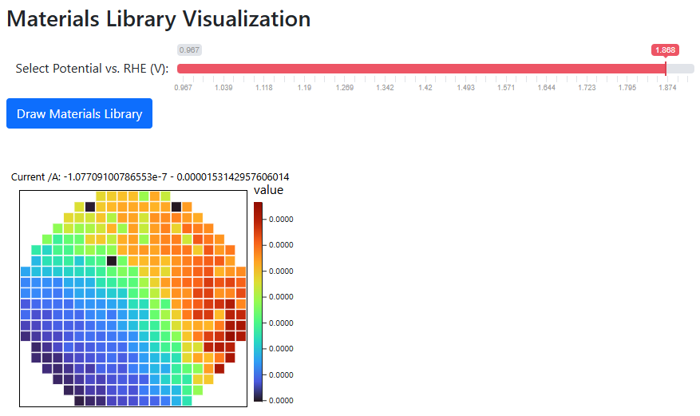
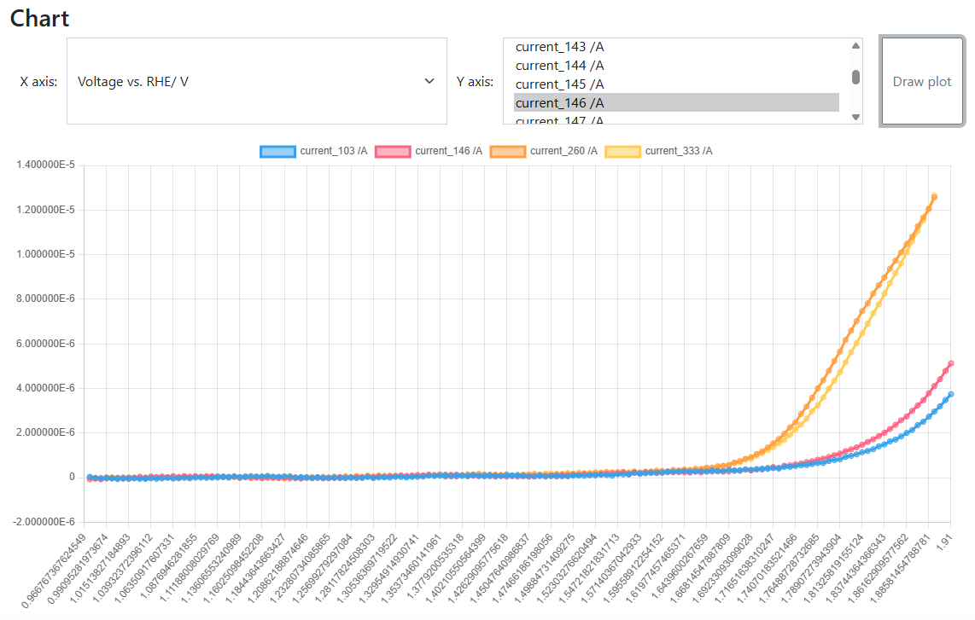
Sliders in data visualizations
Goal: Implement interactive data visualization
Use case:
SDC Processed (csv, zip) type
CSV with fixed format
Strange things in experiments (discovery or mistake?):
https://crc247.mdi.ruhr-uni-bochum.de/file/csv/22677
https://crc247.mdi.ruhr-uni-bochum.de/file/csv/22674
SDC Processed (csv, zip): https://crc247.mdi.ruhr-uni-bochum.de/object/20250204_0010671_colanio_ph12_8_oer_lsv_eis-22680
Visualization with a slider: https://crc247.mdi.ruhr-uni-bochum.de/file/csv/22680

Slide 4
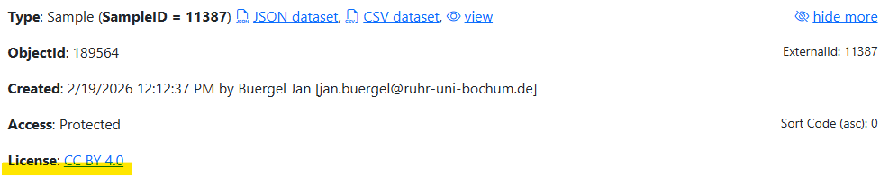
Licenses in objects
Goal: accompany objects/data with explicit data sharing terms.
Default: tenant’s license (CC BY 4.0), configured for a tenant
Adjustment – set License (String) property for the object:
Name: “License”
Value: <License_Name> (e.g., “CC BY 4.0”)
Comment: <License_URL> (e.g., “https://creativecommons.org/licenses/by/4.0/”)
https://mdi.matinf.pro/object/au-ir-rh-ir-rich-dataset-5-189564
Possible licenses: https://creativecommons.org/licenses/

Slide 5
RDMS Access Levels
Motivation:
Managing data access policy using the Access Control attribute at the individual object level.
RDMS data access policy is controlled via Access Levels
Five Access Levels:
Public (for anonymous users, search engines):
    - objects are available to everybody regardless of authorization (visible to internet search engines);
^{NEW} Partner (for external users / collaborations)^{NEW}:
    - objects are visible to the authorized users with a Partner claim (and at least User role assigned);
Protected (by default, visible to the community only):
- objects are visible to the community (available to authorized users with at least User role assigned);
ProtectedNDA (restricted visibility):
- objects are visible to the authorized users (at least User role assigned) with NDA claim set OR to Administrators;
Private (person’s secret, but open for Administrators):
- objects are visible to the user-creator (at least PowerUser role assigned);
- objects are visible to all users of Administrator role.
relaxed
User’s Access Claim:
Partner
NDA
strict
Protected is default access level in the CRC
NDA - Non-Disclosure Agreement

Slide 6
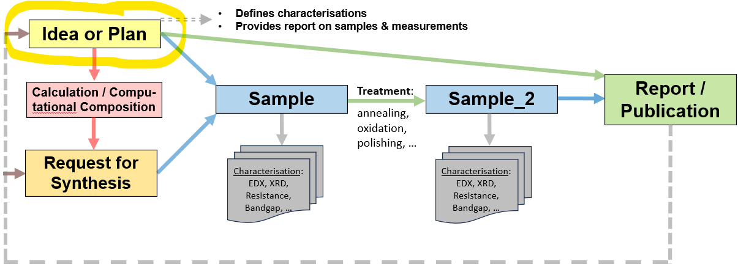

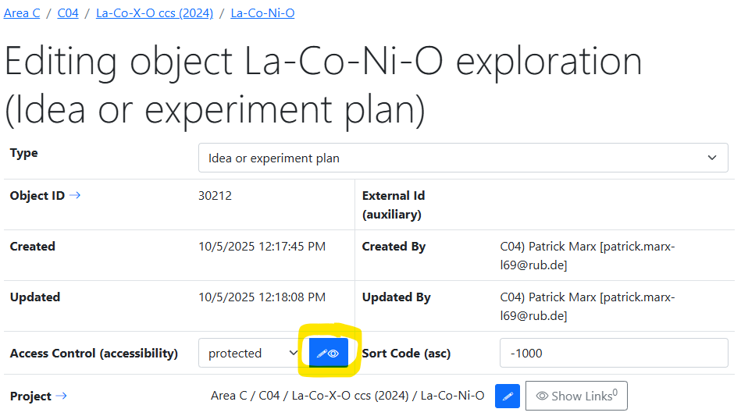
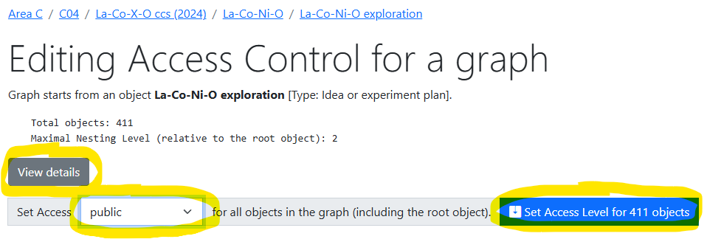
Data publication
Goal:
Change Access Control for entire object graph
Making objects public
Detailed statistics:
Access Control
Licenses
Authors (Creators)
Full Object list for a graph
https://crc247.mdi.ruhr-uni-bochum.de/adminobject/edititem/30212/?returl=%2Fobject%2Fla-co-ni-o-exploration-147192
https://crc247.mdi.ruhr-uni-bochum.de/adminobject/editgraph/30212?mode=AccessControl

Slide 7
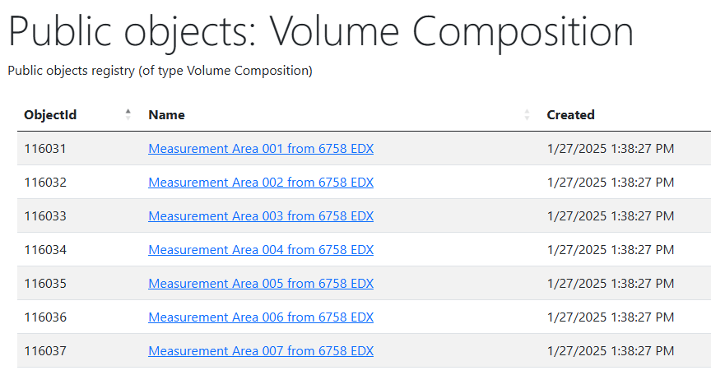
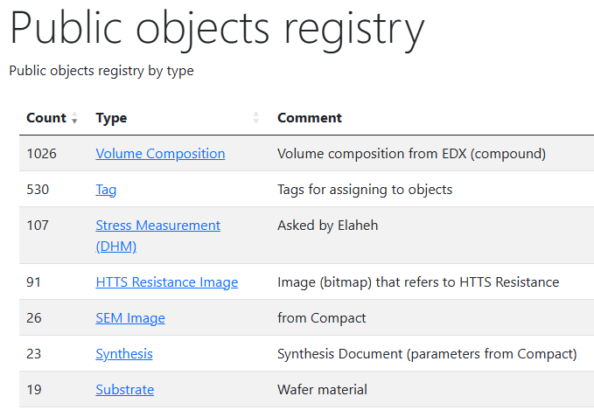
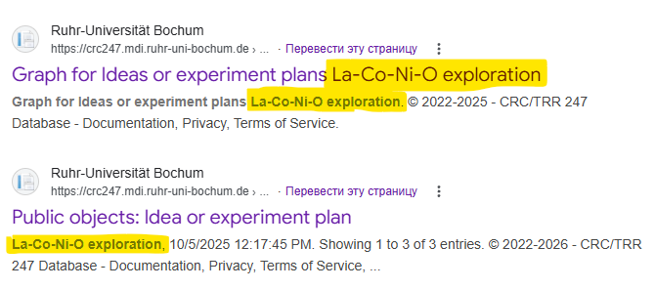
Public objects registry
Goal:
make public objects findable for search bots
To do: generate sitemap.xml (metadata for search bots)
https://mdi.matinf.pro/public https://mdi.matinf.pro/public/type/8
https://www.google.com/search?q=la-co-ni-o+exploration+site%3Acrc247.mdi.ruhr-uni-bochum.de

Slide 8
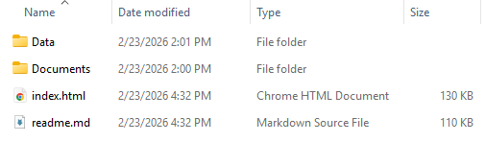

Data publication script
Python code on the top of VRO API
Goal:
Create a graph snapshot (folder with (meta)data) to publish on external repositories (Zenodo, etc).
Input:
Tenant URL (https://crc1625.mdi.ruhr-uni-bochum.de)
VRO API Key (assigned to user by an administrator upon request; to do: GUI for power users…)
root ObjectId (top-level object, e.g., idea or experiment plan)
Output:
A folder that contains:
readme.md
index.html
Data folder (with CSV and JSON)
  + index.csv / index.json – all basic objects metadata in a graph
Documents (with files associated)
data.zip
https://gitlab.ruhr-uni-bochum.de/vic/infproject/-/tree/master/SCRIPTS/Extract_ExperimentData
python VroApi.py --object-id 30212 --tenant-url "https://crc247.mdi.ruhr-uni-bochum.de" --api-key "<VRO_API_Key>" --publish-dir "Publish"

Slide 9
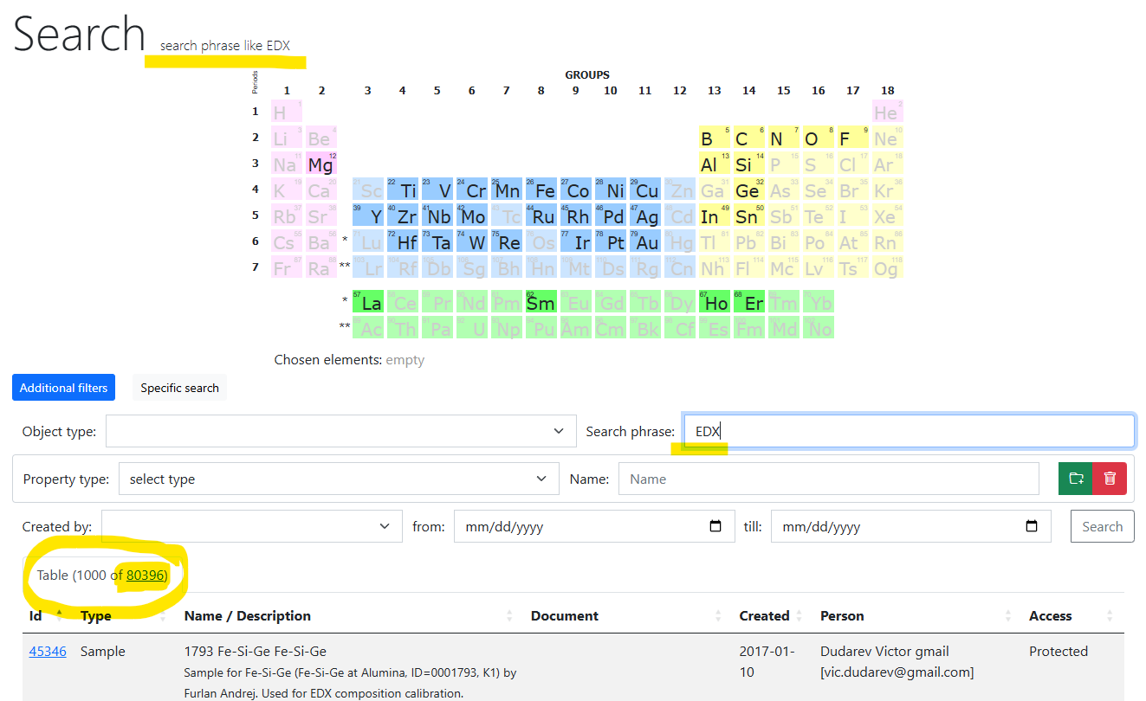
RDMS: Search
Problem: slow browser render time on large data sets (UI freeze)
Changes:
By default, search is limited to Top 1000 results (no UI freeze)
Important note:
you can see all results by explicitly clicking on the link with total results
Plans:
pagination (or browser render optimization)
https://mdi.matinf.pro/search/?searchphrase=EDX

Slide 10

RDMS Free Playground
Questions & Answers
Thanks for your kind attention
  https://inf.mdi.ruhr-uni-bochum.de/
Playground to test RDMS (multiple tenants with shared users list):
https://inf.mdi.ruhr-uni-bochum.de/
Login and Password (User role): User1@user.org
Login and Password (PowerUser role): PowerUser1@user.org
Login and Password (Administrator role): Admin1@user.org
https://vdudarev.ru
Notes:
https://qr.io/

