Slide 1
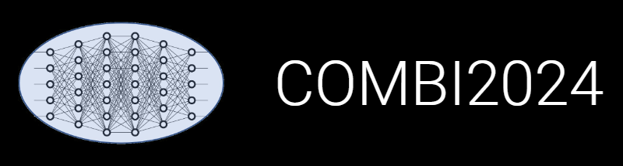

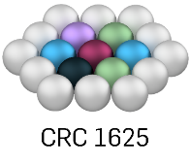
INF: Research Data Management System Update
(and a Recap of the Key Points)
Victor
Dudarev
Enabling Data Publication

Slide 2
Agenda
Sample-oriented workflow Recap
Sliders in data visualizations
Licenses in objects
Public objects registry
Data publication:
  Access Levels consistency
  License consistency
  Contributors/authors list
  Script to create “experiment snapshot”: (meta)data + documents
Search improvement
Some statistical overview
Architecture outlook

Slide 3
Object Graph as a Research Workflow Representation
STAR paradigm: Statefulness, Traceability, Aim, and Result
Defines characterisations
Provides report on samples & measurements
Idea or Plan
Calculation / Compu-tational Composition
Treatment:
annealing,
oxidation,
polishing, …
Report / Publication
Sample
Sample_2
Request for Synthesis
Characterisation:
EDX, XRD, Resistance, Bandgap, …
Characterisation:
EDX, XRD, Resistance, Bandgap, …
EDX – Energy-Dispersive X-ray spectroscopy (to determine composition) XRD – X-Ray Diffraction (to determine crystallographic structure)

Slide 4
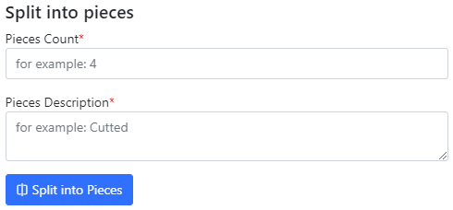
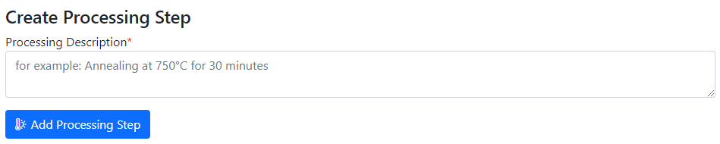
Statefulness: Sample Transformation Workflow
Create Processing State & Split Sample
Sample_2a_2
(subsample 2a state 2)
polishing
Documents2a_2
Sample_2a
(subsample 2a)
annealing
splitting
Sample_2b_2
(subsample 2b state 2)
Sample
(initial state)
Sample_2
(changed state 2)
oxidation
Sample_2b
(subsample 2b)
documents
documents2
Documents2b_2
https://crc1625.mdi.ruhr-uni-bochum.de/object/10472-agauirpdpt-on-au-111-on-mica-34573

Slide 5
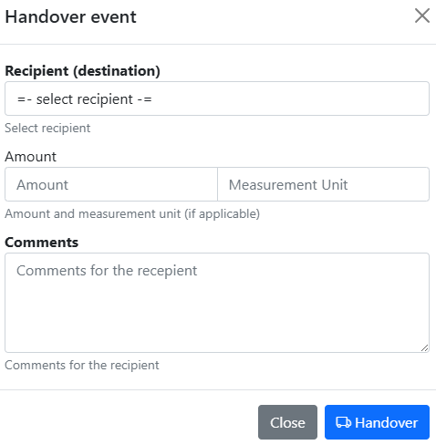
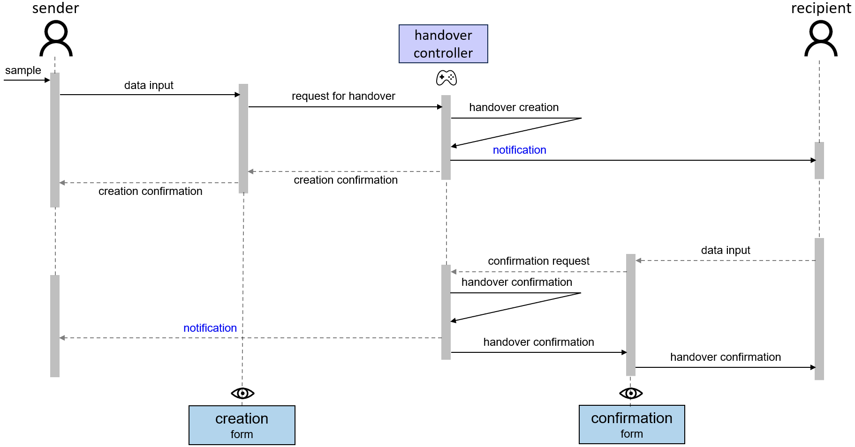

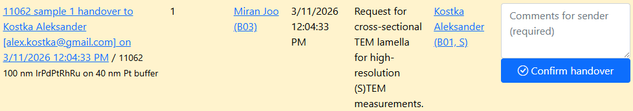
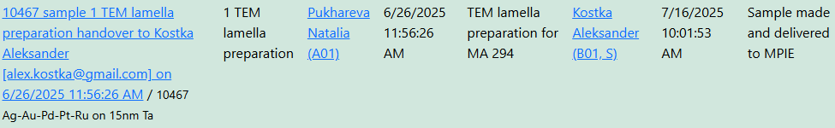
Traceability: Handovers Workflow
Motivation: trace samples (who holds the sample?)
https://crc1625.mdi.ruhr-uni-bochum.de/rubric/s

Slide 6
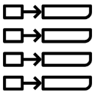

Goal: RDMS evolution towards AI-ready datasets
Document-oriented Graph Factographic
project
project
project
1
1
1
key-value
subproject
subproject
subproject
subproject
subproject
subproject
2
3
4
5
6
2
3
4
5
6
2
3
4
5
6
subsubproject
subsubproject
subsubproject
7
7
7
table
RDMS: Research Data Management System
Notes:
Statefulness, Traceability, Aim, and Result

Slide 7

Documents workflow: Standardisation, Testing, Extraction
Failure
Type-dependent mechanisms
fail
document
MatInf RDMS
Data
validation
user
/ API
ok
Data extraction
JSON
Persisting
(document + data)
objects
properties
Database
document
View
SHA-256
link
File
storage
Data visualisation
document
HTML

Slide 8
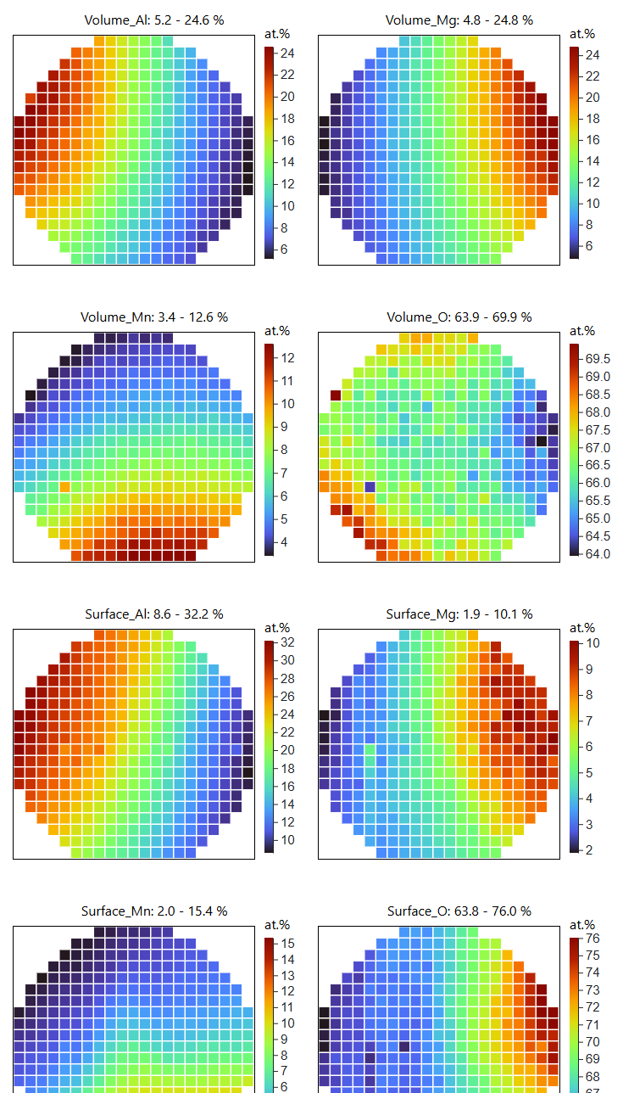
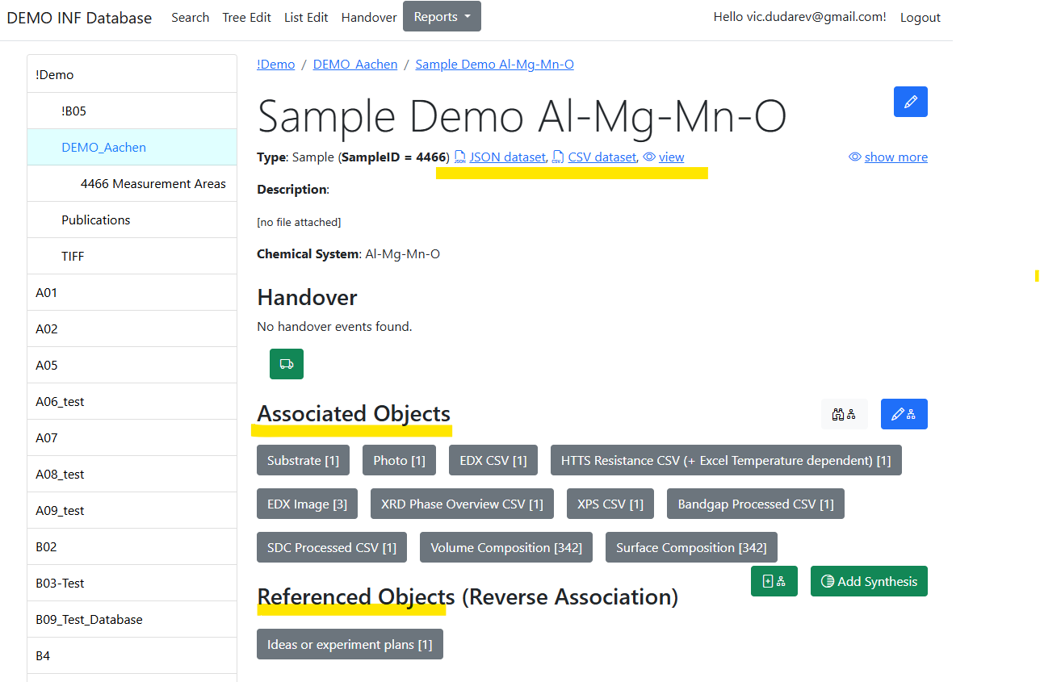
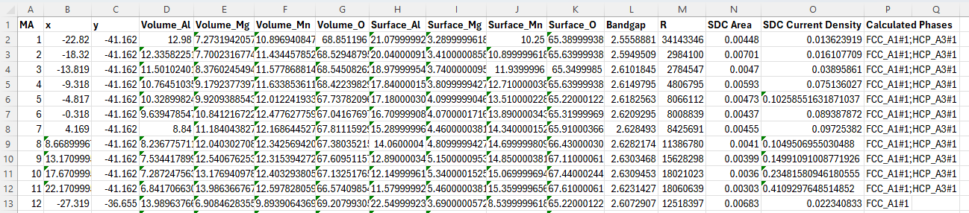
Data Integration: AI-ready datasets
Example: Volume & Surface compositions, Bandgap, Resistance, Catalytic activity
https://inf.mdi.ruhr-uni-bochum.de/object/sample-demo-29196

Slide 9

Ok. Enough with recap…
What’s new?
DB structure adjusted (ObjectInfo: ObjectFileSize introduced, IsPublished removed, etc.)
VRO API views changed accordingly
Successful RDMS Migration to .Net 10 (LTS)
DB migration to SQL Server 2025 (vectors, RegExp, JSON native type, optimized locking)
is in test phase (TBD in April)
Goal: publish data…

Slide 10
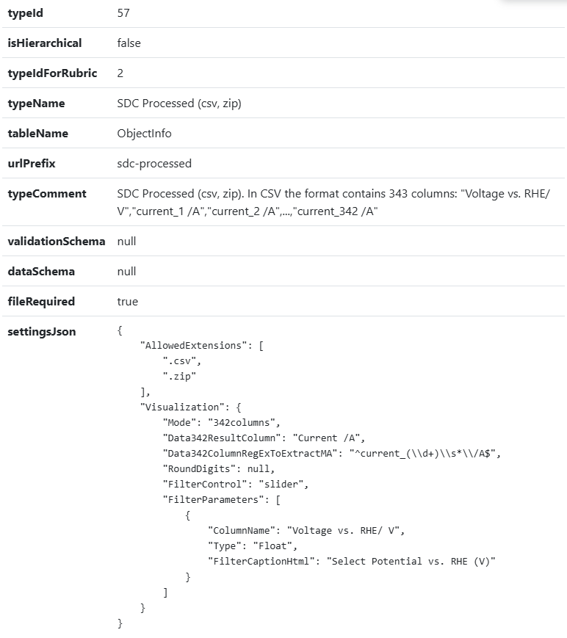
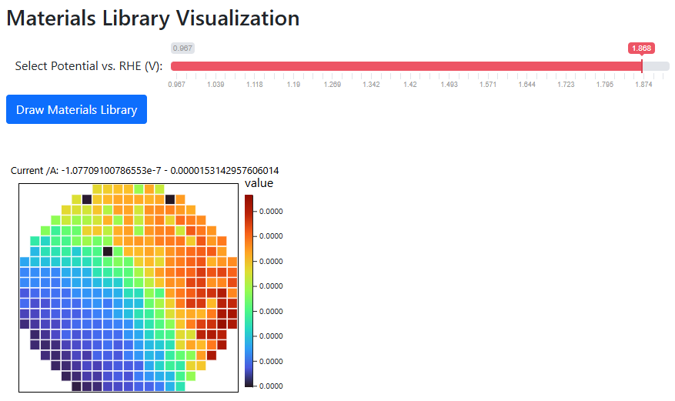
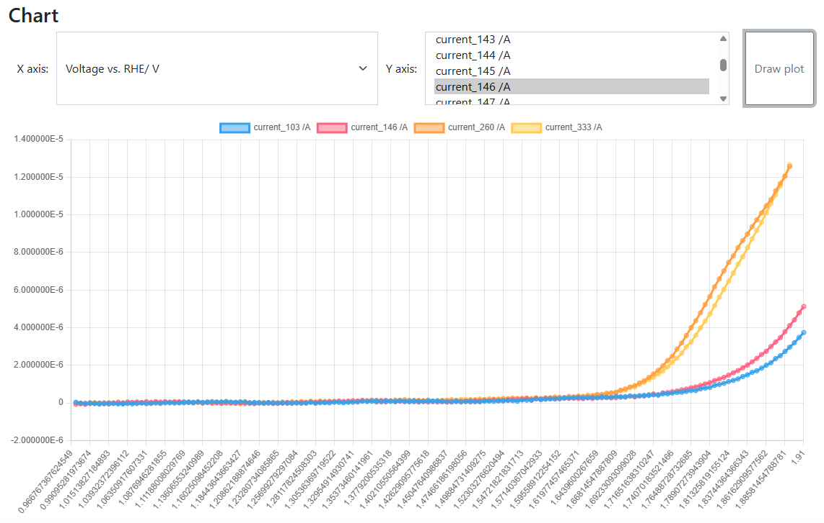
Sliders in data visualizations
Goal: Implement interactive data visualization
Use case:
SDC Processed (csv, zip) type
CSV with fixed format
Strange things in experiments (discovery or mistake?):
https://crc247.mdi.ruhr-uni-bochum.de/file/csv/22677
https://crc247.mdi.ruhr-uni-bochum.de/file/csv/22674
Quality Assurance
(personal responsibility)
SDC Processed (csv, zip): https://crc247.mdi.ruhr-uni-bochum.de/object/20250204_0010671_colanio_ph12_8_oer_lsv_eis-22680
Visualization with a slider: https://crc247.mdi.ruhr-uni-bochum.de/file/csv/22680

Slide 11

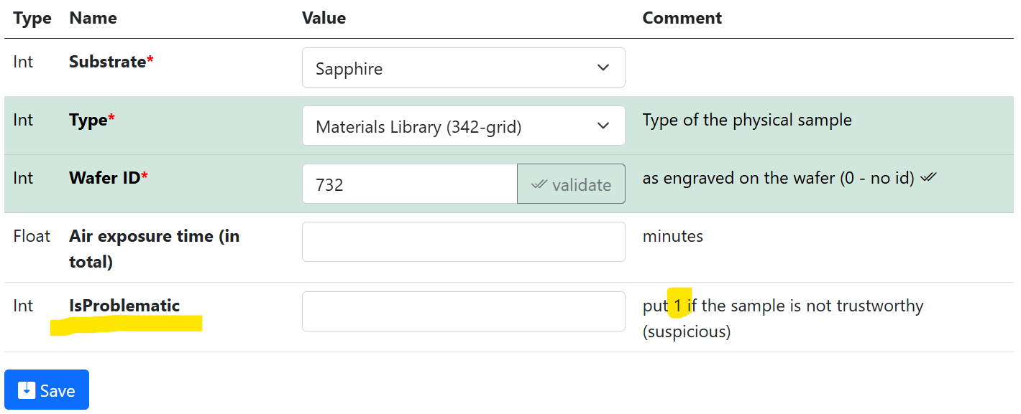
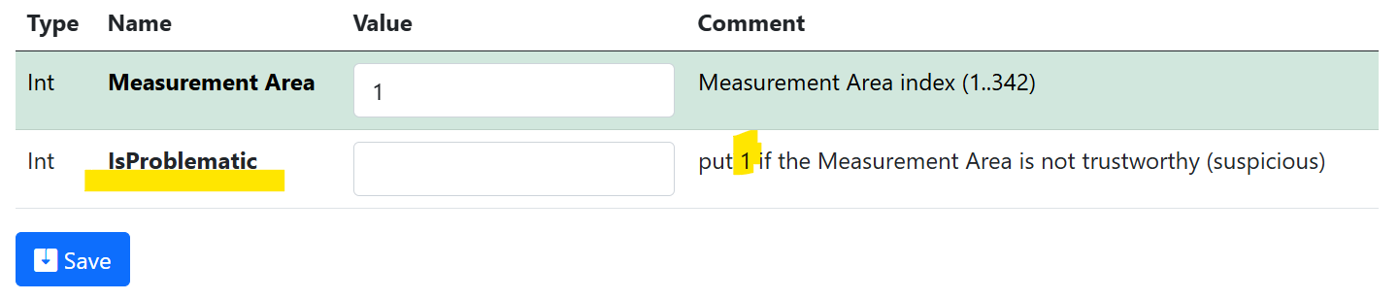
Towards Curation: Flagging unreliable data
Motivation: mark/flag suspicious samples / samples regions (measurement areas) => IsProblematic property
Sample properties
Volume composition properties

Slide 12
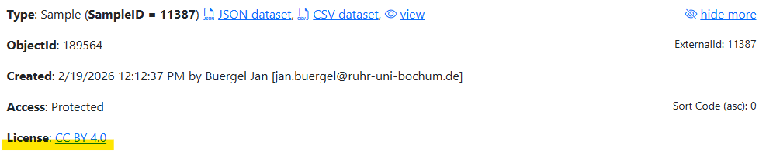
Licenses in objects
Goal: accompany objects/data with explicit data sharing terms.
Default: tenant’s license (CC BY 4.0), configured for a tenant
Adjustment – set License (String) property for the object:
Name: “License”
Value: <License_Name> (e.g., “CC BY 4.0”)
Comment: <License_URL> (e.g., “https://creativecommons.org/licenses/by/4.0/”)
https://mdi.matinf.pro/object/au-ir-rh-ir-rich-dataset-5-189564
Possible licenses: https://creativecommons.org/licenses/

Slide 13
RDMS Access Levels
Motivation:
Managing data access policy using the Access Control attribute at the individual object level.
RDMS data access policy is controlled via Access Levels
Five Access Levels:
Public (for anonymous users, search engines):
    - objects are available to everybody regardless of authorization (visible to internet search engines);
^{NEW} Partner (for external users / collaborations)^{NEW}:
    - objects are visible to the authorized users with a Partner claim (and at least User role assigned);
Protected (by default, visible to the community only):
- objects are visible to the community (available to authorized users with at least User role assigned);
ProtectedNDA (restricted visibility):
- objects are visible to the authorized users (at least User role assigned) with NDA claim set OR to Administrators;
Private (person’s secret, but open for Administrators):
- objects are visible to the user-creator (at least PowerUser role assigned);
- objects are visible to all users of Administrator role.
relaxed
User’s Access Claim:
Partner
NDA
strict
Protected is default access level in the CRC
NDA - Non-Disclosure Agreement

Slide 14
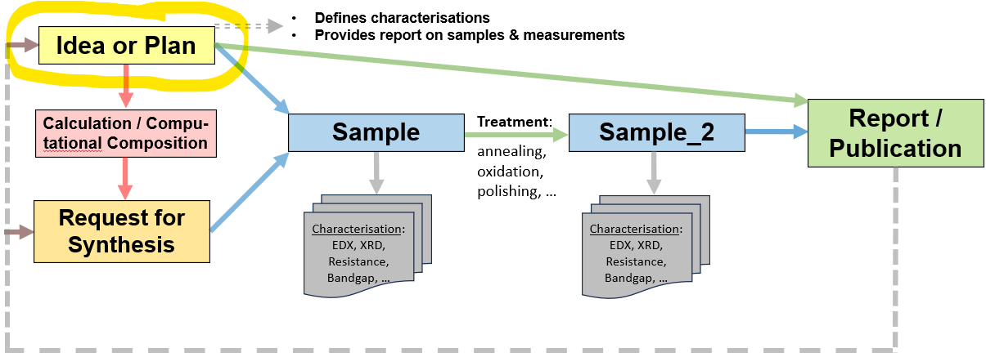

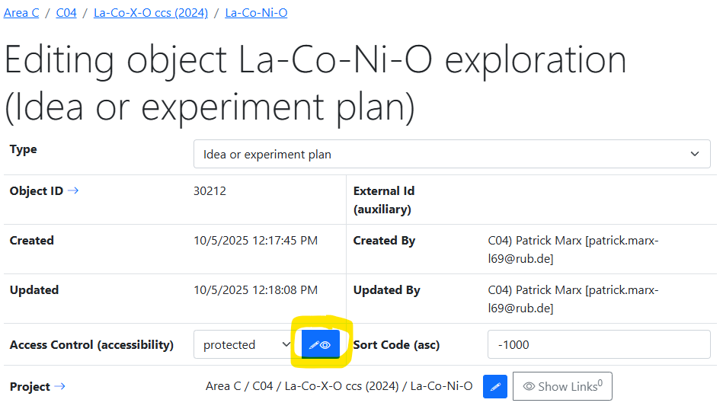
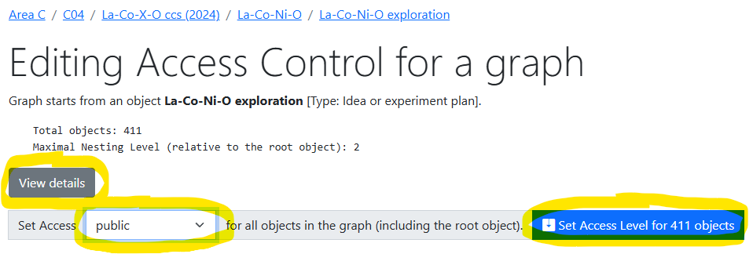
Data publication
Goal:
Change Access Control for entire object graph
Making objects public
Detailed statistics:
Access Control
Licenses
Authors (Creators)
Full Object list for a graph
https://crc247.mdi.ruhr-uni-bochum.de/adminobject/edititem/30212/?returl=%2Fobject%2Fla-co-ni-o-exploration-147192
https://crc247.mdi.ruhr-uni-bochum.de/adminobject/editgraph/30212?mode=AccessControl

Slide 15
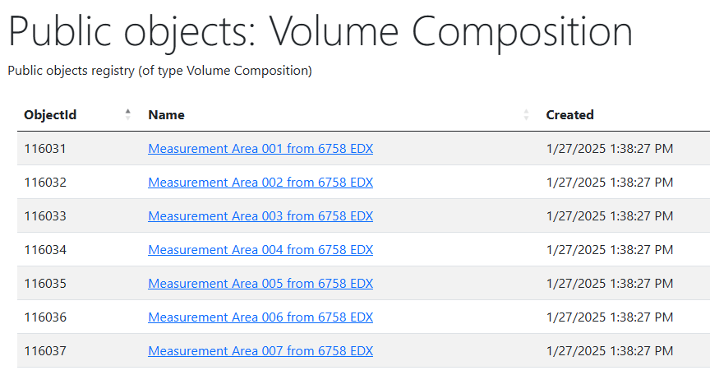
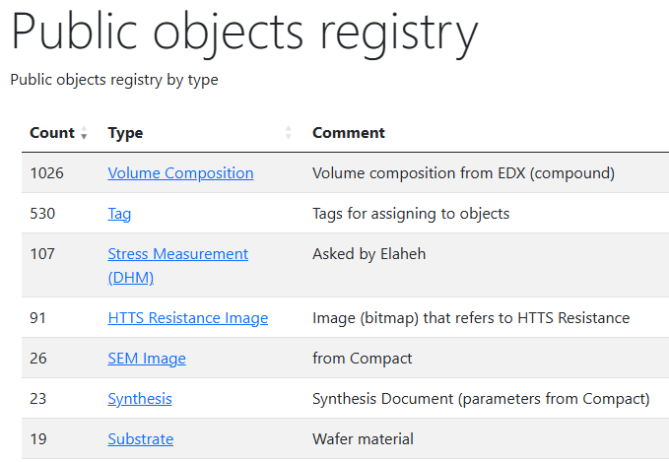
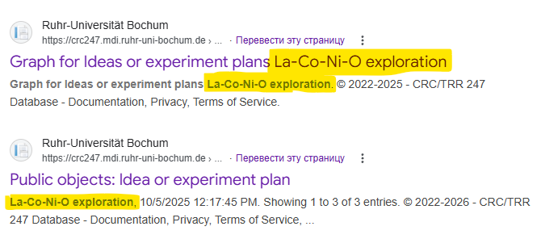
Public objects registry
Goal:
make public objects findable for search bots
To do: generate sitemap.xml (metadata for search bots)
https://mdi.matinf.pro/public https://mdi.matinf.pro/public/type/8
https://www.google.com/search?q=la-co-ni-o+exploration+site%3Acrc247.mdi.ruhr-uni-bochum.de

Slide 16
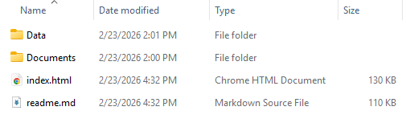

Data publication script
Python code on the top of VRO API
Goal:
Create a graph snapshot (folder with (meta)data) to publish on external repositories (Zenodo, etc).
Input:
Tenant URL (https://crc1625.mdi.ruhr-uni-bochum.de)
VRO API Key (assigned to user by an administrator upon request; to do: GUI for power users…)
root ObjectId (top-level object, e.g., idea or experiment plan)
Output:
A folder that contains:
readme.md
index.html
Data folder (with CSV and JSON)
  + index.csv / index.json – all basic objects metadata in a graph
Documents (with files associated)
data.zip
https://gitlab.ruhr-uni-bochum.de/vic/infproject/-/tree/master/SCRIPTS/Extract_ExperimentData
python VroApi.py --object-id 21579 --tenant-url "https://crc1625.mdi.ruhr-uni-bochum.de" --api-key "<VRO_API_Key>" --publish-dir "Publish"

Slide 17
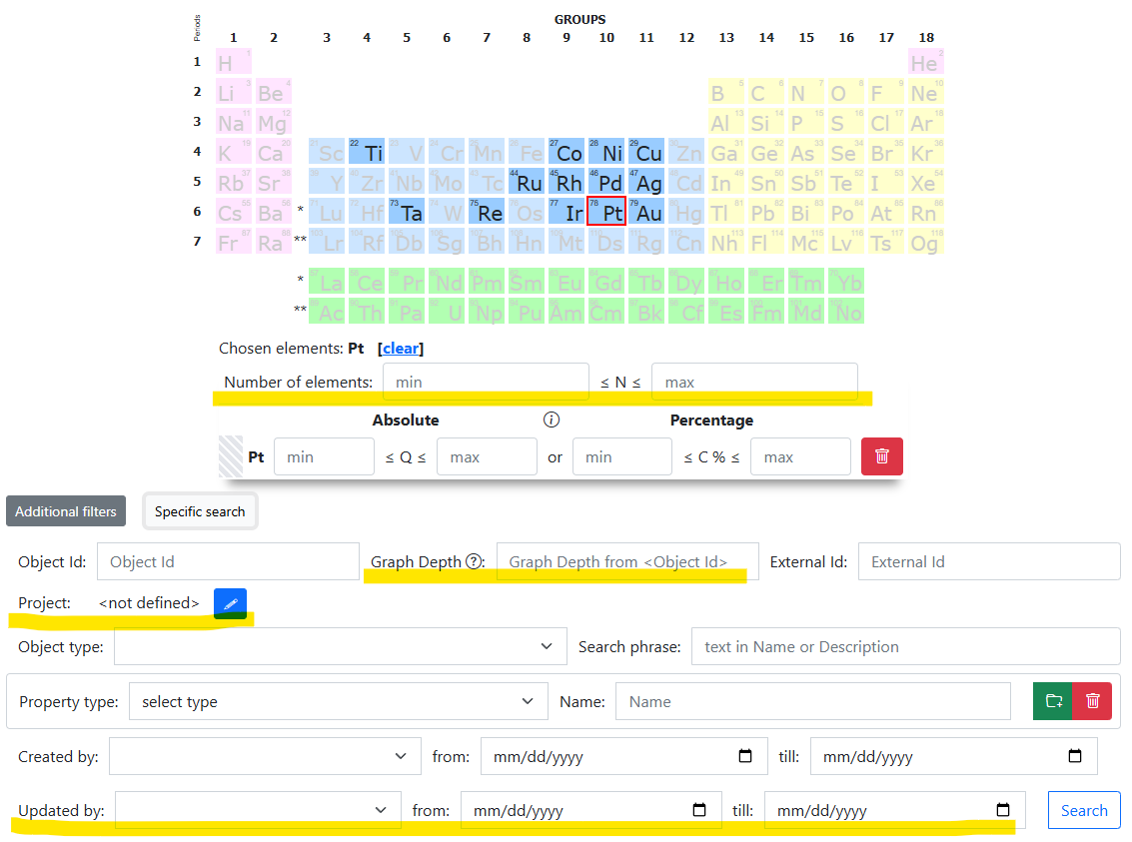
RDMS: Search Criteria Extension
Motivation: add more search criteria to increase expressiveness
New search parameters (as named in query string):
rid – Rubric identifier (to search objects only within specified rubric)
nmin – Minimal number of distinct elements
nmax – Maximal number of distinct elements
olonl – Graph depth (root in <Object Id> node)
updatedbyuser – user, who updated the data
updatedmin – minimal datatime stamp of object update
updatedmax – maximal datatime stamp of object update
pgsize – search page size in objects (1000 – default)
pgn – search page number (1 – default)
By default: top 1000 search results…
https://crc1625.mdi.ruhr-uni-bochum.de/search/?system=Pt&pgsize=1000

Slide 18
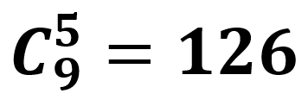
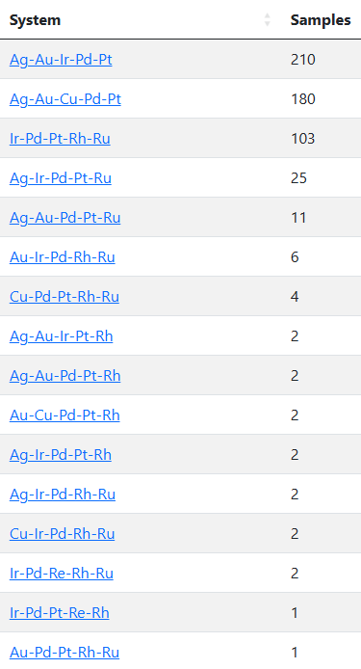
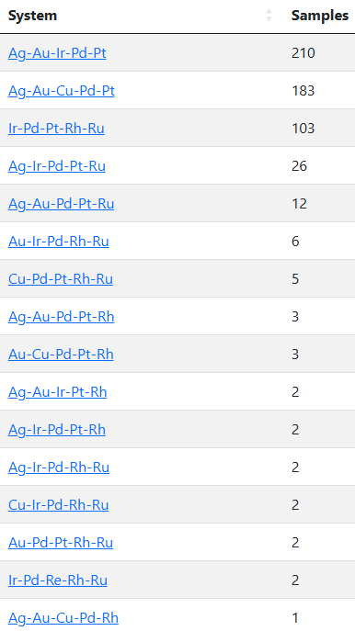
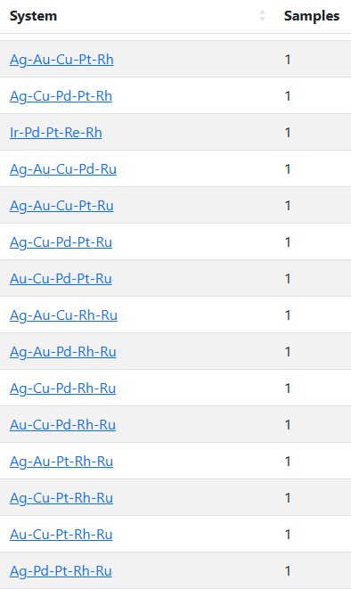
A01-A02: How many quinary systems do we have?
Chemical space coverage for systems of 5 elements from { Ag, Au, Cu, Ir, Pd, Pt, Re, Rh, Ru }
Strict result: 16 of 126 (quinary only) Relaxed result: 31 of 126 (quinary+)
vs
FP1 Proposal, page 118:
WP 1.1: Exploration strategy and selection of CCSS systems
For the 9 elements which are considered in phase I (Pt, Ir, Au, Rh, Ru, Pd, Ag, Cu, Re), 126 different quinary CCSS systems A-B-C-D-E are possible, from which the most promising ones (about 15 systems per year) for synthesis will be selected (see also cross-project collaboration, Section 1.2.2.8) to tackle the CRC research questions.
Takeaway message:
we are not that bad (as reported yesterday)…
Strict search (16/126): https://crc1625.mdi.ruhr-uni-bochum.de/report/chemspacecoverage?nmin=5&nmax=5
Relaxed search (31/126): https://crc1625.mdi.ruhr-uni-bochum.de/report/chemspacecoverage

Slide 19
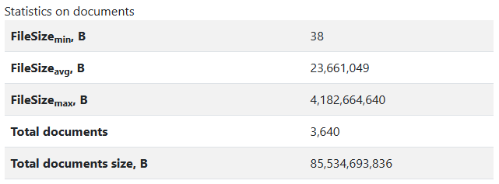
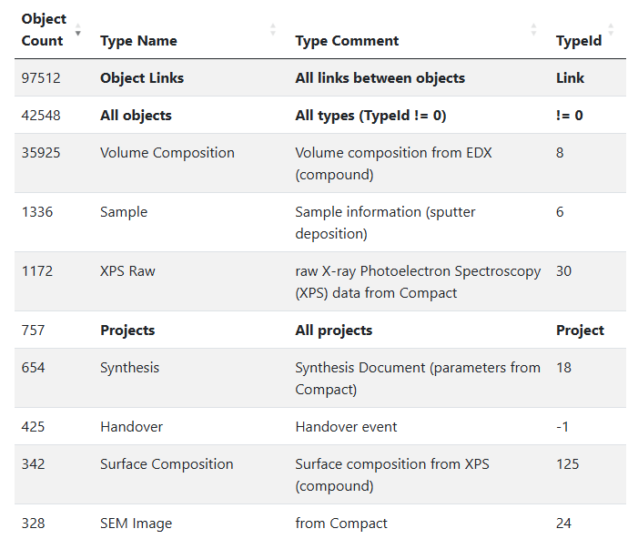
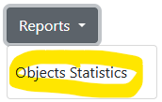
How many data do we have?
Task: raw data volume evaluation
Documents (files):
Total number: 3640
Total volume: 84 Gb
SQL Database:
42 k Objects (36 k volume compositions - auto)
98 k Links (between objects)
757 Projects
Total rows (all tables): 5834 k (~6 M)
Total volume: 90 Mb
In proposal (p. 348): 10 Tb
General raw statistics: https://crc1625.mdi.ruhr-uni-bochum.de/home/general
Objects Statistics report: https://crc1625.mdi.ruhr-uni-bochum.de/report/objectsstatistics

Slide 20

















Outlook: Architecture
Application Services
Web Application
users
Visualisation
Controller
View
Web API Services
Model
API
agents
Validation
Data Access Layer
Data Extraction
Dapper
IO (SMB/S3)
Queue
External Type Support Services
Database
File Storages
Apache
Kafka
Database
Databases
Storage Services
Message Bus
MatInf – Research Data Management System

Slide 21
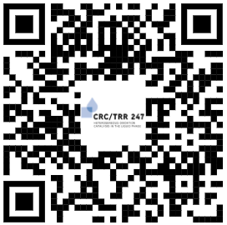
RDMS Free Playground
Questions & Answers
Thanks for your kind attention
  https://inf.mdi.ruhr-uni-bochum.de/
Playground to test RDMS (multiple tenants with shared users list):
https://inf.mdi.ruhr-uni-bochum.de/
Login and Password (User role): User1@user.org
Login and Password (PowerUser role): PowerUser1@user.org
Login and Password (Administrator role): Admin1@user.org
https://vdudarev.ru
Notes:
https://qr.io/

Slide 22
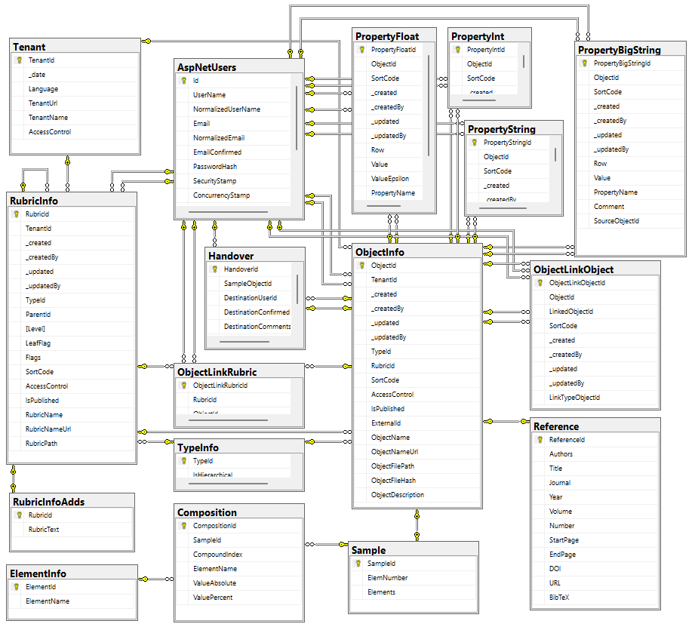

Data Acquisition API: Dashboards & Datasets
The RDMS exposes all data as read-only views
and downloadable documents
API user can introduce any queries over views
POST /vroapi/v1/execute
Executes SQL statement and returns a dataset (in JSON)
GET /vroapi/v1/download
Downloads document by specified identifier (ObjectId)
Database schema documentation:
https://crc1625.mdi.ruhr-uni-bochum.de/home/doc
https://crc1625.mdi.ruhr-uni-bochum.de/home/doc

Slide 23
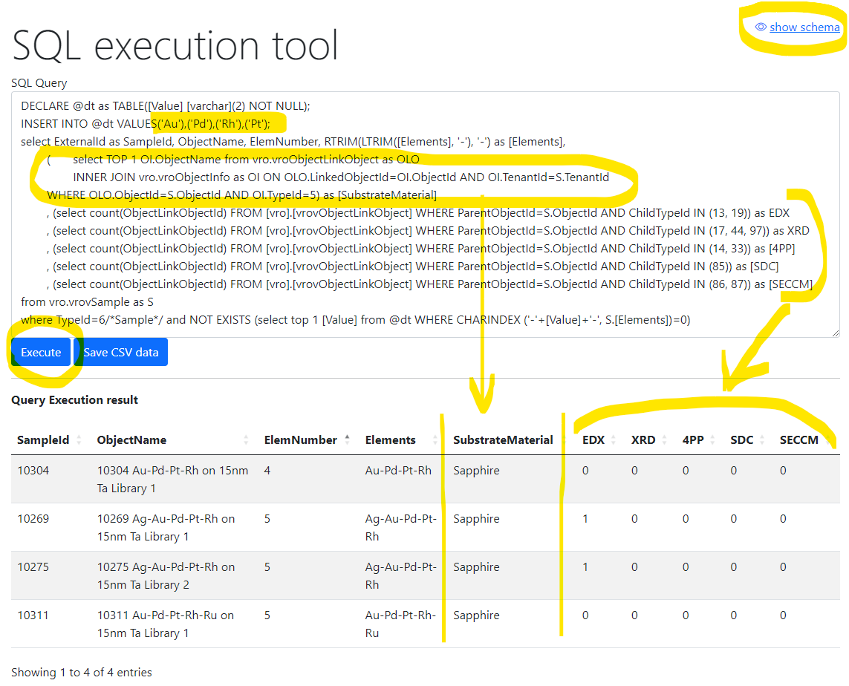
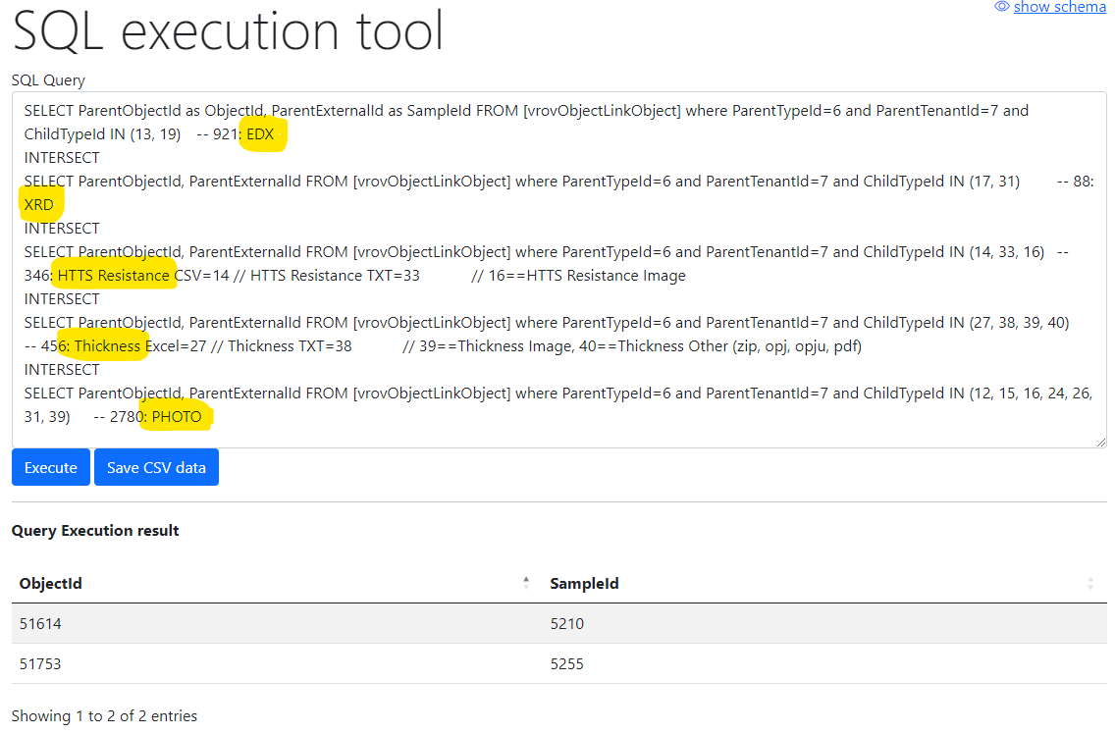
Flexible data queries for advances users
Database schema documentation:
https://mdi.matinf.pro/home/doc
Show samples having Au-Pd-Rh-Pt and how many characterization documents for them we have (EDX, XRD, 4PP, SDC, SECCM)
Show samples (identifiers) that have all enlisted characterisations: EDX, XRD, Resistance, Thickness, Photo
https://mdi.matinf.pro/vroui
EDX - Energy-Dispersive X-ray spectroscopy; XRD - X-ray diffraction; 4PP – 4 Points Measurement (Resistance);
SDC - Scanning Droplet Cell; SECCM - Scanning ElectroChemical Cell Microscopy

Slide 24
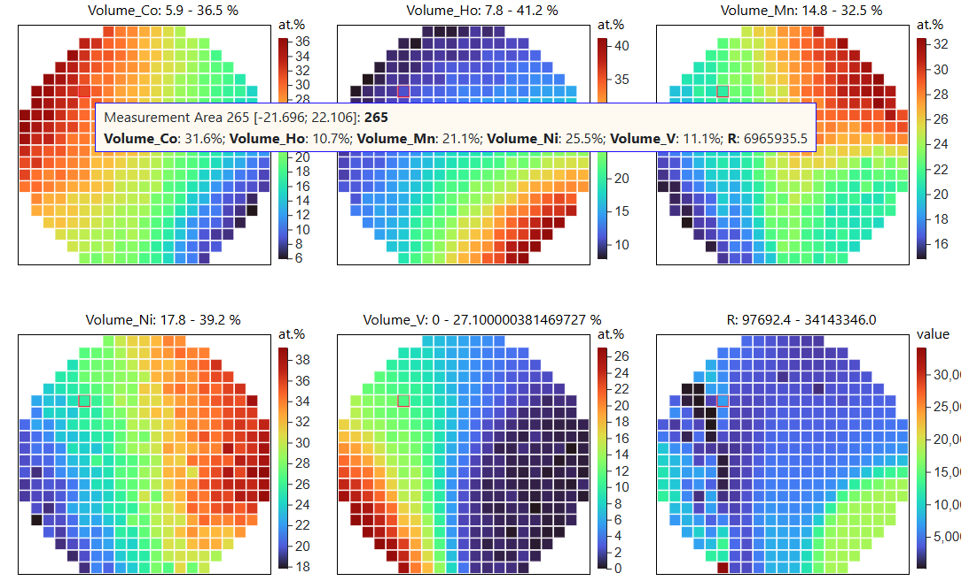
RDMS: Getting a Composition-Property Dataset
Goal: explore a materials library and get composition-property dataset
Workflow:
Create a materials library (Sample) & create Sample (Synthesis?) object in RDMS
Measure compositions in a high-throughput way (EDX) & upload to RDMS
Measure property (4PP Resistance) in a high-throughput way & upload to RDMS
In RDMS: download a dataset (in CSV), containing 342 composition-property data points
In RDMS: visualize a composition-property dataset and draw conclusions
Sample
EDX
4PP
Resistance
EDX – Energy-Dispersive X-ray spectroscopy (to determine composition) 4PP – 4-Point Probe structure)
https://inf.mdi.ruhr-uni-bochum.de/object/test-sample
https://inf.mdi.ruhr-uni-bochum.de/dataset/sampleshowascsv/32682

Slide 25
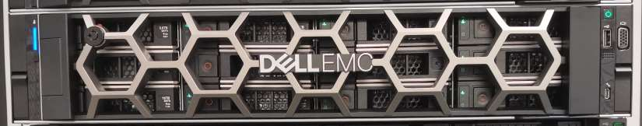
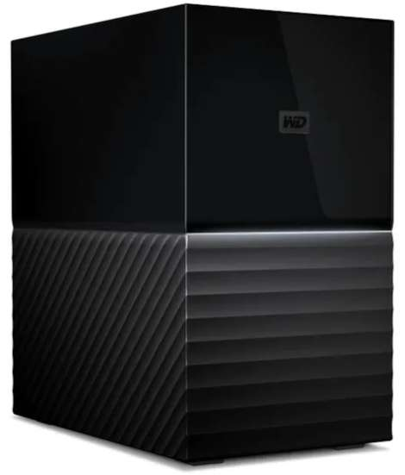
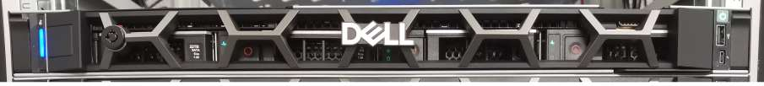
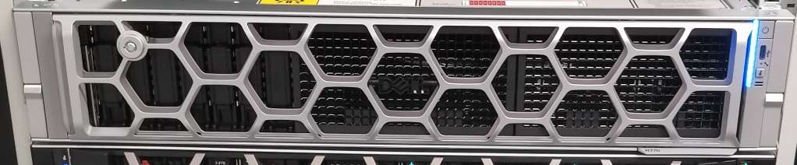
RDMS: Is my data safe?
IC OST Server Room
RUB DC
2 km
Main
Daily/weekly backups
Data
External
Storage
Weekly
backups
Backup
Monitoring
Compute
https://matinf.pro/crc247-fp2-inf-report.htm

