Slide 1
Doaa Mohamed, Victor Dudarev, Markus Stricker
INF: FAIR collection, curation, and management of multidimensional research data
26 September 2026

Slide 2
What is INF good for? → Enabler
Data in Brief publication
(KG-driven data extraction, ontology alignment, ro-crate, …)
Cold start active learning, both exploration and exploitation (API to access/trigger optimal cold start predictions, external service)
Contrastive learning (API + local data processing, to be done as extractors)
A03 segregation prediction from MD simulations (CRUD API)
GUI assessment + improvement (user study)
Virtual electrochemist (“proper” metadata for SECCM; reassessment of data and metadata structure for all projects)
RAG: Chatbot for internal and external paper queries
RDM workshop (early 2027)
Markus

Slide 3
Scope since the last general meeting/retreat
Last agreed plans:
Active learning for materials characterization
ML-based XRD phase prediction
Extend methods across characterization techniques
RAG System
Dataset Paper
Virtual Electrochemist
Progress achieved:
Active learning: resistance prediction implemented
XRD: single-phase prediction implemented
Handover: handover group as destination for handover
(S project: EDX, XRD)
FAIRsharing.org: CRC 1625 tenant was approved
Dataset Paper: Datasets generation over a group of samples
Remaining focus:
Extend XRD prediction to multiphase systems
Extend active learning to SECCM
Generalize to further characterization techniques
CRUD API
Workshops (general, data publication, advanced API)
Markus

Slide 4

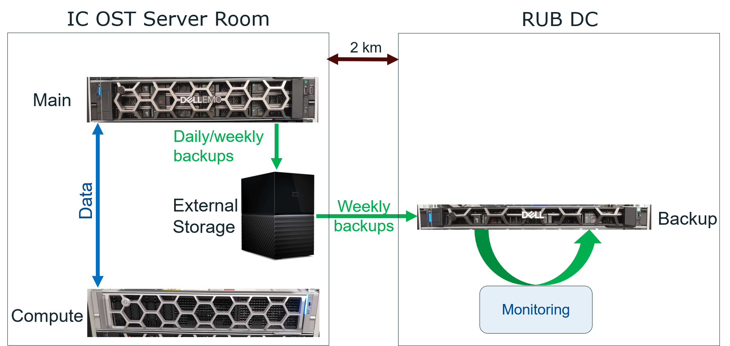
Dedicated Hardware INFrastructure
Victor

Slide 5
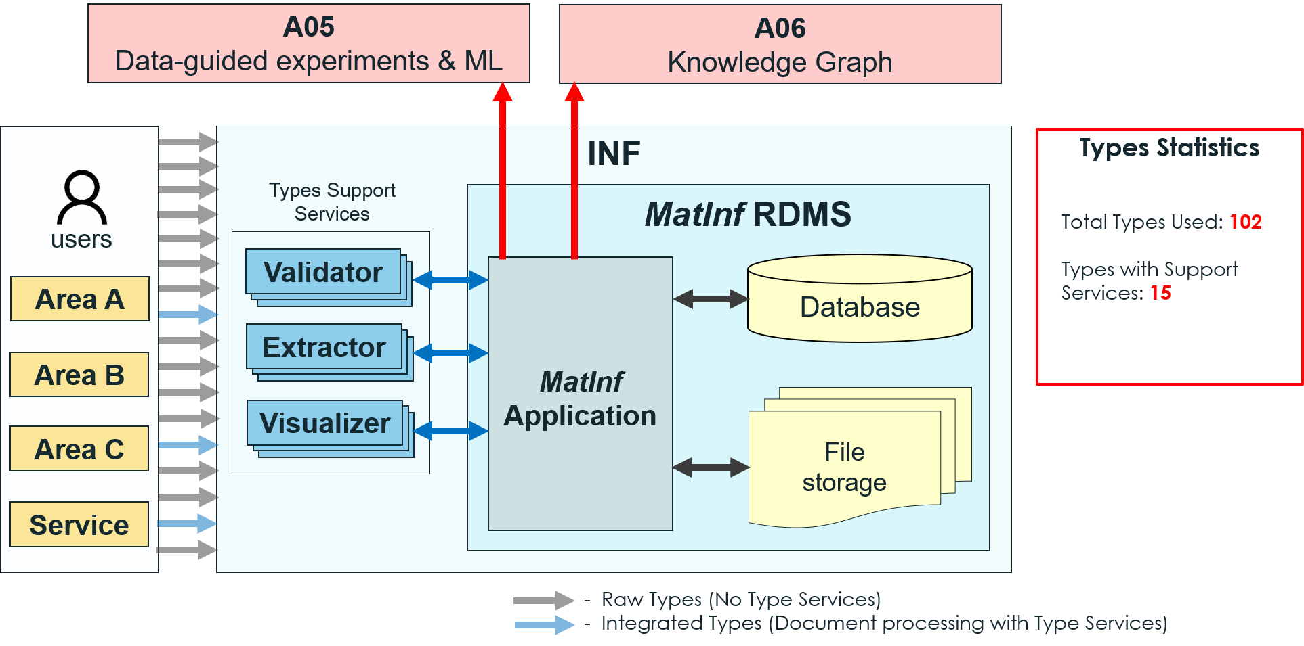
INF Placement
Victor

Slide 6
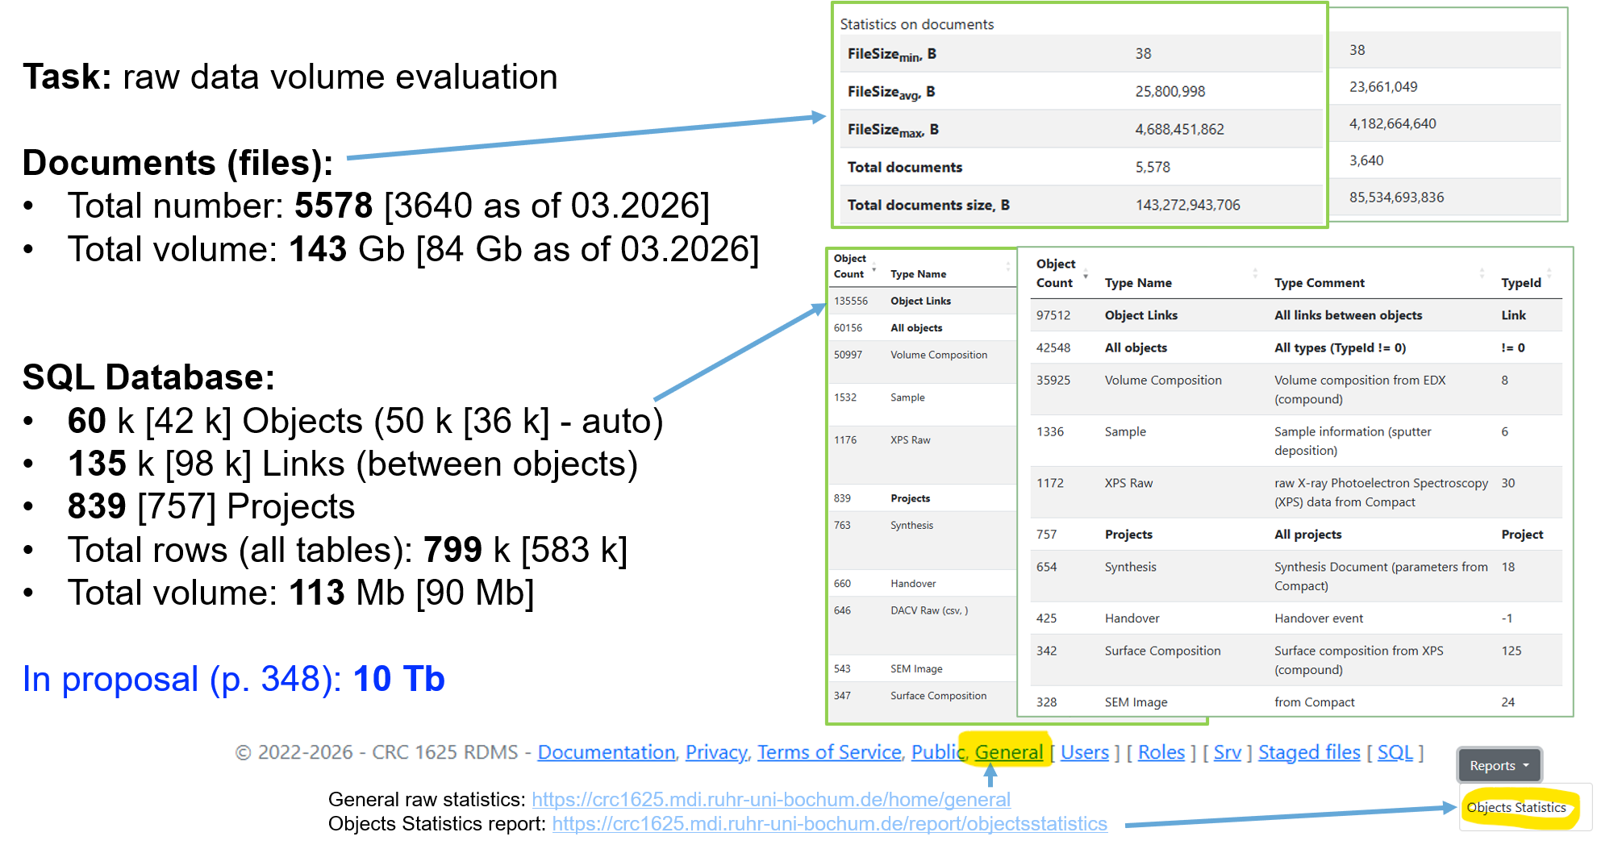
Data: how many?
Growth in data:
Victor

Slide 7
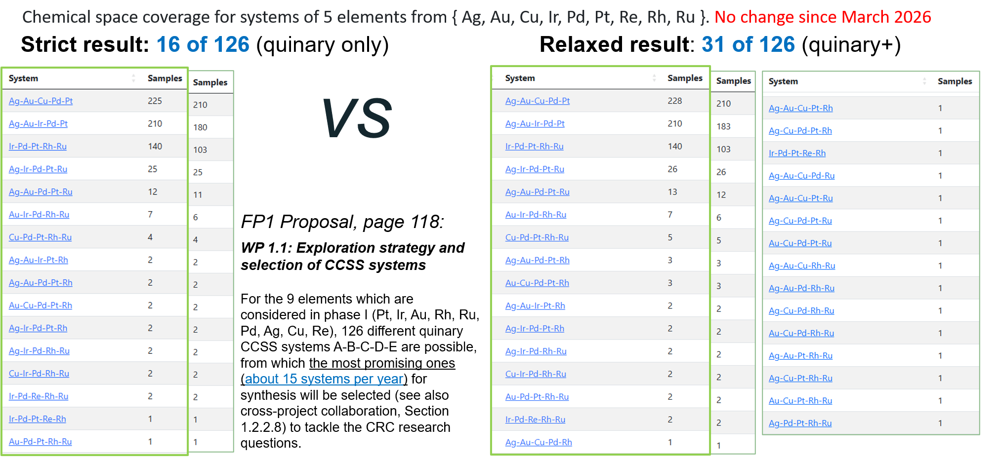
How many quinary systems do we have?
Victor
Strict search (16/126): https://crc1625.mdi.ruhr-uni-bochum.de/report/chemspacecoverage?nmin=5&nmax=5
Relaxed search (31/126): https://crc1625.mdi.ruhr-uni-bochum.de/report/chemspacecoverage

Slide 8
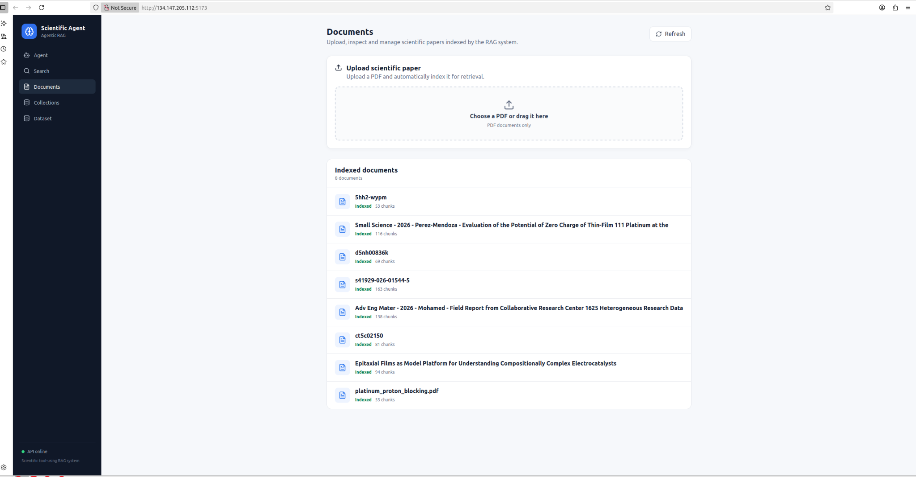
RAG — Retrieval-Augmented Generation
Upload papers here
📄 Scientific Papers → 🔍 Retrieval → 🧠 LLM → 💬 Grounded Answer
Doaa

Slide 9
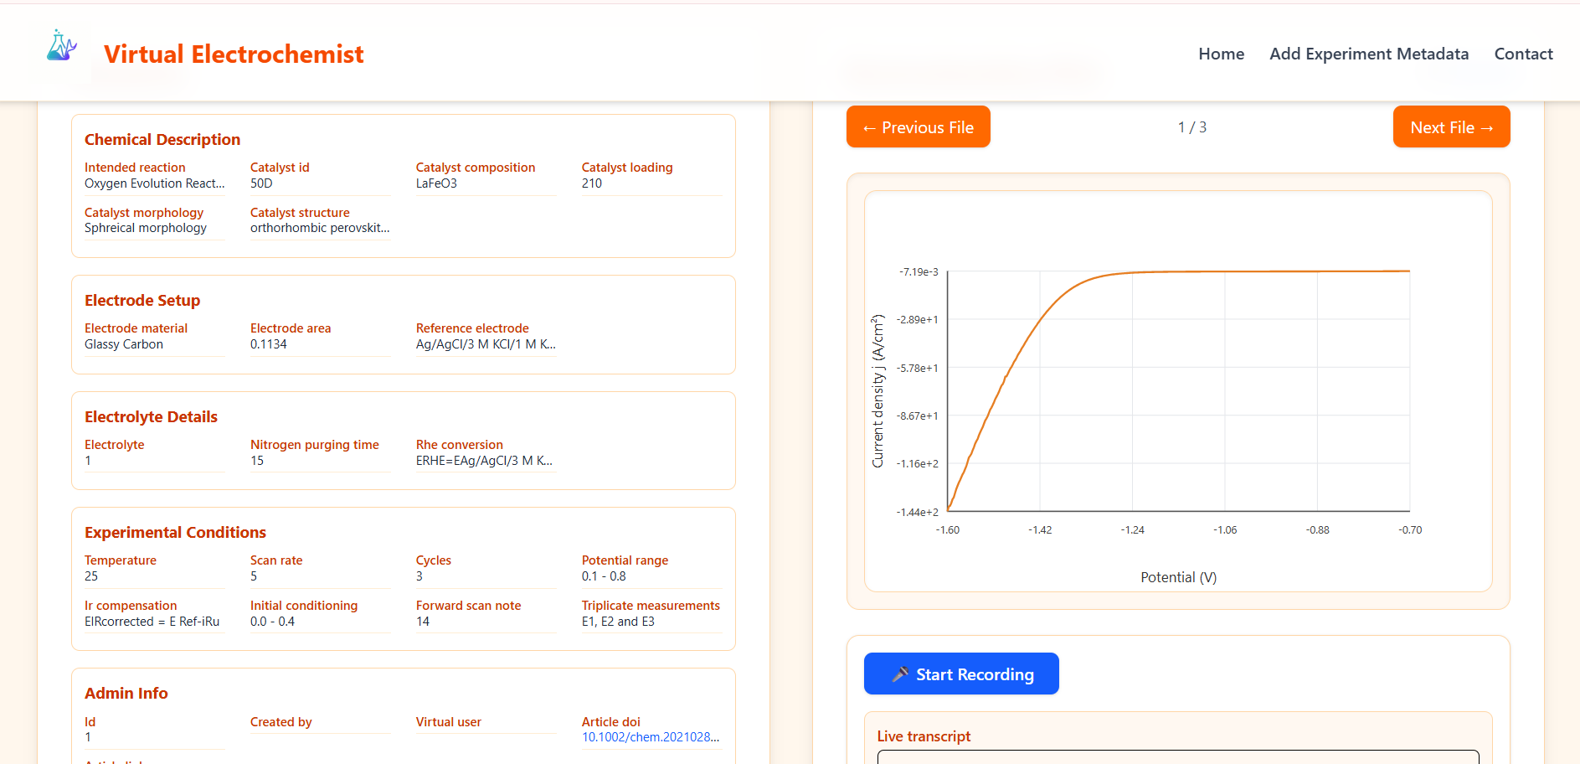
Virtual Electrochemist: Descriptor development
A web-based platform for electrochemical research that enables structured metadata entry, visualization of voltammograms, and recording expert descriptions to support data-driven analysis and AI-based interpretation.
🗄️ RDMS → 🌐 Website → 📈 LSV/CSV → 🎙️ Voice Recording → 📝 Speech-to-Text → 🔎 Text Mining → 🧩 Descriptors
Doaa

Slide 10
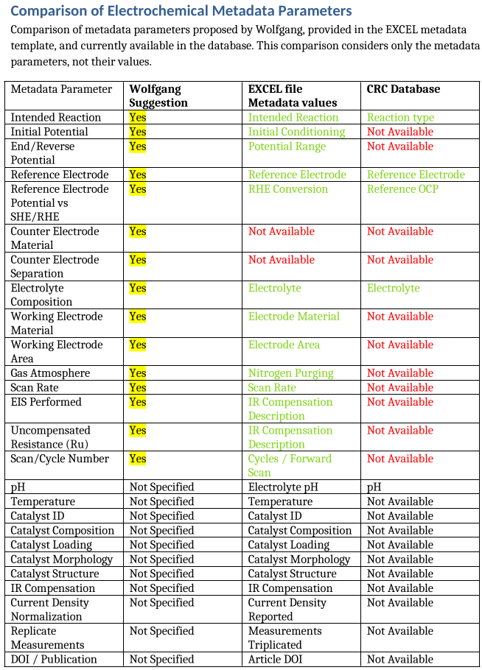
Metadata cleanup: SECCM
Incomplete, relevant metadata is missing in RMDS
With each project: reassess current schemas and ingest workflows
LLM-assisted ingest? (future)
Doaa

Slide 11

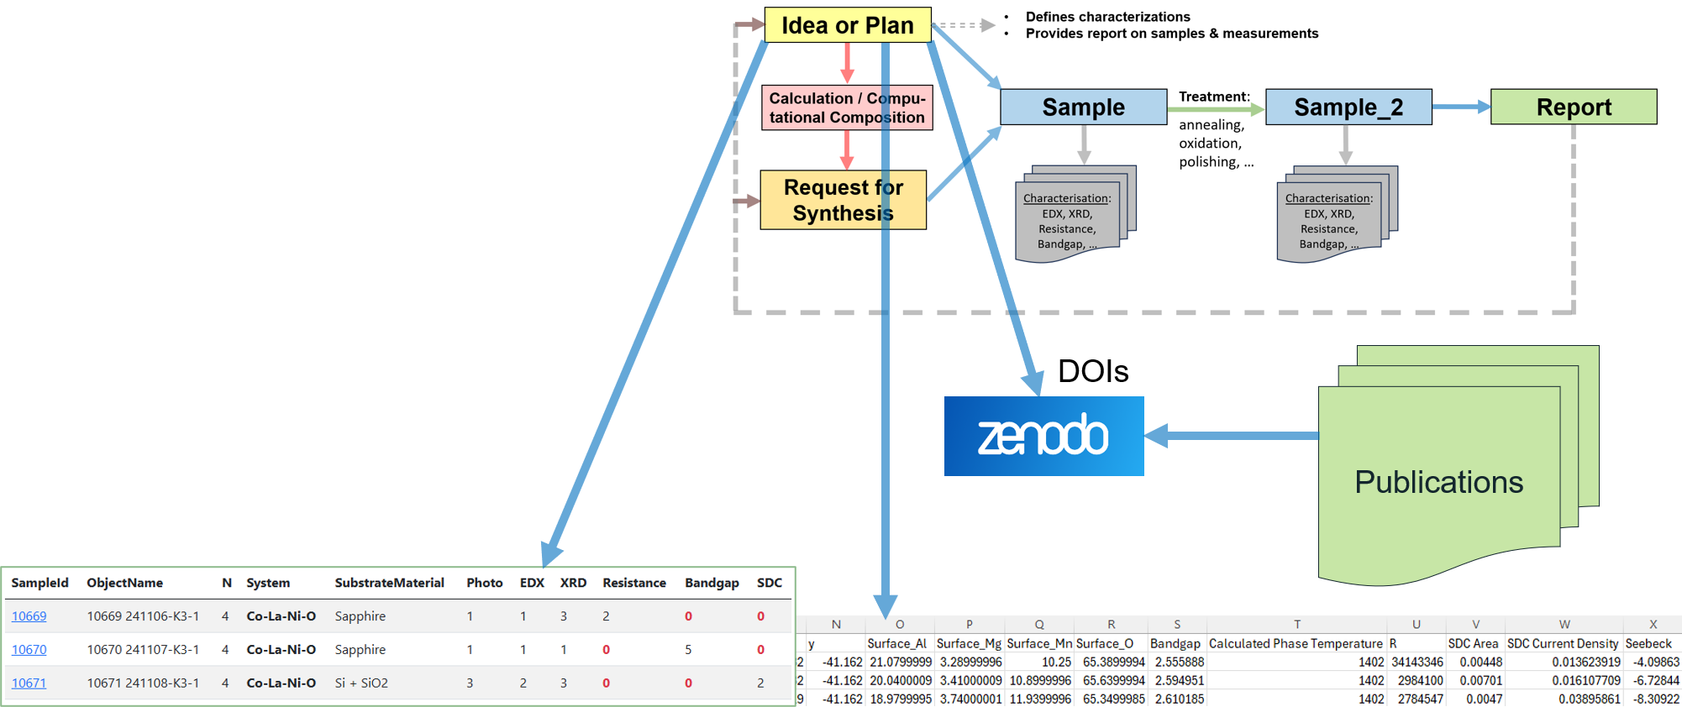
Project highlights
Work package | Highlight | Evidence / output | Why it matters for the proposal
WP3 |  | https://fairsharing.org/FAIRsharing.76c84e DOI: https://doi.org/10.25504/FAIRsharing.76c84e | CRC 1625 Repo satisfies strict Springer Data Repository Guidance rules.
WP4 | Dataset generation over a group of samples | JSON / CSV | Automated way to produce datasets
Victor

Slide 12
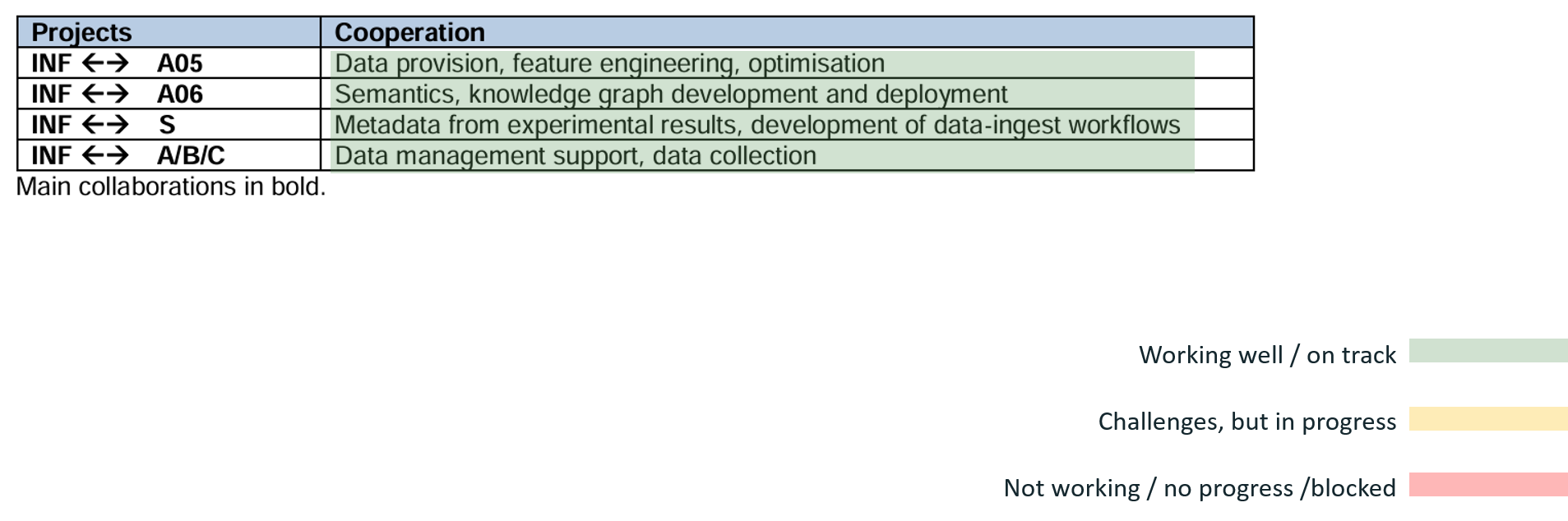
Cross-project collaborations: planned vs. realized
Victor

Slide 13
What we need from the consortium
Decision needed:
Data quality assessment (Who? When? PIs with 3 months embargo)
Input needed:
GUI assessment?
Critical assessment of metadata
DMP (lite version) for subprojects (data formats description / guided RDMS fingerprint)
Support needed:
Data curation
Data quality assessment
Victor
DMP - Data Management Plan

Slide 14
Publications: 2026 outputs and upcoming
Published
1) Dudarev, V., Ludwig, A. "Evolve with your research: stepwise system evolution from document-driven to fact-centric research data management in materials science". J Cheminform., 2026.
2) Dudarev V., Kiselyova N., Ludwig A. “Information support for collaborative research in the field of thin-film materials: from synthesis to workflow control”. Pattern Recognition and Image Analysis, 2026.
3) Mohamed, D.; Vázquez, S. G.; Mardani, B.; Dudarev, V.; Ludwig, A.; Acosta, M. & Stricker, M. Field report from Collaborative Research Center 1625: Heterogeneous research data management using ontology representations, Advanced Engineering Materials: Special Issue NFDI MatWerk, 2026
4) Mohamed, D. & Stricker, M. Knowledge-driven XRD phase identification via multi-view retrieval and explanation, ECML PKDD 2026
Submitted/review
Mohamed, D.; Thelen, F.; Zehl, R.; Ludwig, A. & Stricker, M. Strategies for cold-starting active learning loops using multiple data modalities, TMLR
In preparation/planned
Mohamed, D.; (et al.); Acosta, M. & Stricker, M.; Enhancing Materials RDMS with AI-Assisted Data Access and User-Centered Interface Design
Mohamed, D.; (et al.) & Stricker, M.; (Extendable) reference dataset – all CRC members as co-authors (Data in Brief)
Dudarev, V.; Stricker, M.; Ludwig, A.: Dual-Access Publication Strategy for Reproducible Research Data in Materials Science
Posters/presentations
Poster at SFB-INF Workshop (2024)
Poster at CoRDI (2025)
Poster at All-Hands-on-Deck - NFDI (March 2026)
Poster at AI4AM (May 2026)
Talk at MSE (September 2026) (3)
Talk at MMM12 (November 2026)
RDMS ZBT Duisburg
Victor

Slide 15
Finish the project in the best possible way
Now
Good publication record, also technical publications
Working and developing RDM solution
MatInf and associated technologies are visible
Next 3 months
Data in Brief paper (metadata!)
RAG
CRUD API
Workshop (RDM+metadata)
Before project end (before finishing proposal)
“Living” dataset publication + access
APIs
Data ingest from theory
(via CRUD API)
Victor
Guidance: End with specificity, name the final milestones and what the other can do to help

Slide 16
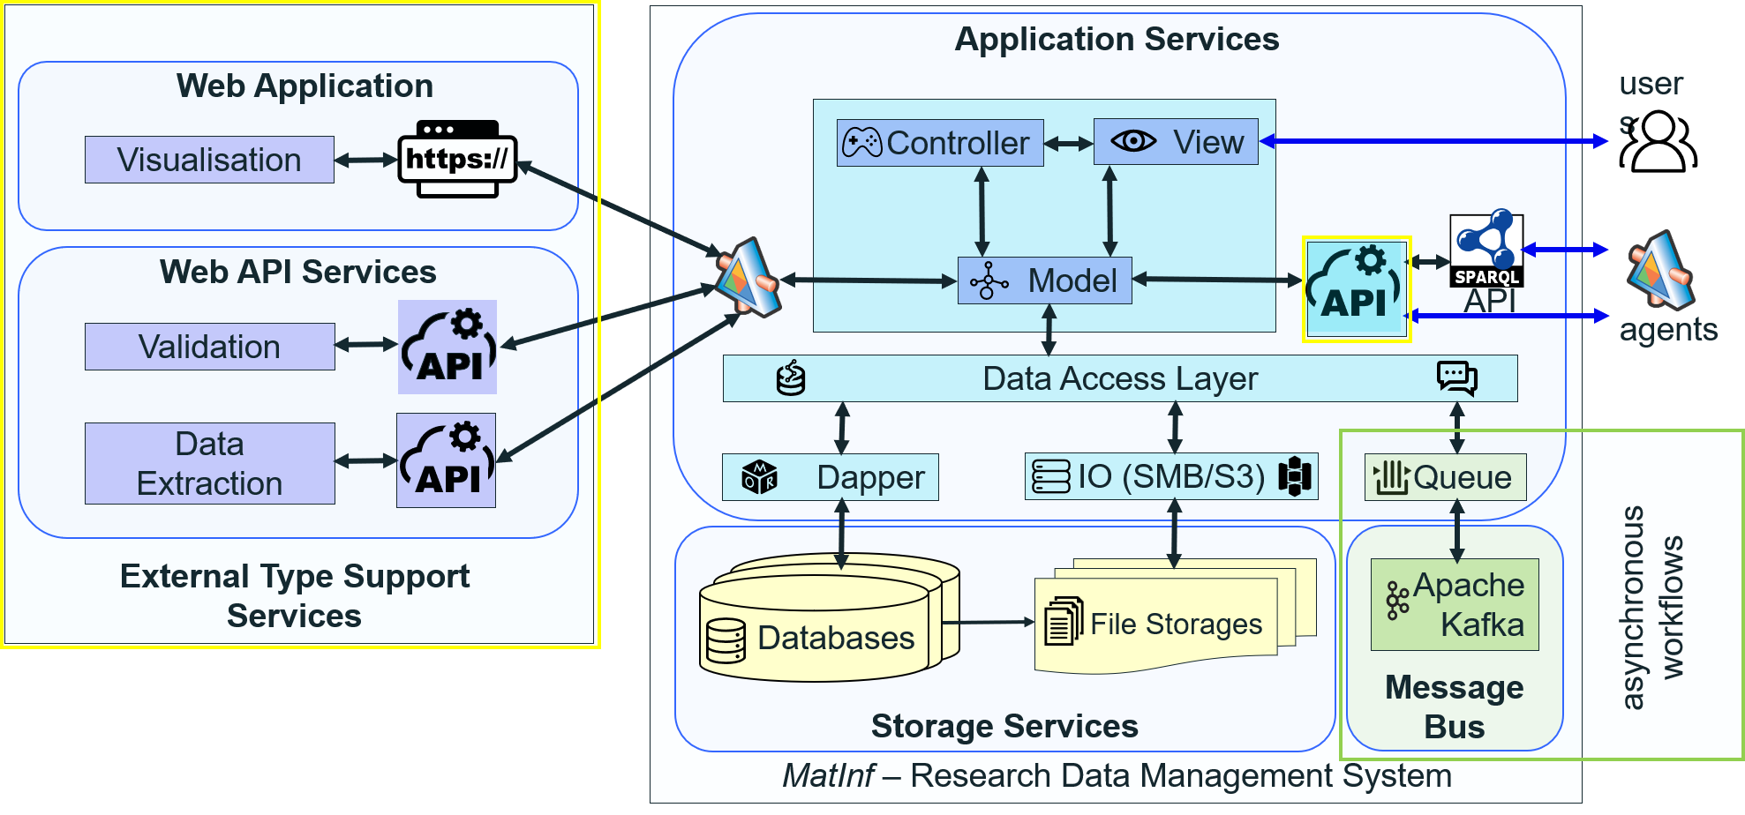
Outlook: Architecture
Victor

Slide 17
Outlook: Funding phase 2
A “living” reference dataset: Append to the published reference dataset (Scientific Data), ideally automatically as data becomes available
Integration of sample-specific cold start strategies as (meta)data of samples to be used in robotic measurement campaigns
A03: Automated service for segregation prediction, possibly combined with EDX-to-XPS
EDX-to-XPS general model rather than Active Learning (possibilities: NLP; MLIPs?)
Automated characterization of LSV/CV based on Virtual Electrochemist outcome
Streamlining data ingest; LLM- or rule-based ELN extraction, even from "weekly reports"/powerpoints
Streamline data publication with connections to relevant indices/registries so data can be found (even if licencing permit direct download) with A06
More data validators/extractors for existing types (standardization input is required)
Depending on the consortium structure: add new data modalities if they are available
Metadata schemas, aligned with ontology + ontology development with A06
Support for .ELN format and collaboration within the ELN Consortium
OPTIMADE API
Cross reference another databases: Alexandria/Materials Project, etc
Materials Database Integration Platform (… FP3)
Continuous teaching/workshops of data management
Victor

Slide 18
Thank You!
Any Questions?

Slide 19
Backup slides

Slide 20
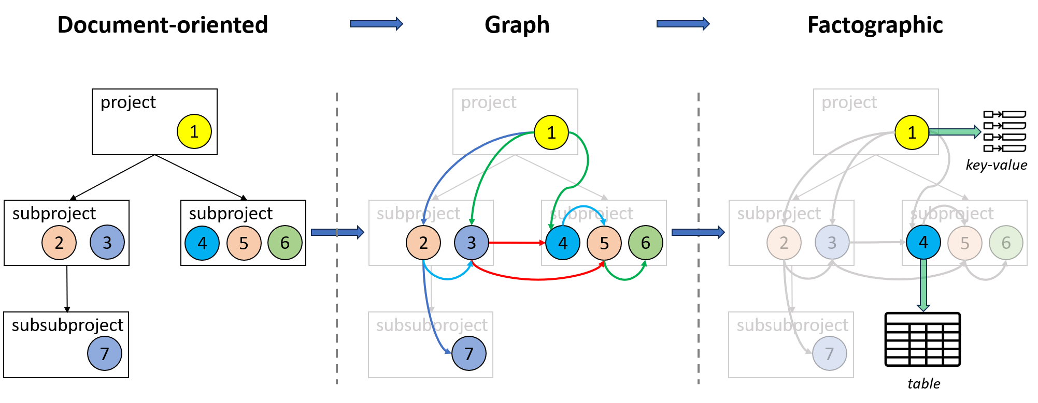
Towards AI-ready datasets
https://inf.mdi.ruhr-uni-bochum.de/object/sample-demo-29196

Slide 21
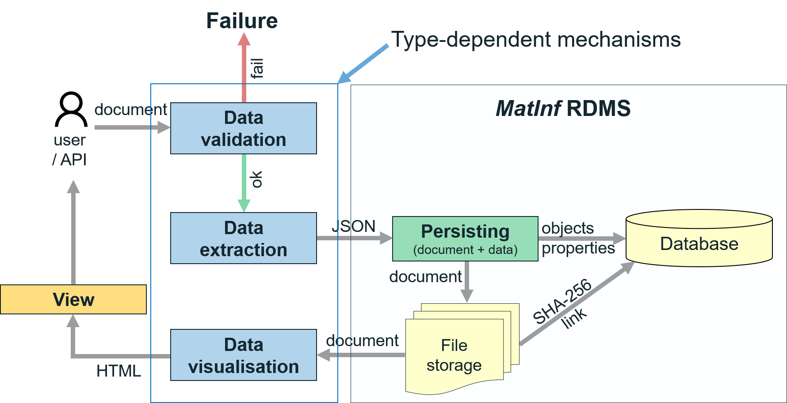
Documents: Standardisation, Testing, Extraction

Slide 22
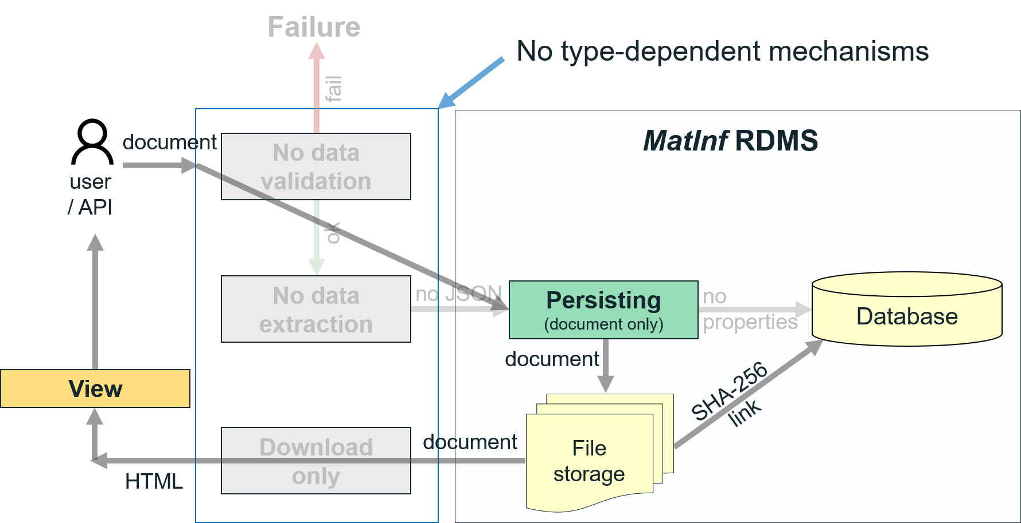
[Raw] Documents: no data processing

Slide 23
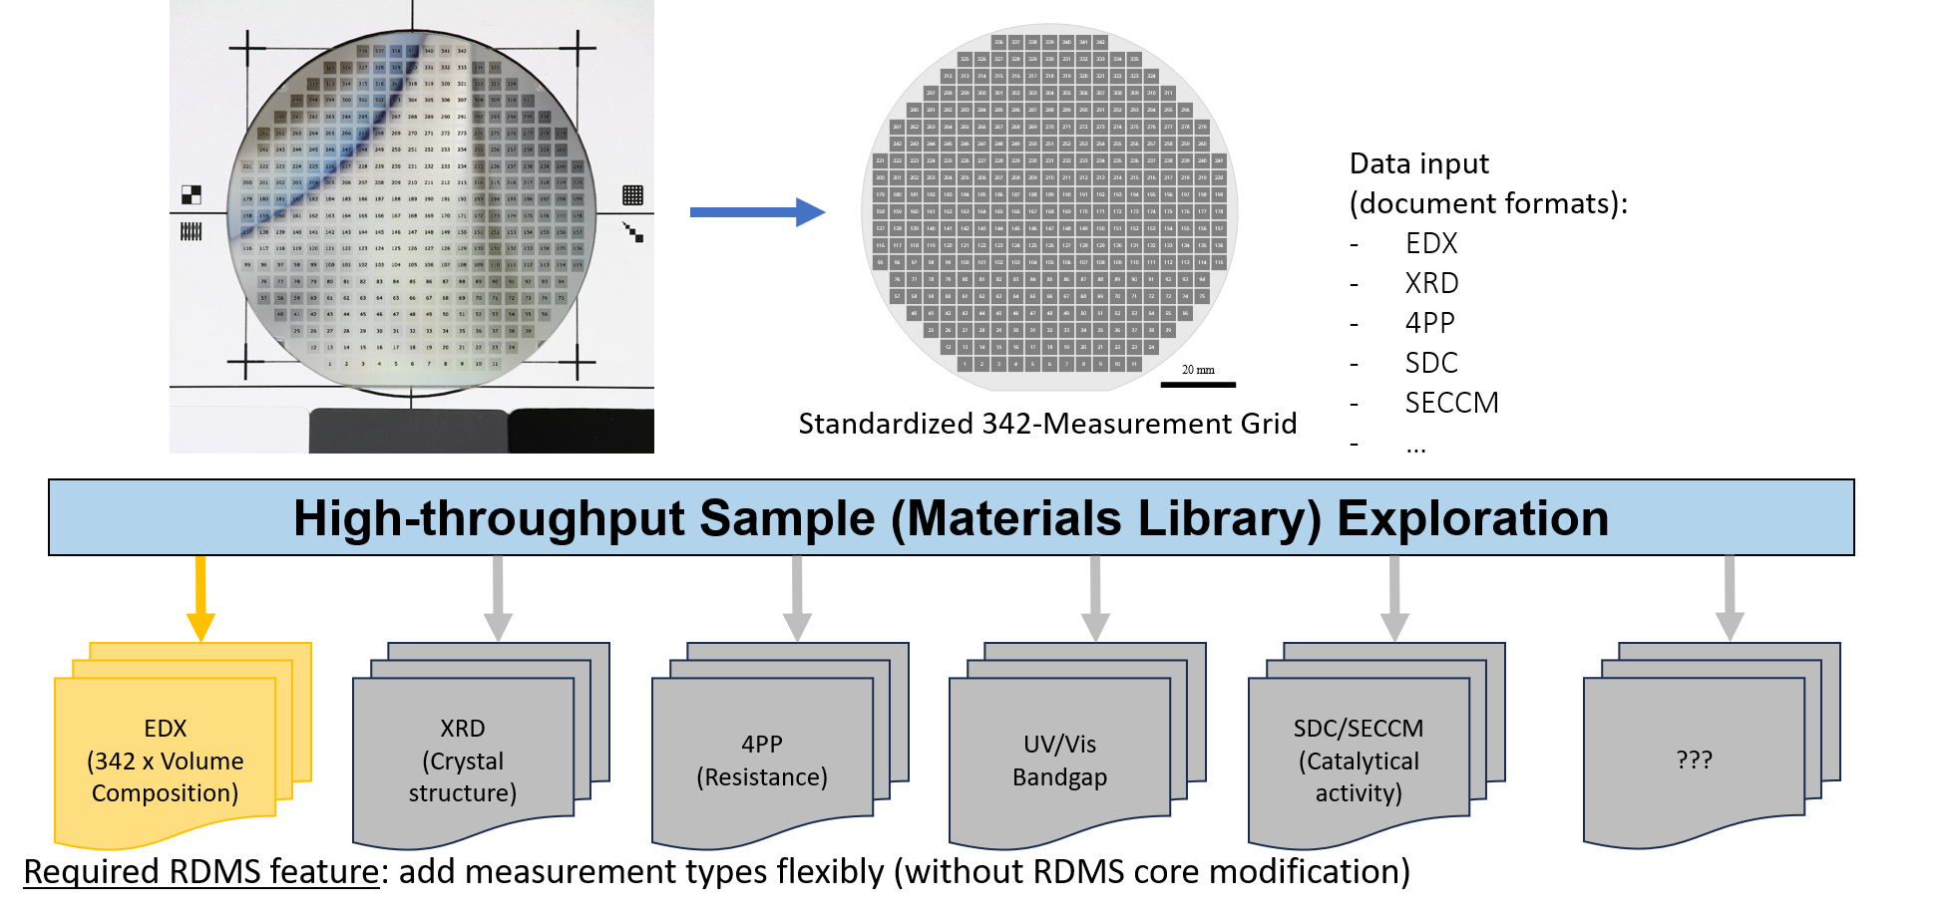
High-throughput Materials Library Exploration

Slide 24
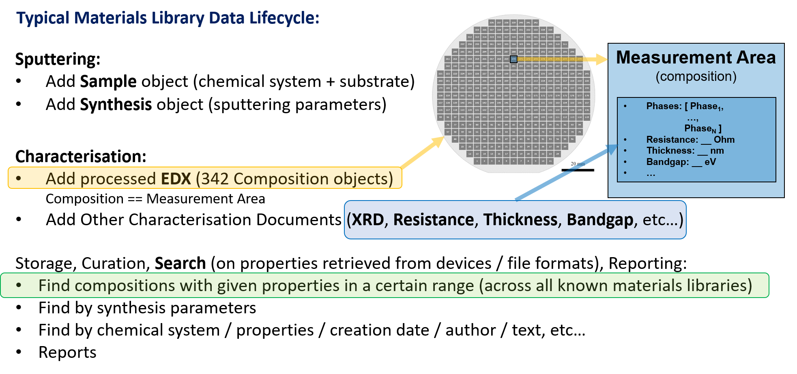
Integration of heterogeneous measurements

Slide 25
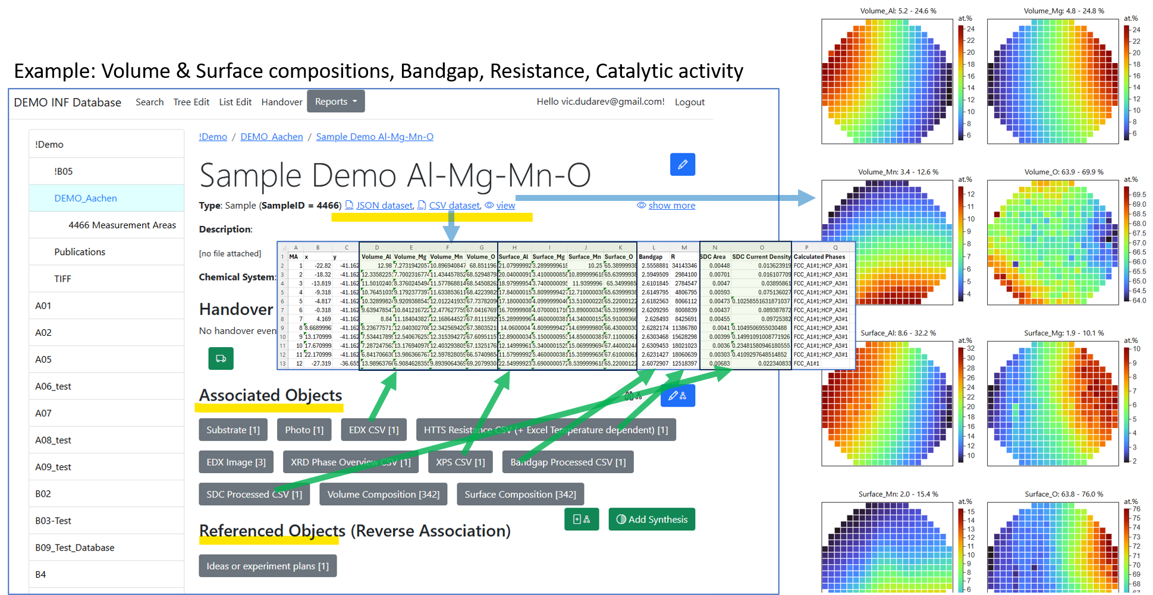
Data Integration for a Sample
https://inf.mdi.ruhr-uni-bochum.de/object/sample-demo-29196

Slide 26
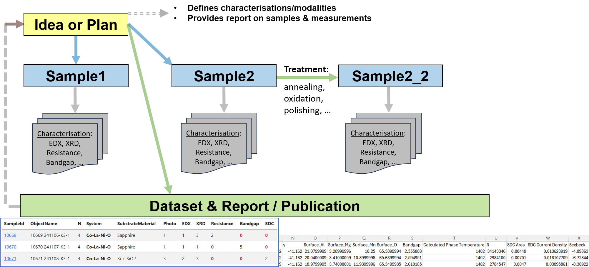
Multi Sample Research & Data Integration
https://inf.mdi.ruhr-uni-bochum.de/object/sample-demo-29196

Slide 27
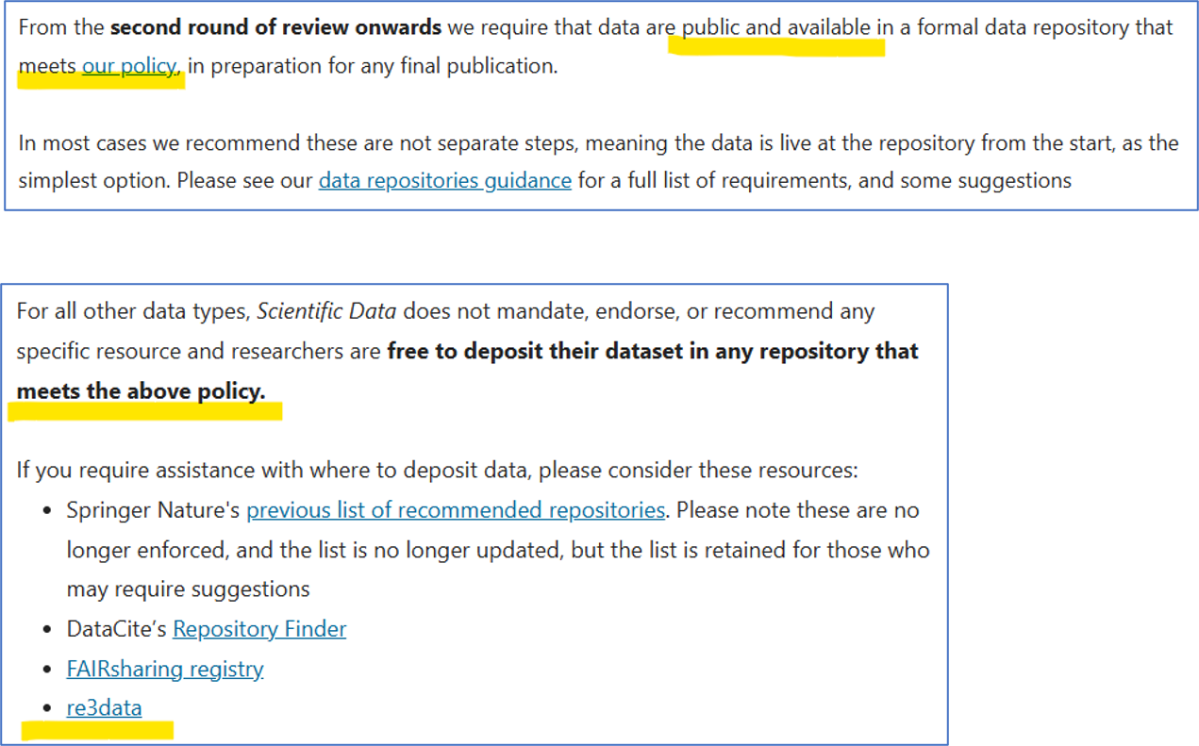
Data publication requirements: Nature Scientific Data case
https://www.nature.com/sdata/submission-guidelines
https://www.nature.com/sdata/policies/repositories

Slide 28
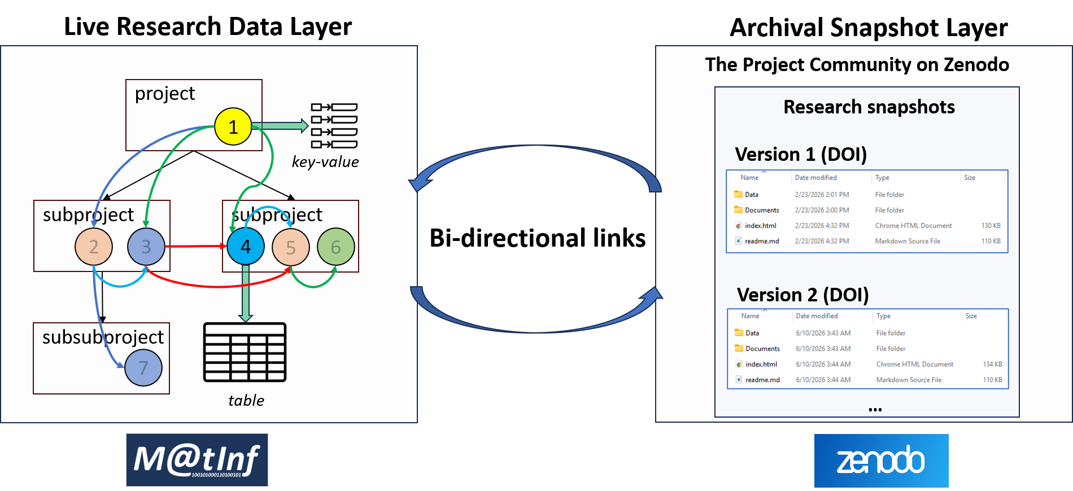
Dual Data Access Publication Strategy
https://www.nature.com/sdata/submission-guidelines
https://www.nature.com/sdata/policies/repositories

Slide 29
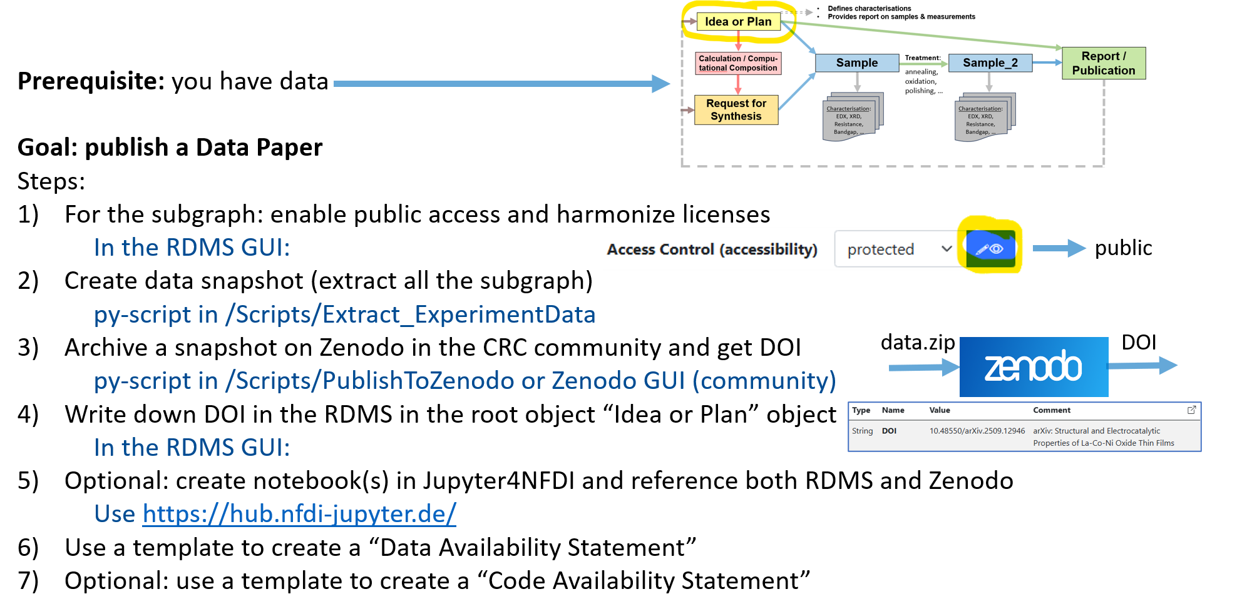
Summary: publication workflow

Slide 30

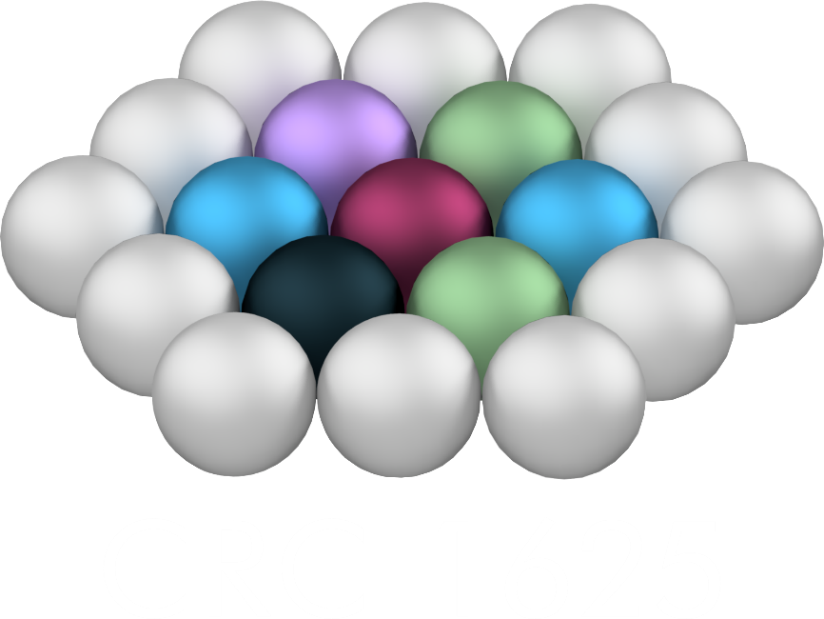
Color for project
Project A #45ACDF
Project B #8DBB8C
Project C #A485CE
Project general #737373
CRC 1625 font Arial
Background color #14272E

Slide 31
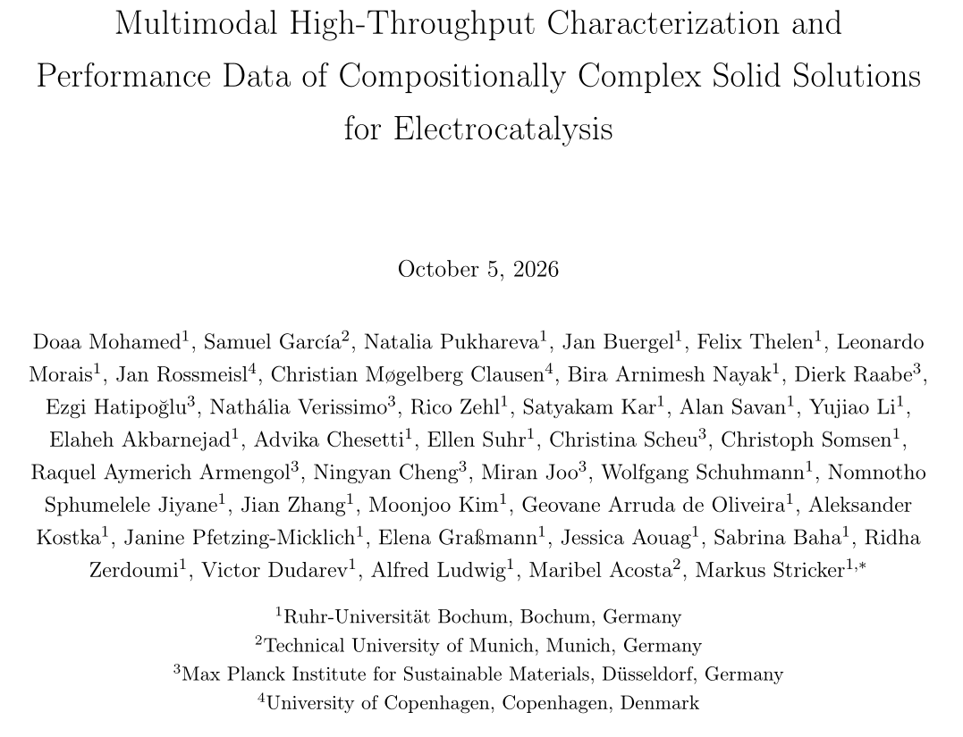
Scientific Data (paper about our data)
We need your help, see slack channel
#2027_scientific_data
Individual method descriptions (paragraph length)
Metadata cleanup/correction
Cross-reading (later)
Consent
Check names, affiliations, ORCIDs, etc.
Internal Deadline: Dec 11, 2026
Markus

Slide 32
Dataset Paper: Modality overview
Characterization Group | Object Type | Number of Creators
Synthesis | Synthesis | 9
Elemental composition | XRD | 7
Crystal structure | XRD | 5
Microscopy and microstructural characterisation | SEM Image and any SEM raw/metadata | 3
Surface topography | Topography / AFM, AFM Analyzed Height (spm, txt, tif/tiff, png, jpg), AFM metadata | 4
Electrochemical characterisation | SECCM, SDC | 3
Electrical characterisation | Resistance | 3
Optical imaging | Photo | 5
https://docs.google.com/document/d/1R-MWIu_nL2EyCNcicu_3FKT-Lb2A4Zce9Y3DYj7GHRQ/edit?{ab=t.0
Markus

